Slide 1

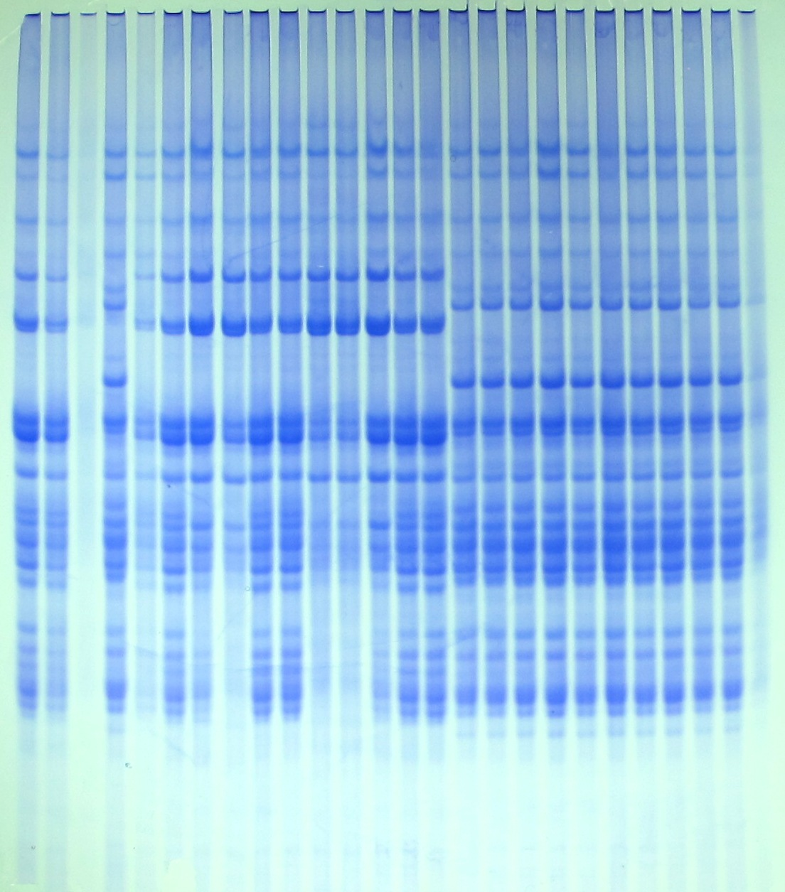
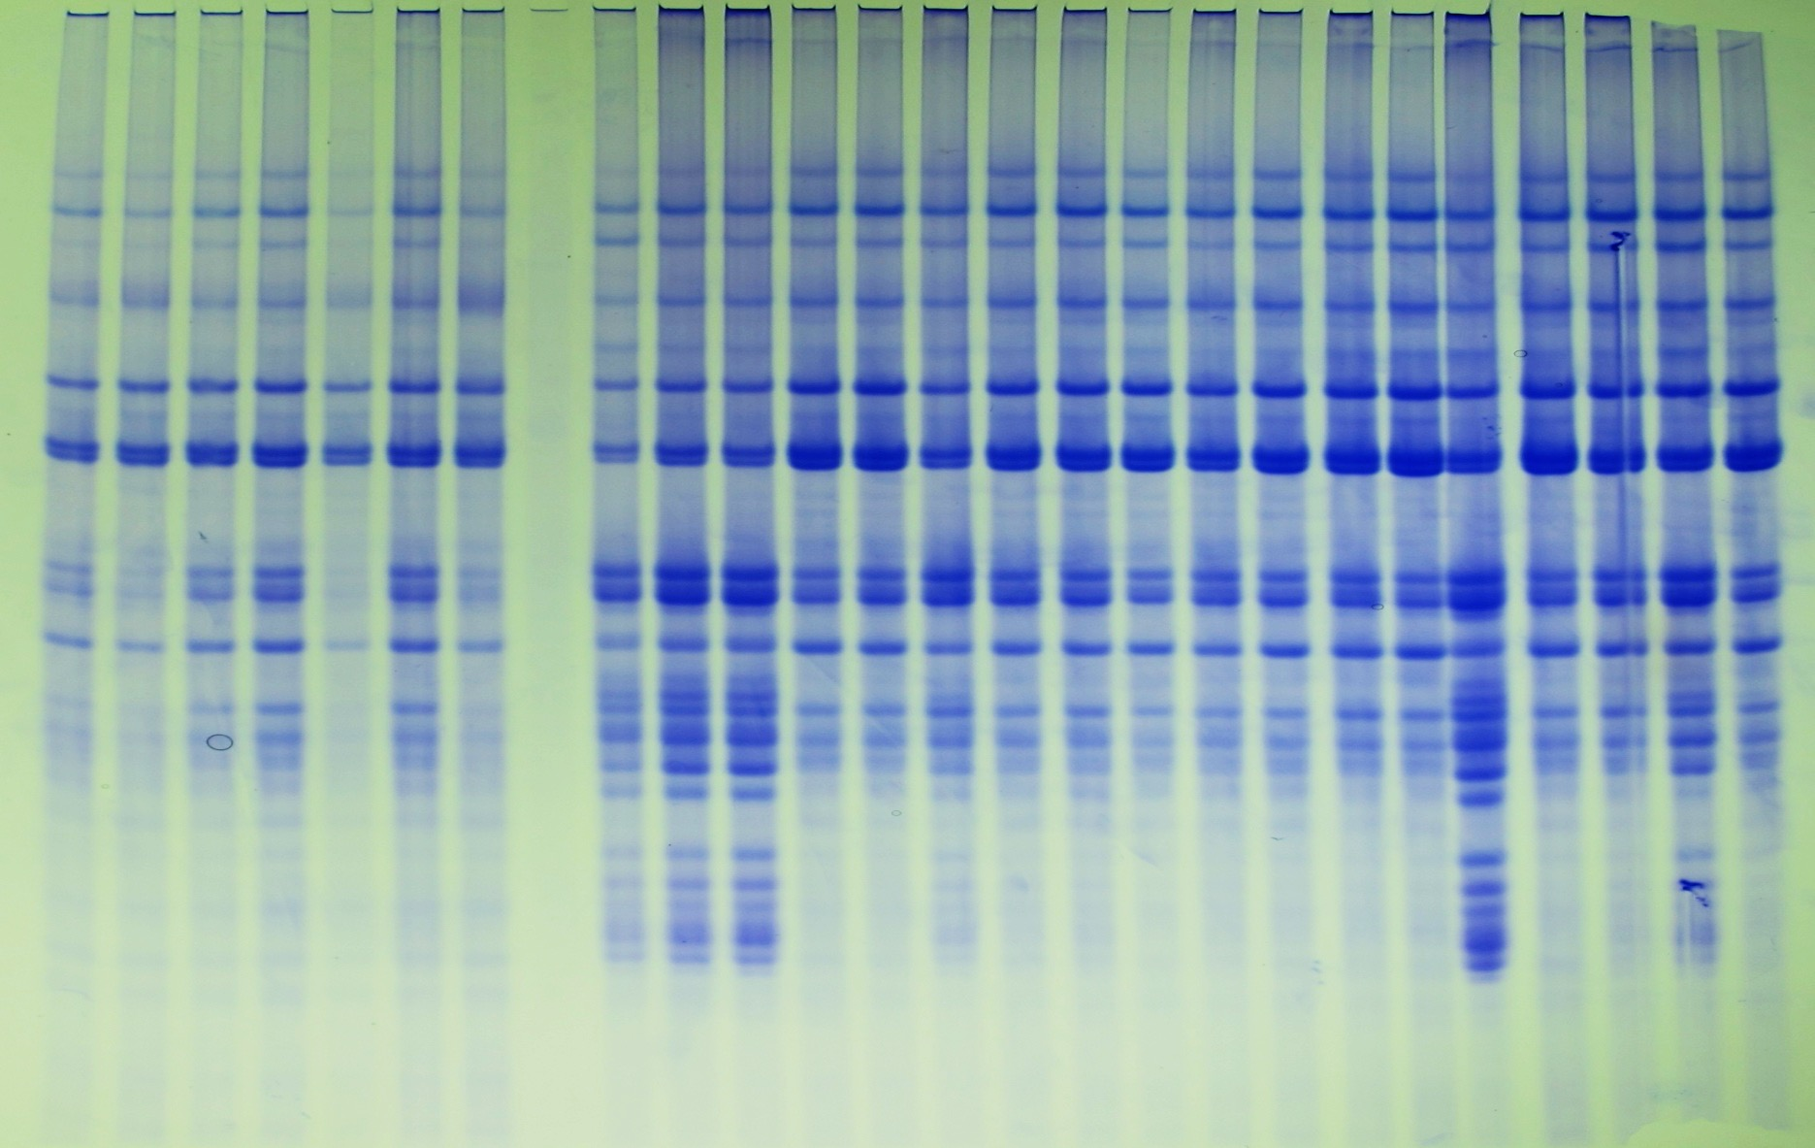
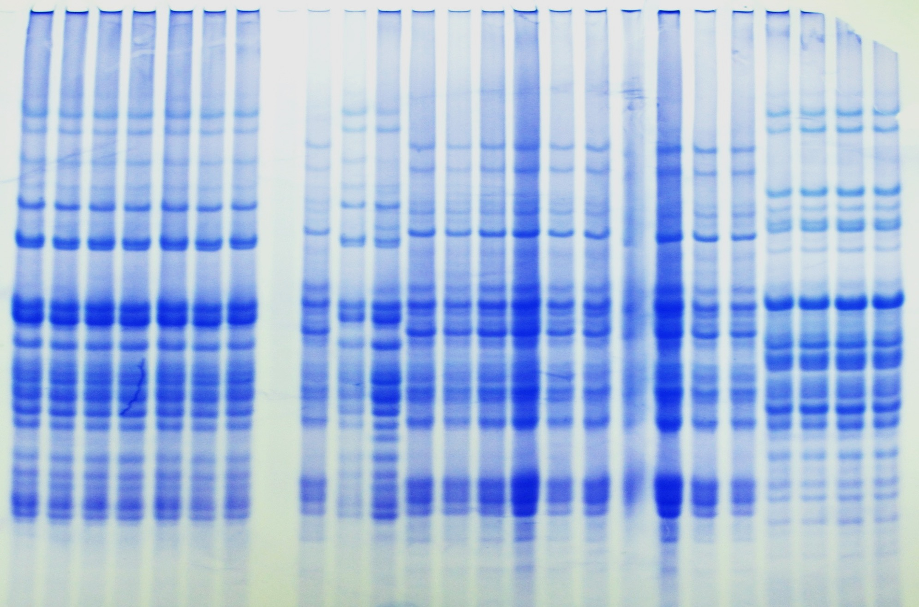
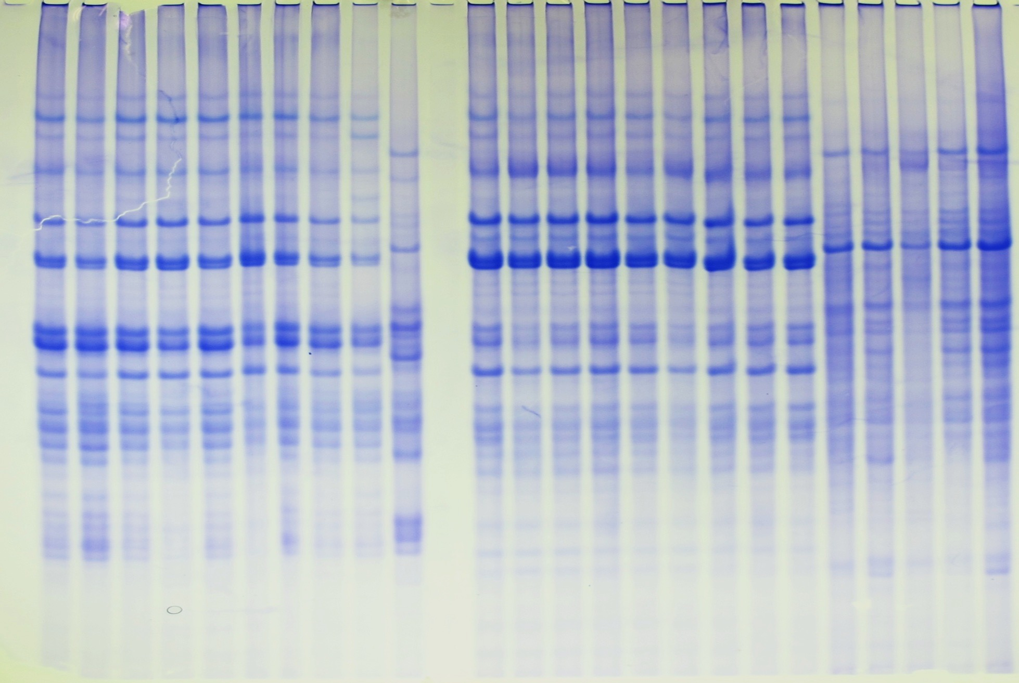
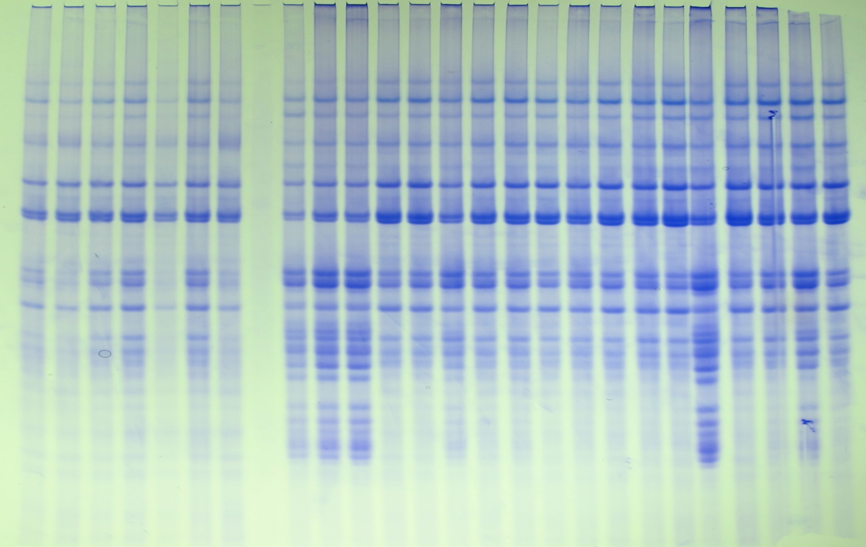
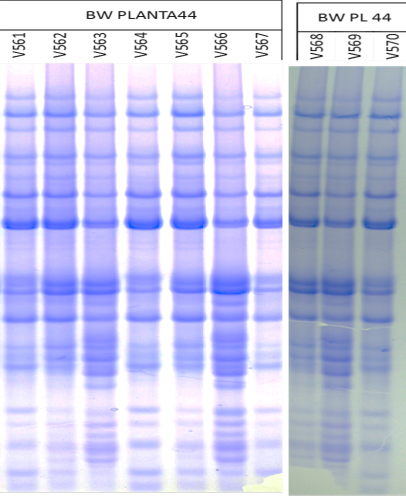
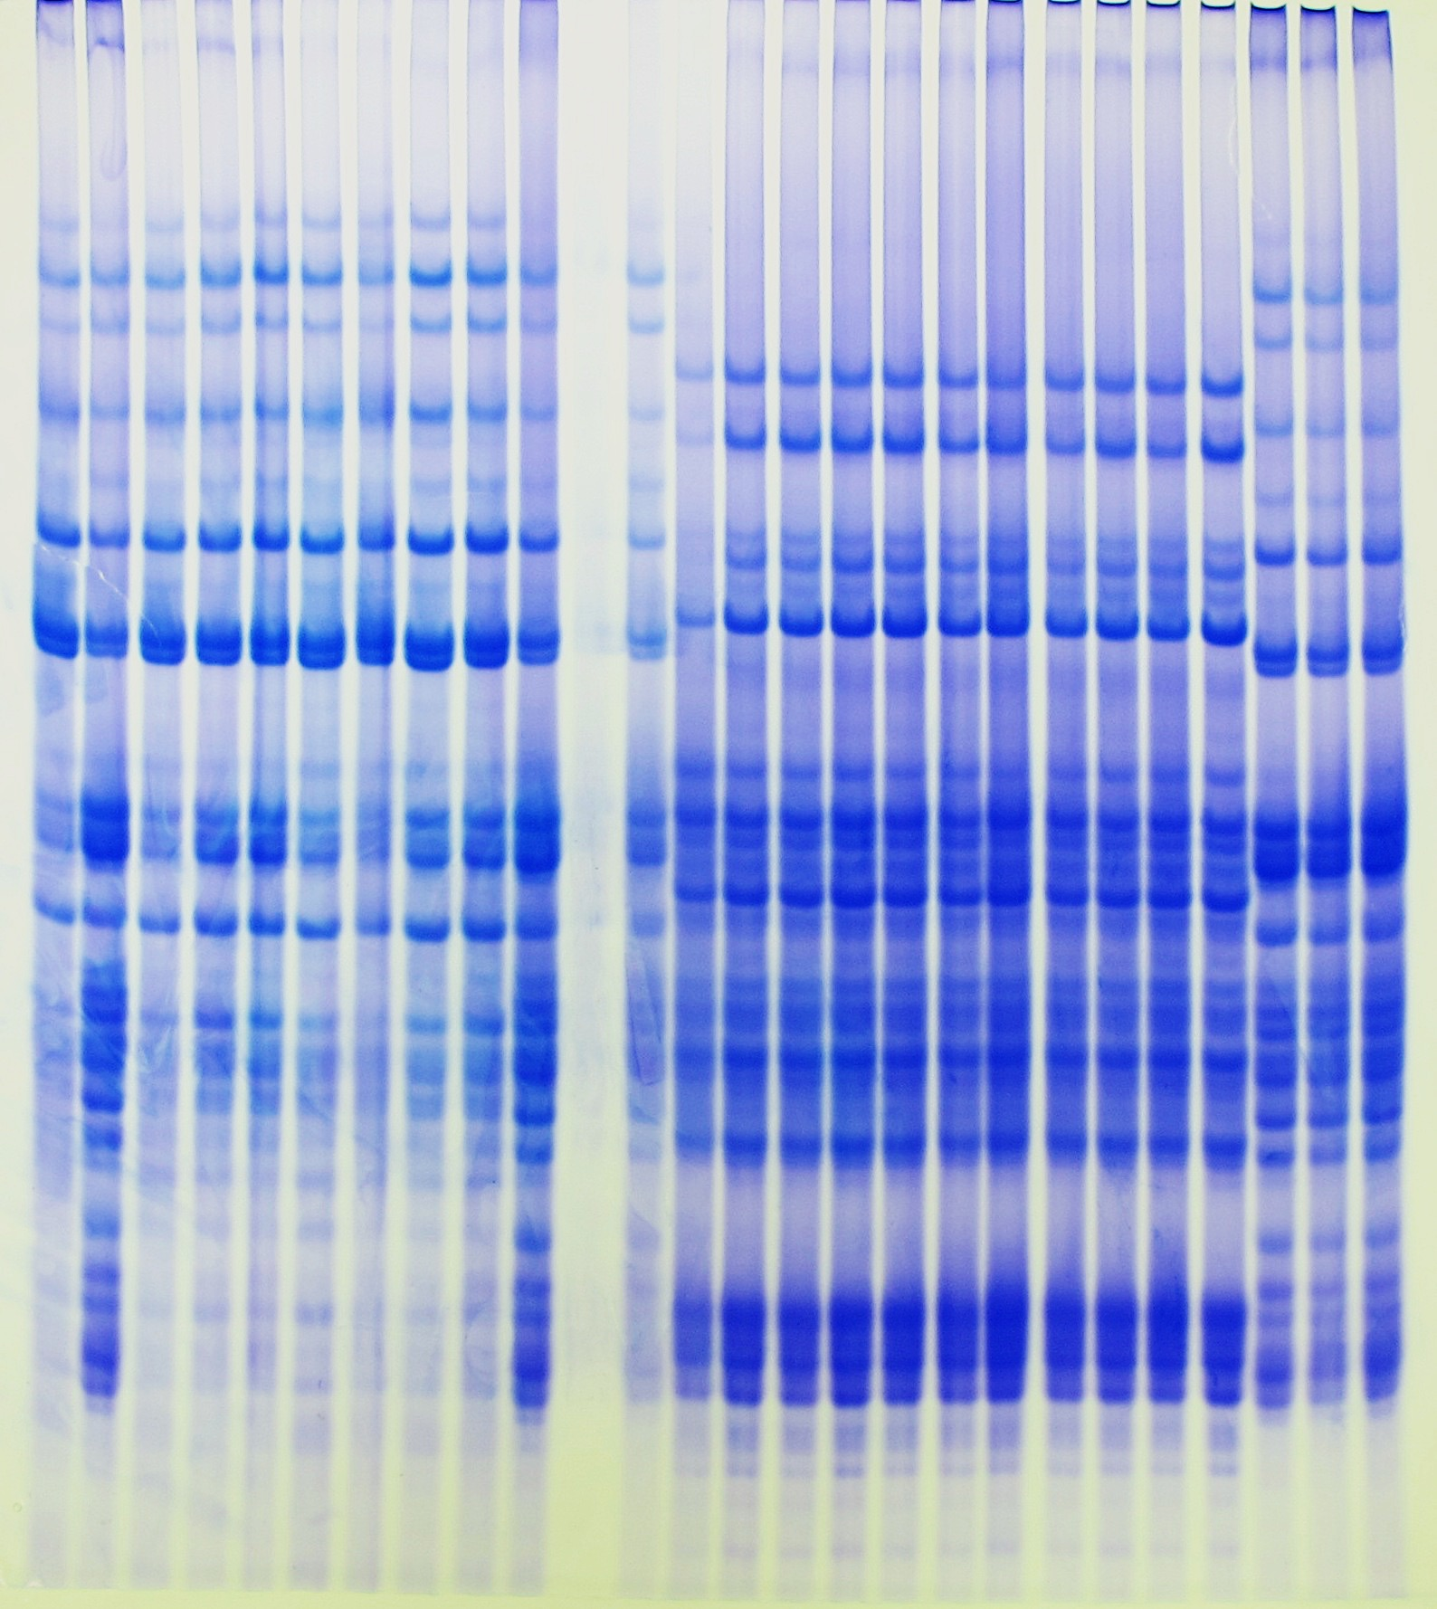
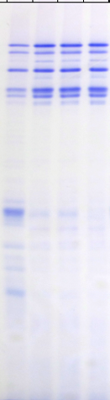

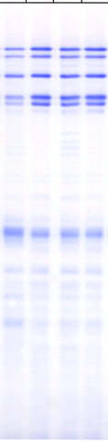


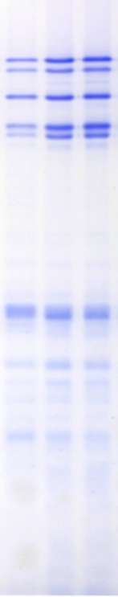



a
sgAlpha-2
sgAlpha-1
Plant 10
WT | T544 | T545 | T553
Plant 49
WT | V001 | V002
Plant 48
WT | V019 | V020 | V021
Plant 12
T557 | T558 | WT
Plant 61
WT | T884 | T886
Plant 14
WT | T566 | T567
Plant 28
WT | T577 | T578
Plant 44
WT | V564 | V565
Plant 52B
WT | T838 | T839
𝞈
𝞈
𝝲
𝝲
𝝰
𝝰
b
HMW
HMW
LMW
LMW
Notes:
Supplementary Figure 8. Gliadin and glutenin protein fractions analyzed by A-PAGE and SDS-PAGE from T1 half-seeds derived from T0 lines transformed with sgAlpha-1 and sgAlpha-2 constructs. (a) A-PAGE of gliadin profile of T1 transgenic lines derived from BW08 lines. Migration of 𝝰-, 𝝲- and 𝞈-gliadin protein bands are outlined by brackets. Arrows indicate new additional bands present in some lines but not in the wild type. (b) SDS-PAGE of glutenins for the same T1 lines in (a). Migration of high molecular weight (HMW) and low molecular weight (LMW) glutenin subunits are outlined by brackets. (c) A-PAGE of the gliadin profile in T1 transgenic lines derived from THA53 lines. Arrows indicate new additional bands present in some lines but not in the wild type. (d) SDS-PAGE of glutenins for the same T1 lines in (c). (e) A-PAGE of gliadin profile of T1 transgenic lines derived from DP lines. Arrows indicate new additional bands present in some lines but not in the wild type. (f) SDS-PAGE of glutenins for the same T1 lines in (e).

Slide 2
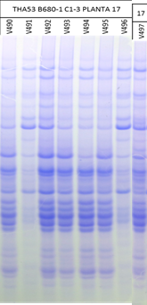
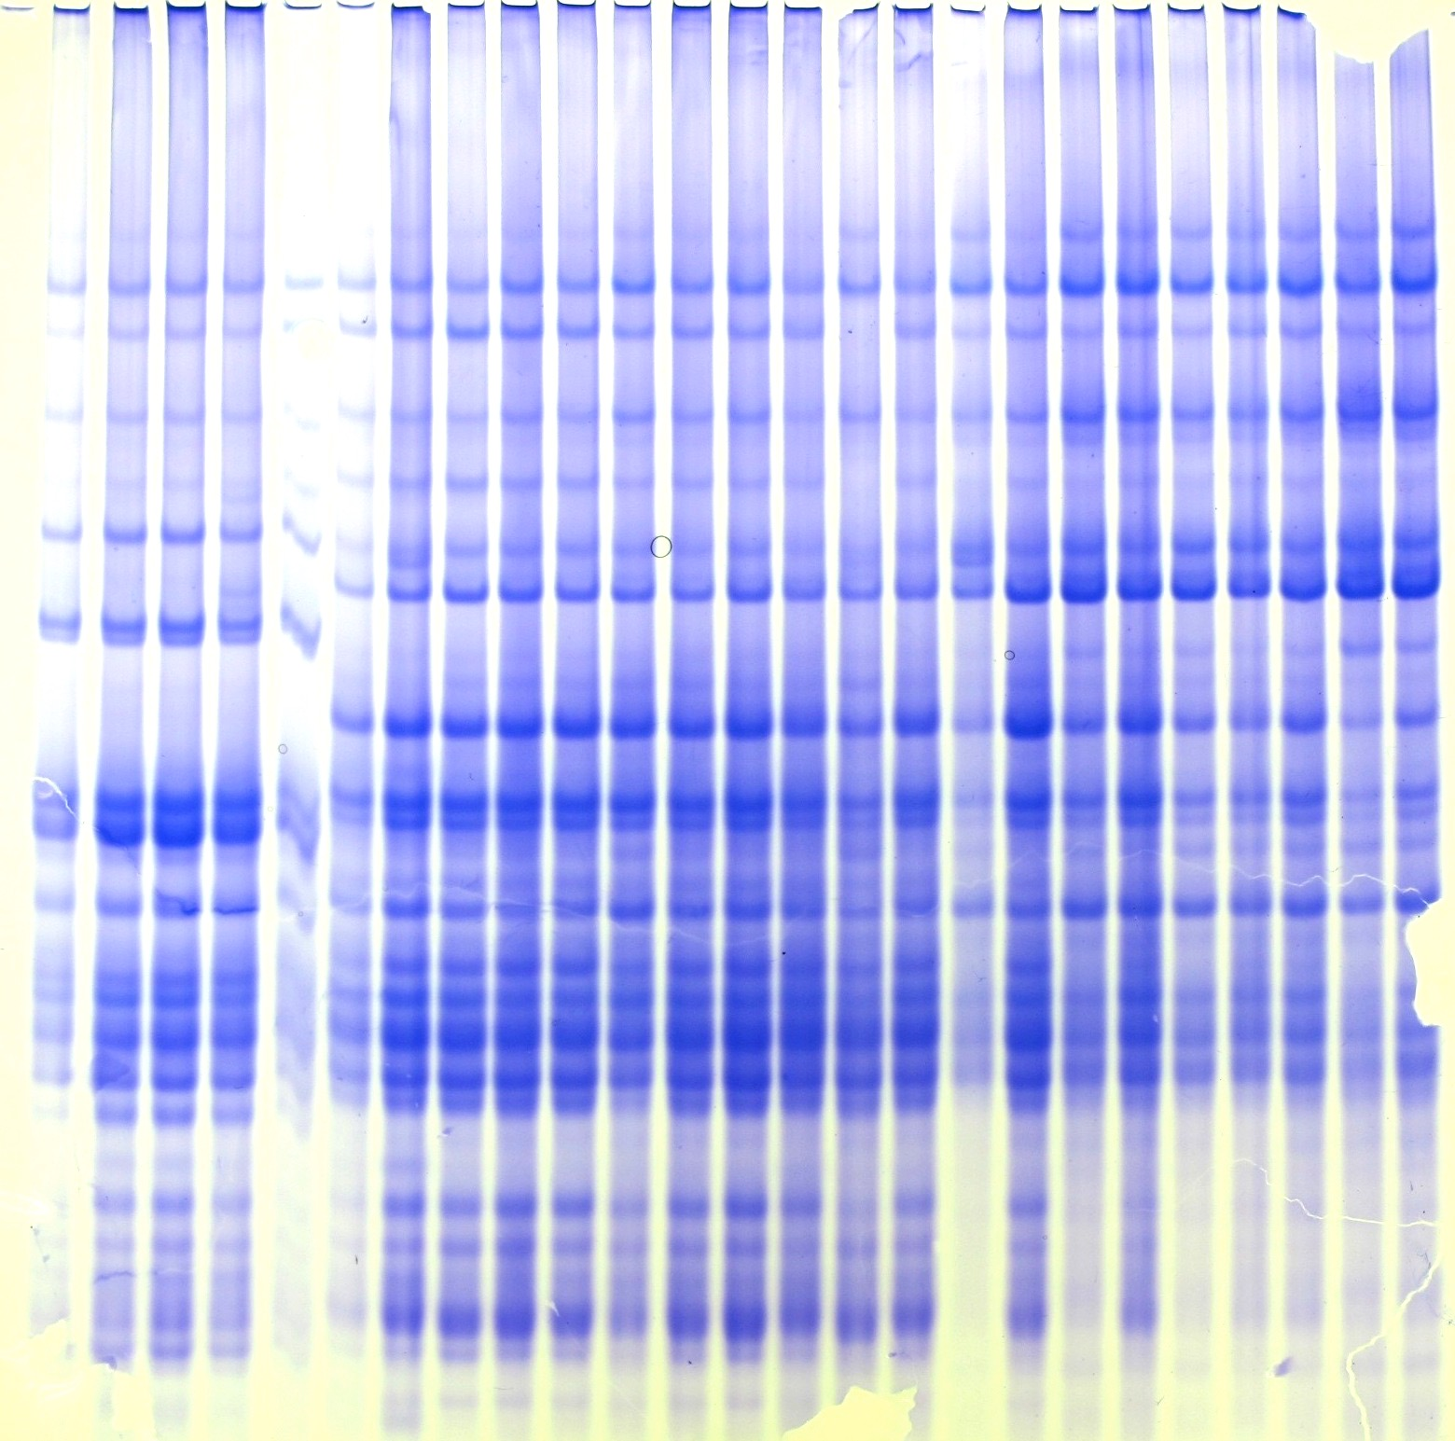

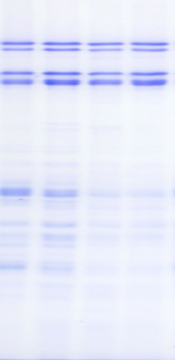
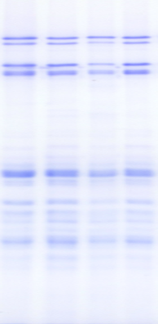
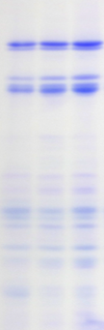
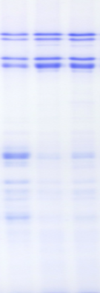
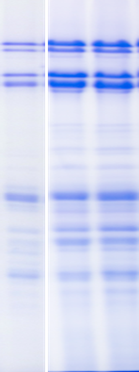
c
sgAlpha-1
sgAlpha-2
Plant 20
WT | V461 | V464 | V465
Plant 6
WT | V470 | V473 | V474
Plant 15
WT | V480 | V482 | V484
Plant 21
WT | V501 | V502
Plant 17
WT | V491 | V496
Plant 77
WT | V323 | V324
𝞈
𝞈
𝝲
𝝲
𝝰
𝝰
d
HMW
HMW
LMW
LMW

Slide 3

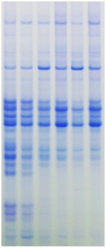
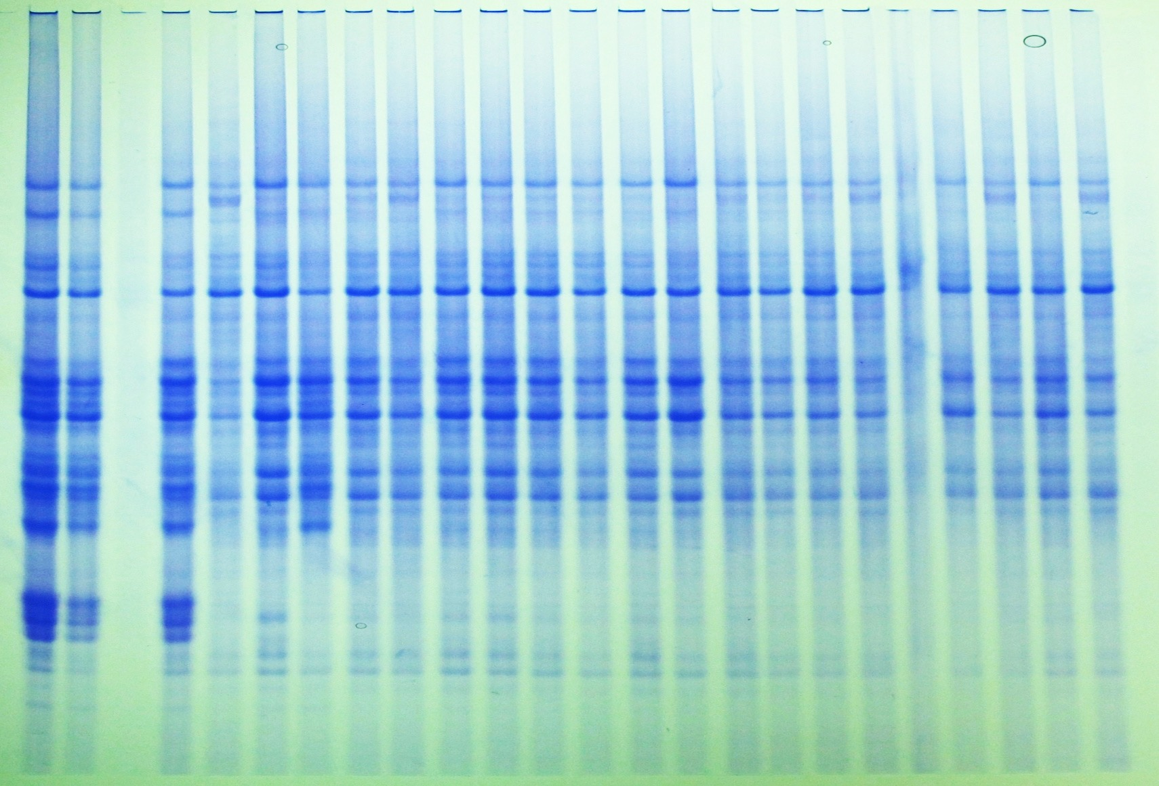
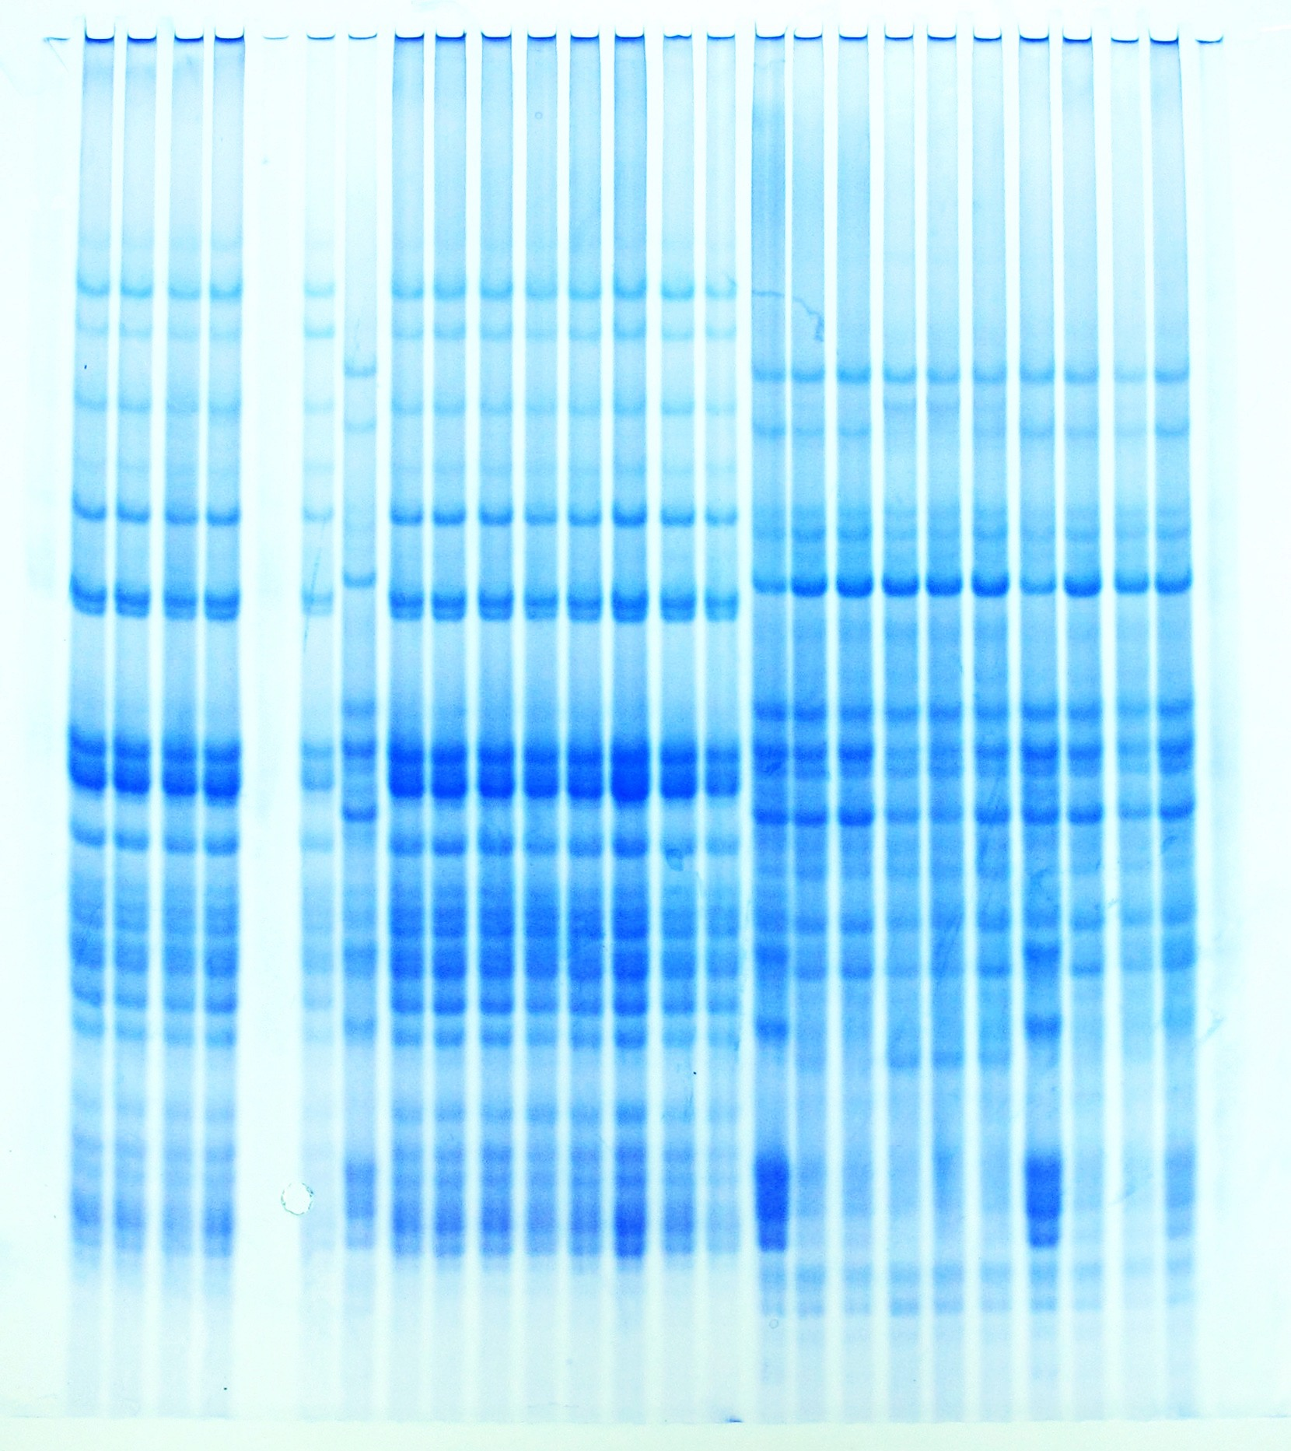
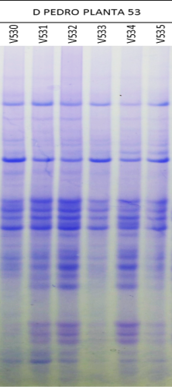
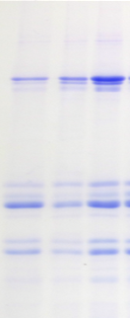
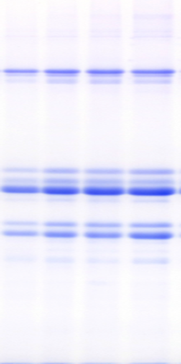
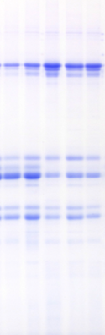
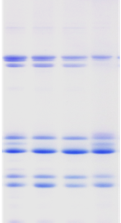
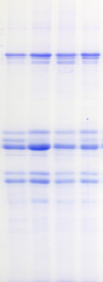
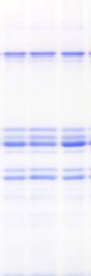
e
sgAlpha-2
Plant 32
WT | V515 | V516
Plant 2
WT | T666 | T668 | T670
Plant 5
WT | T654 | T655 | T656 | T657
Plant 50
T904 | T905 | T906 | WT
Plant 42
WT | T827 | T828 | T829 | T830
Plant 53
V530 | WT | V533
𝞈
𝞈
𝝲
𝝲
𝝰
𝝰
f
HMW
HMW
LMW
LMW
Supplementary Figure 8

