Slide 1
Additional file 1

Slide 2
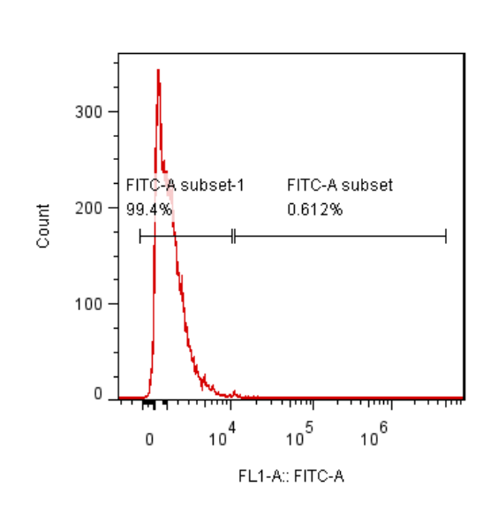
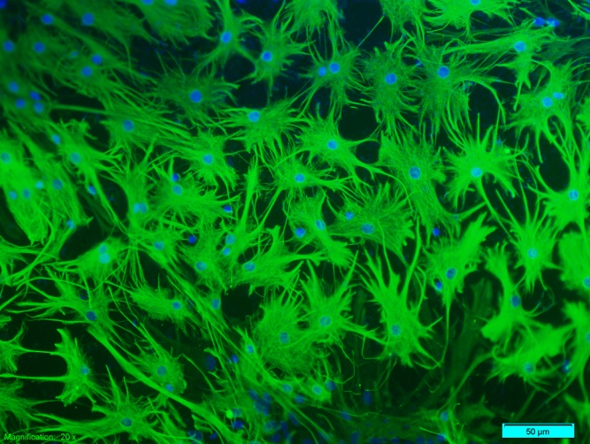
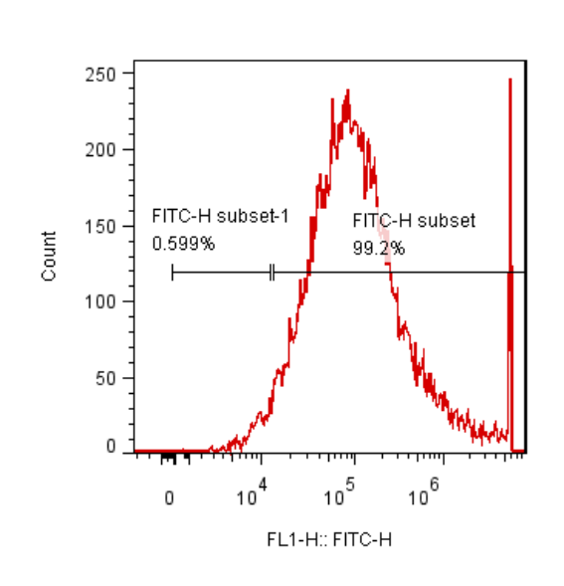
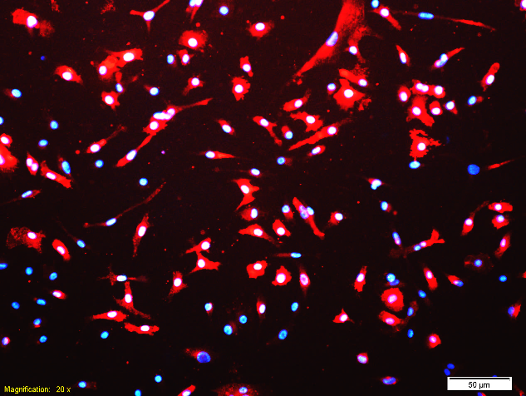
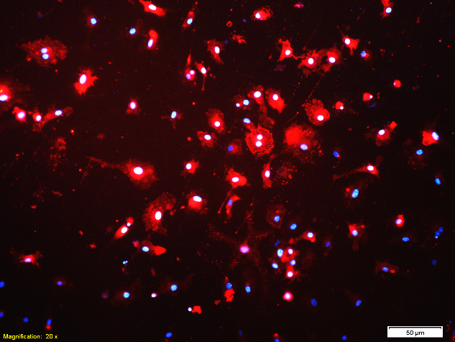
Figure S1
A1
A2
GFAP/DAPI
Astrocytes
CD11b-FITC
B1
B2
CD11b/DAPI
Microglia
CD11b-FITC

Slide 3
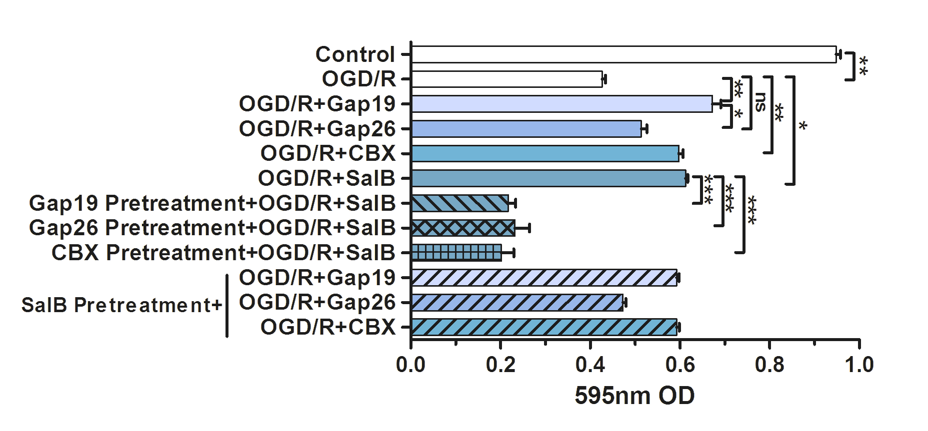
Figure S2
A
C
B
OGD/R+SalB
OGD/R+CBX

Slide 4
Figure S3
Luminescence(RLU)
ATP concentration(nmol/l)

Slide 5
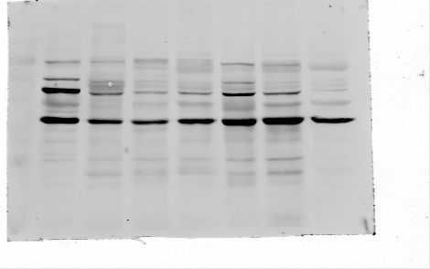
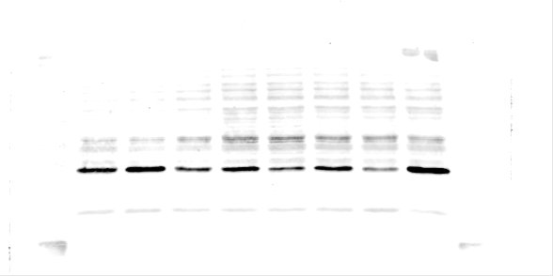
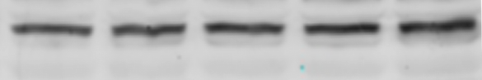
Figure S4
A
B
OGD/R-SalB
Normal
OGD/R
Arginase-1
β-actin
C
D
Arginase-1
β-actin
Vehicle
Normal
OGD/R
OGD/R-CBX
OGD/R-SalB
Microglial OGD/R+Astrocytes conditioned medium

