Slide 1
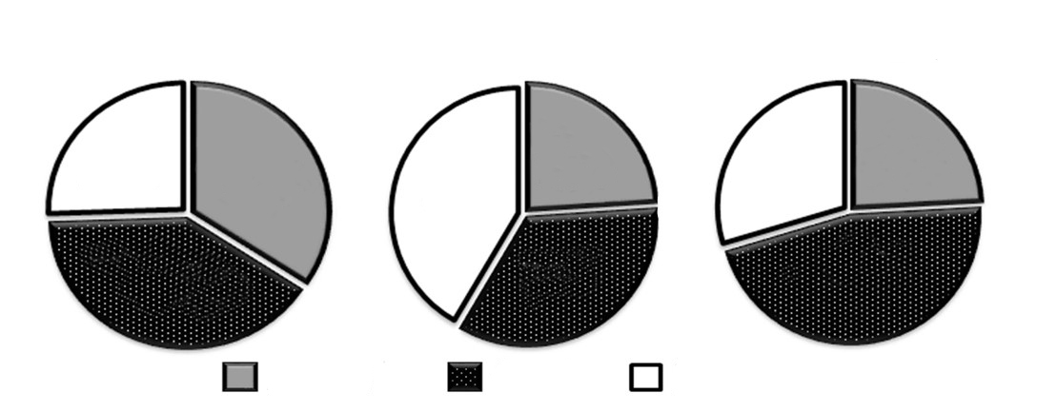
S1
TDB Curdlan Furfurman
26%
34%
24%
30%
24%
42%
40%
34%
46%
NF-κB AP-1 NFAT

