Slide 1
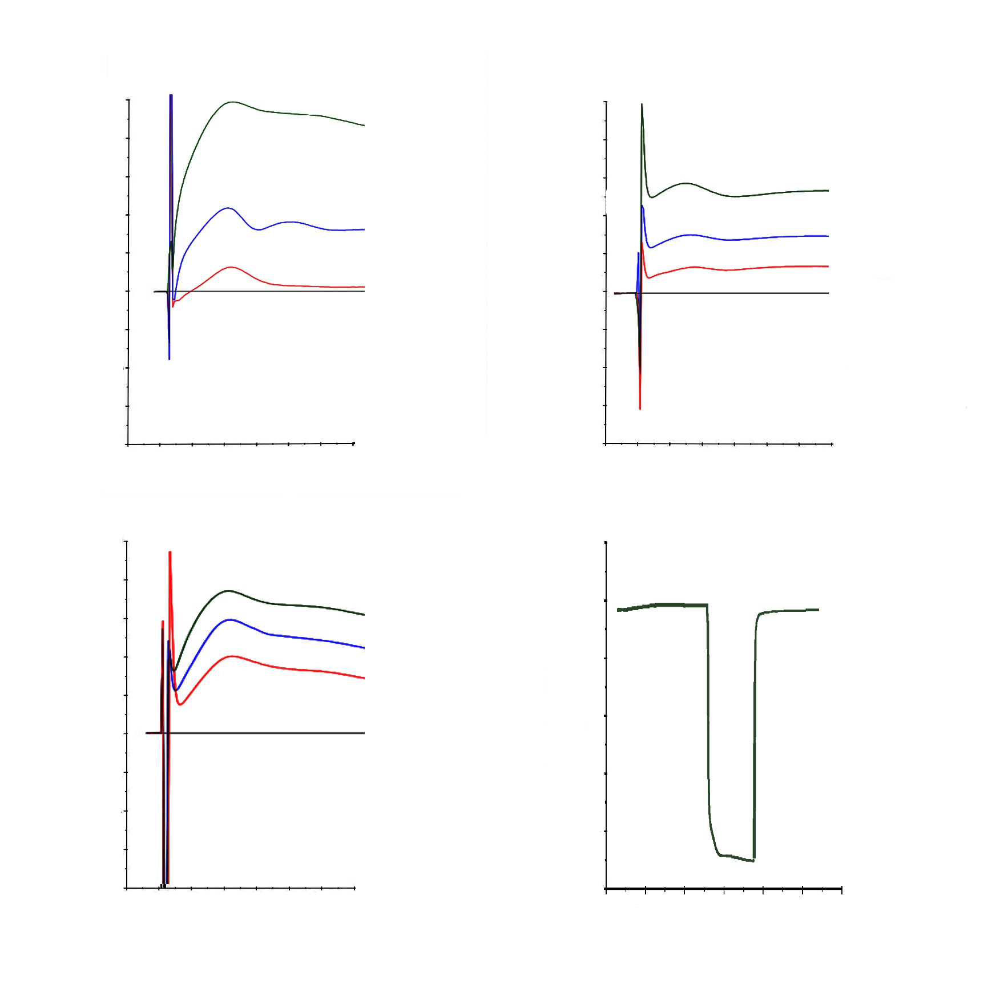
TDB Curdlan
RU
RU
1000
800
600
400
200
0
-200
\
-400
-600
-800
1000
800
600
400
200
0
-200
\
-400
-600
-800
100 µg/ml
50 µg/ml
25 µg/ml
100 µg/ml
50 µg/ml
25 µg/ml
Response differential
Response differential
A D
A D
-20 0 20 40 60 80 100 120
-20 0 20 40 60 80 100 120
Time (s)
Time (s)
RU
Furfurman ODN1286
RU
1000
800
600
400
200
0
-200
\
-400
-600
-800
39000
38500
38000
37500
37000
36500
36000
100 µg/ml
50 µg/ml
25 µg/ml
100 µg/ml
Response differential
Response differential
A D
-20 0 20 40 60 80 100 120
0 20 40 60 80 100 120
Time (s)
Time (s)

