Slide 1
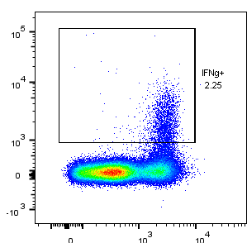

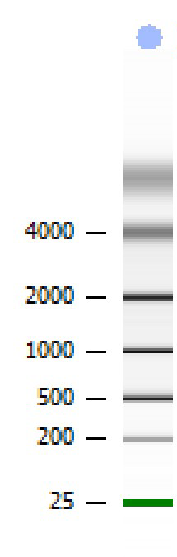

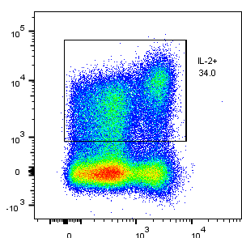
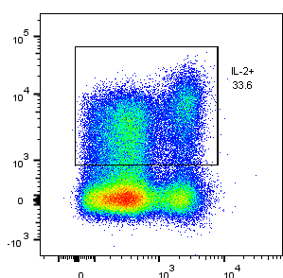
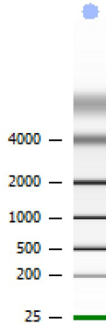

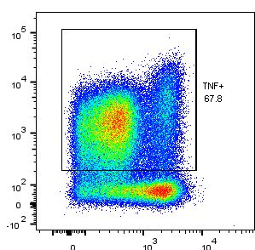
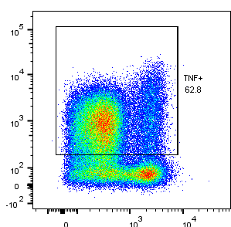
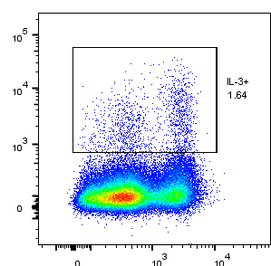
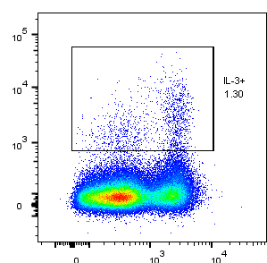


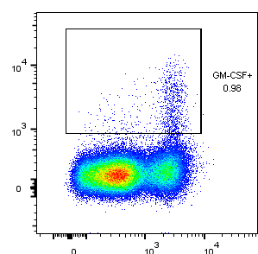
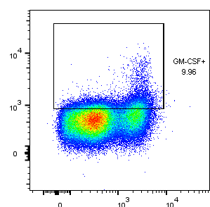
A
PB
High salt buffer
B
10⁵
10⁴
10³
0
-10³
[nt]
L S
2.25
2.20
IFNγ
4000
2000
1000
500
200
25
10⁵
10⁴
10³
0
-10³
34.0
33.6
C
8.4
IL-2
[nt]
L S
10⁵
10⁴
10³
0
4000
2000
1000
500
200
25
TNF
67.8
62.8
9.6
10⁵
10⁴
10³
0
D
IL-3
1.64
1.30
[s]
L S
70
65
60
55
50
45
40
35
30
25
20
10⁴
10³
0
0.98
9.96
GM-CSF
9.4
0 10³ 10⁴
0 10³ 10⁴
CD44

Slide 2
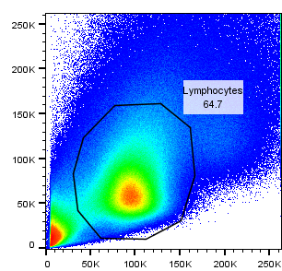
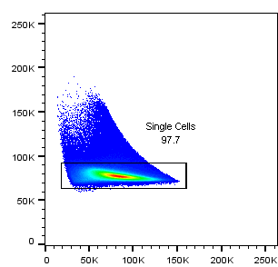
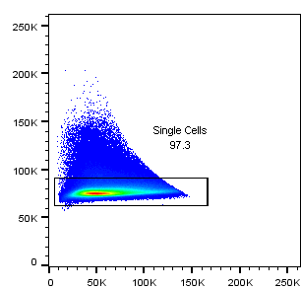
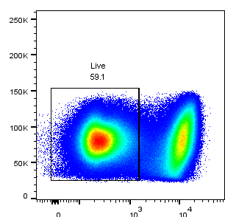
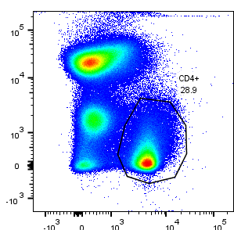
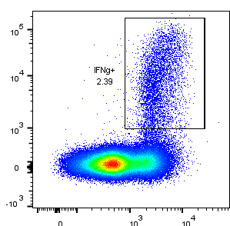
250K
200K
150K
100K
50K
0
250K
200K
150K
100K
50K
0
250K
200K
150K
100K
50K
0
lymphocytes
SSC-A
64.7
FSC-W
single cells
SSC-W
single cells
97.7
97.3
250K
200K
150K
100K
50K
0
250K
200K
150K
100K
50K
0
250K
200K
150K
100K
50K
0
FSC-A
FSC-H
SSC-H
250K
200K
150K
100K
50K
0
10⁵
10⁴
10³
0
-10³
10⁵
10⁴
10³
0
-10³
live cells
CD4⁺
IFNγ
FSC-H
59.1
trash-PE-Cy5
28.9
2.39
IFNγ-Alexafluor 700
0 10³ 10⁴
-10³ 0 10³ 10⁴ 10⁵
0 10³ 10⁴
live-dead blue
CD4-APC-Cy7
CD44-pacific blue
Supplementary Figure 1. Gating strategy used for ICS experiments. Gating strategy used to eliminate doublets, dead cells and non-CD4+ T cells are shown. Each plot shows the cells gated in the previous plot and the numbers indicate the percentage of parent population. Trash cocktail included antibodies to MHCII, CD8α and B220.

