Slide 1
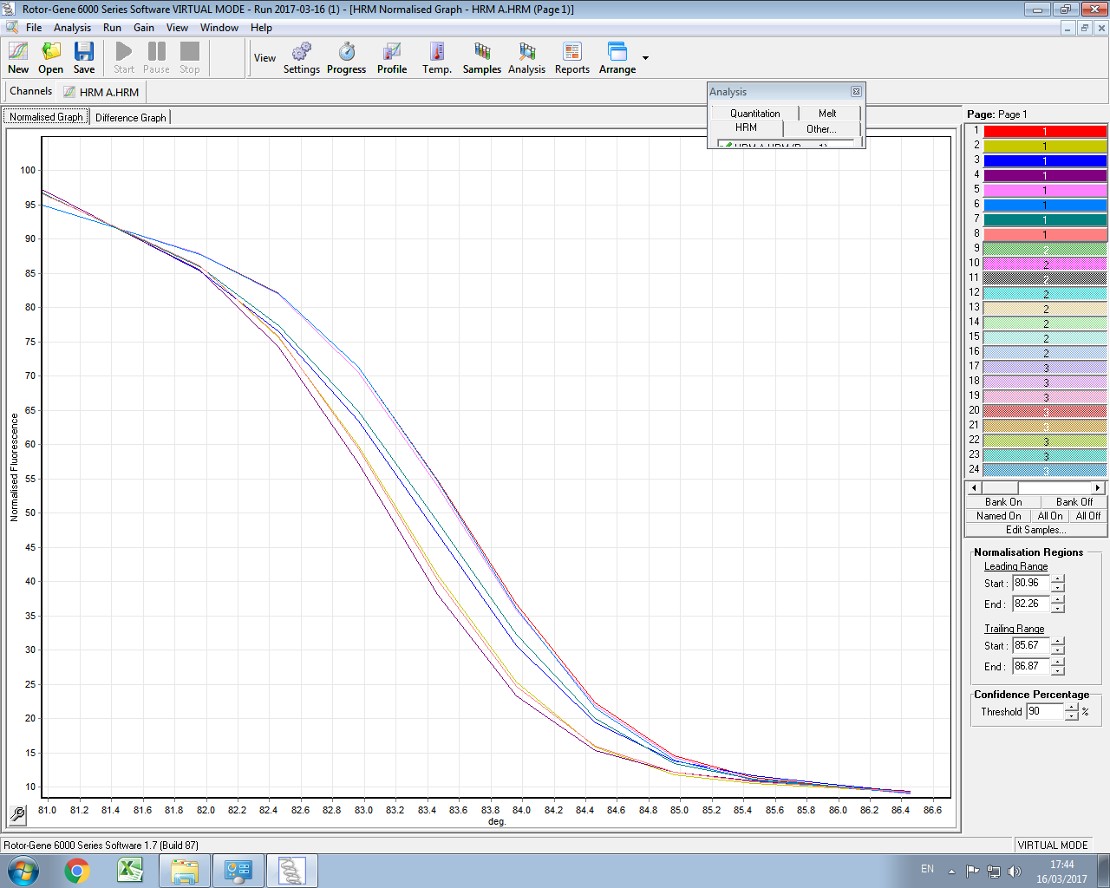
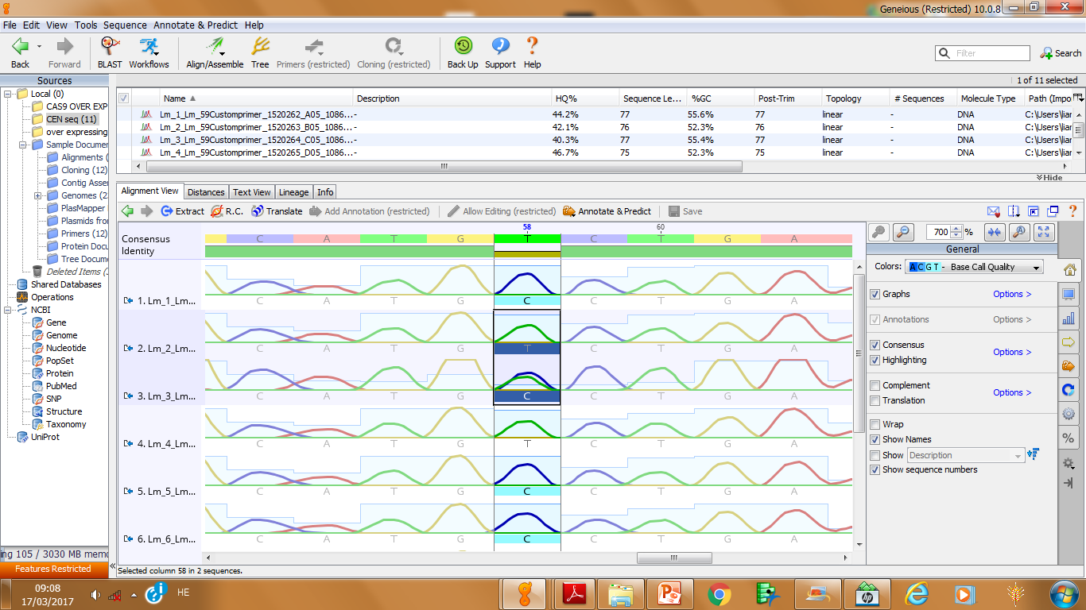
(a)
C Hv/Hv
C+T Hv/Hs
T Hs/Hs
(b)
Fig. S1. Genotyping for the BC₂F₁ pot experiment.

Slide 2
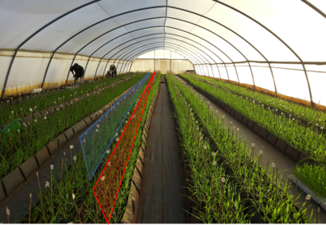
(a)
(b)
(c)
Fig. S2. Details of the irrigation management in the pot experiment.

Slide 3
Hv/Hv
Hv/Hs
Hs/Hs
Fig. S3. Reaction norms for vegetative dry matter in the field experiment.

Slide 4
HEB_16
HEB_05
(a)
(b)
Hv/Hv
Hv/Hv
Hs/Hs
Hs/Hs
Fig. S4. Reaction norms for grain number for HEB-05 and HEB-16 families in the field experiment.

