Slide 1
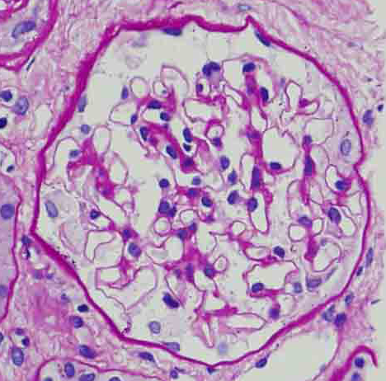
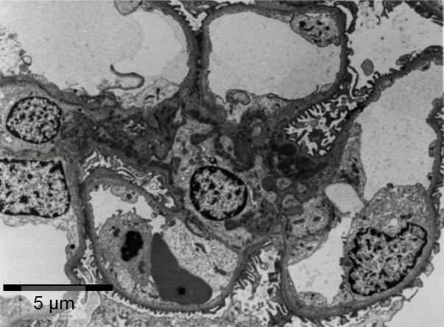
10 μm
IgG
IgA
C1q
IgM
1/5

Slide 2
IgG
IgM
C1q
C3
2/5

Slide 3
IgG
IgM
C1q
C3
3/5

Slide 4
IgG
IgM
C3
4/5
C1q

Slide 5
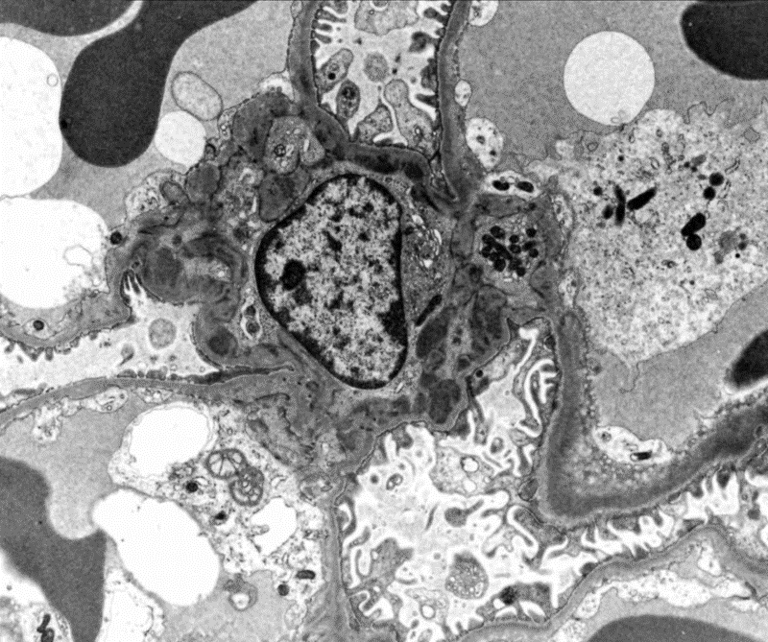
IgG
IgM
C1q
C3
5/5

