Slide 1
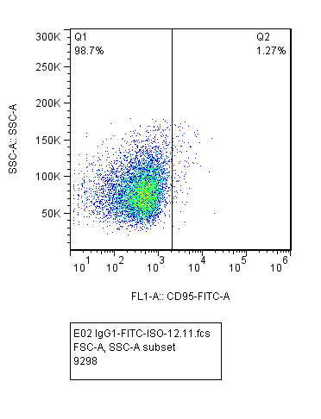
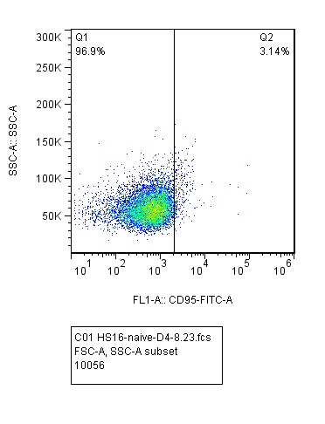
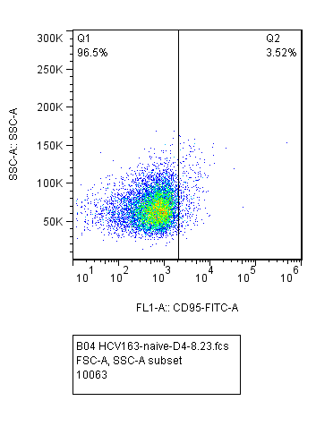
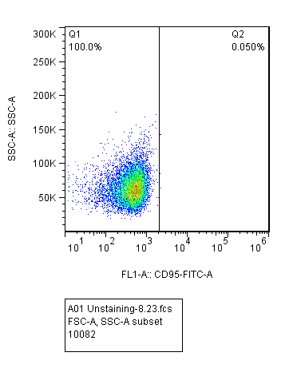
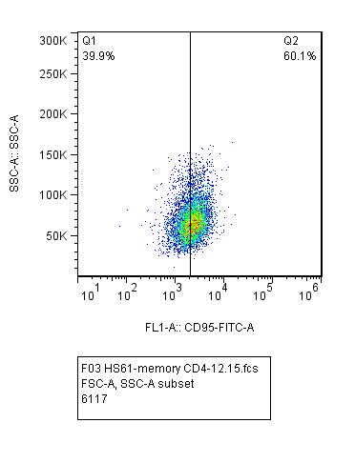
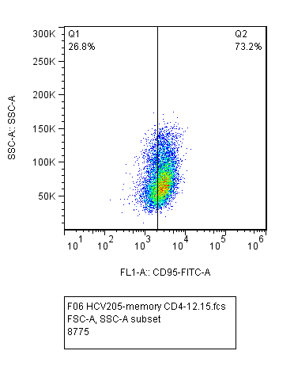
Supplemental Fig.1
A)
Isotype
HS
HCV
Naïve CD4 T cells
Unstained
HS
HCV
memory CD4 T cells
B)
53BP1
γH2AX
γH2AX+53BP1
γH2AX+53BP1+DAPI
HS
HCV

