Slide 1
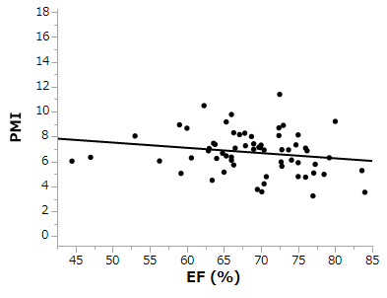
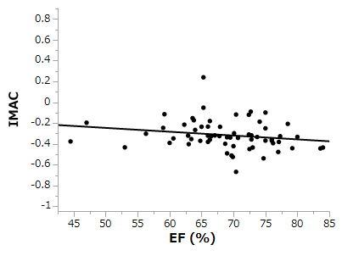
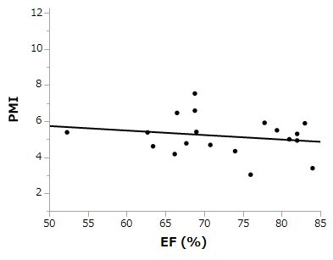
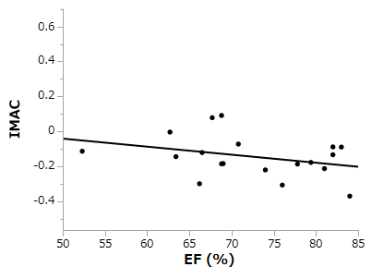
Supplementary Fig. 1
male
A
B
r = -0.190
P = 0.135
r = -0.199
P = 0.118
PMI (cm²/m²)
female
C
D
r = -0.198
P = 0.415
r = -0.330
P = 0.168
PMI (cm²/m²)

