Slide 1
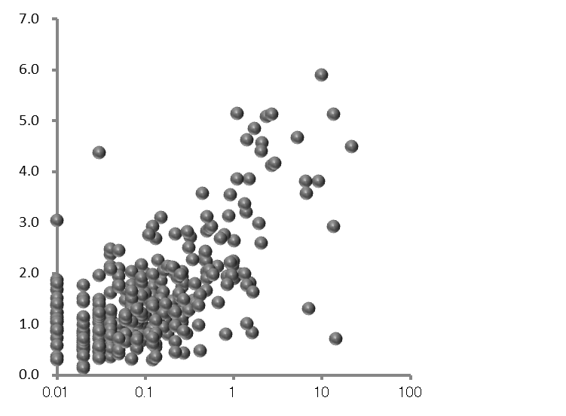
(U/mL)
Concentration of LRG-FTG
(mg/dL)
Concentration of CRP
Figure S3

