Slide 1
Supplemental Figure 1
Schematic representation of the workflow for the global proteomics
LAPC4 wt
LAPC4 AI
Protein Extraction & Tryptic Digestion
14, 15 16, 17
Combine iTRAQ labeled peptides
24 bRP Fractions
LC-MS/MS Q Exactive
PD 1.4
Data Analysis & Ingenuity Pathway

Slide 2
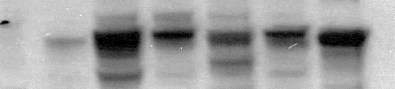
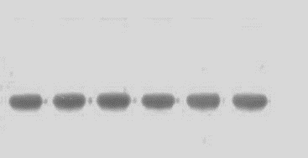
Supplemental Figure 2
LNCaP
VCaP
LNCaP AI
22RV1
MDA PCa-2b
PC3
FUT8
Actin

Slide 3
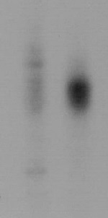
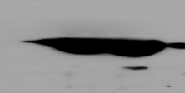
Supplemental Figure 3
A
B
LAPC4 WT
LAPC4 AI
AAL Lectin Blot
Actin

