Slide 1
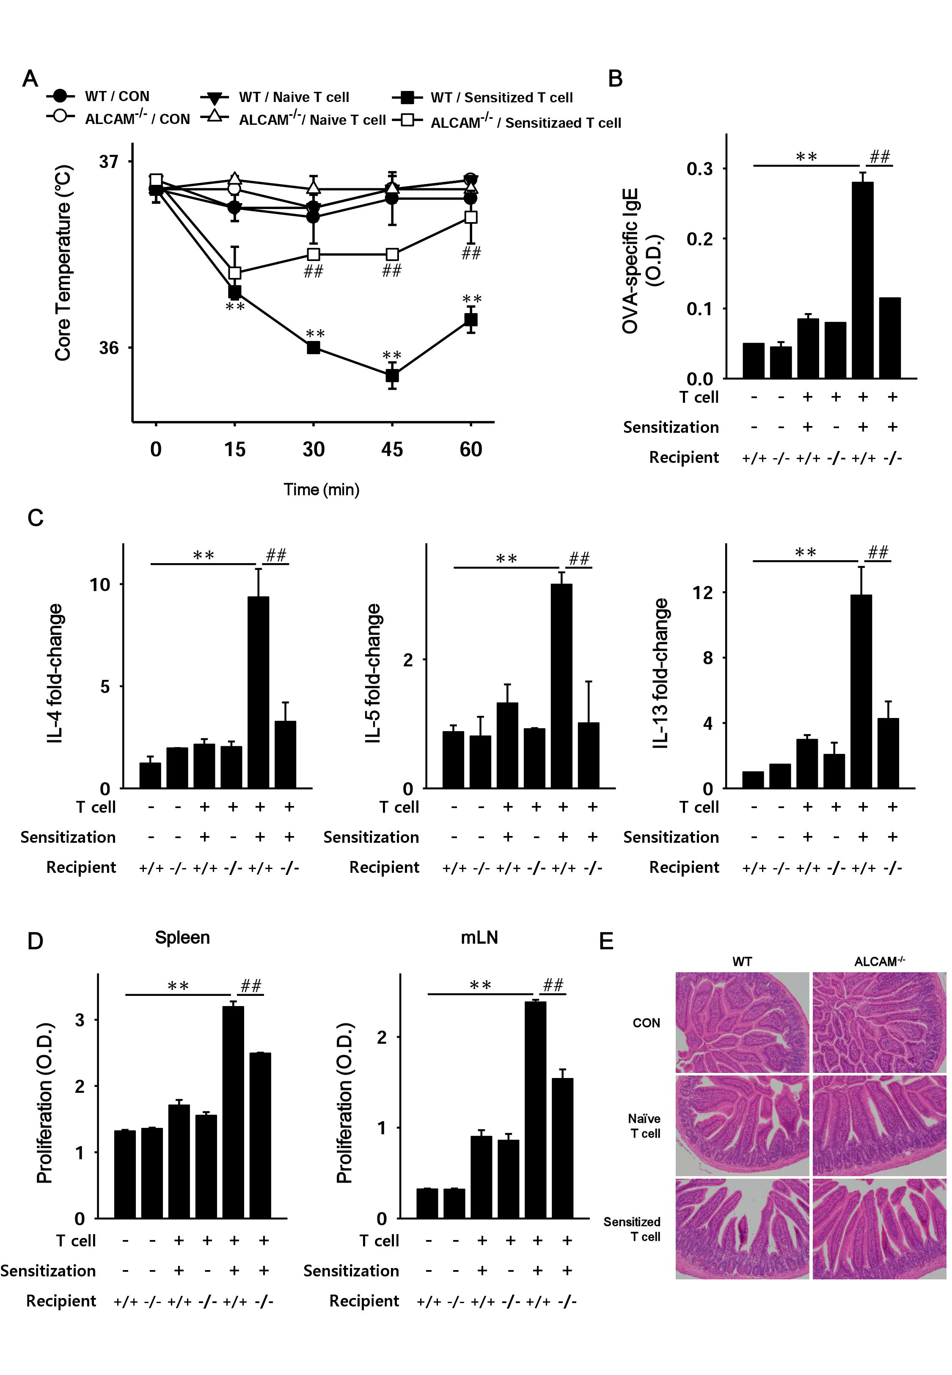
Supplementary Fig. 2.

