Slide 1
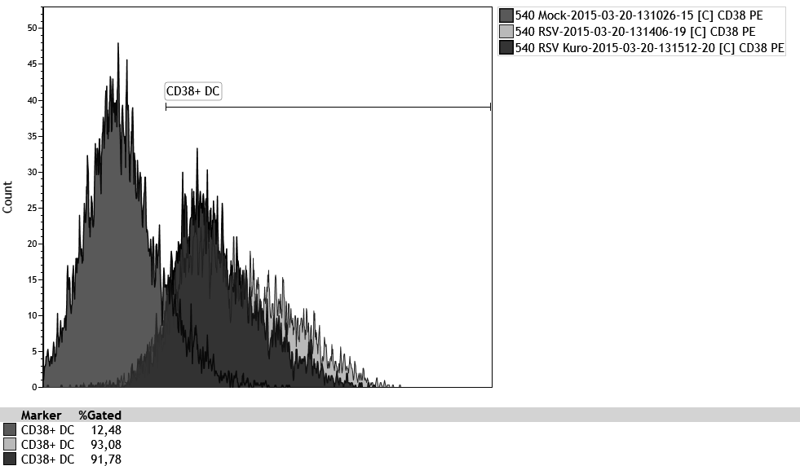
Mock 12.6%
RSV 90.5%
RSV + Kuromanin 87.2%
Counts
CD38
Supplementary Figure 2.
Cells were infected with RSV (MOI of 1) for 2h. Cells were infected with RSV (MOI of 1) for 2h. Where indicated, samples were pre-treated with Kuromanin (100 μM) for 20 minutes. Mock-infected cells were added as control. After infection, cells were washed, incubated in fresh medium and, where indicated, kuromanin was re-added. After 20 h cells were stained and analyzed for CD38 surface expression. Percentages of CD38 positive cells are indicated. A representative experiments out of two performed is shown.

