Slide 1
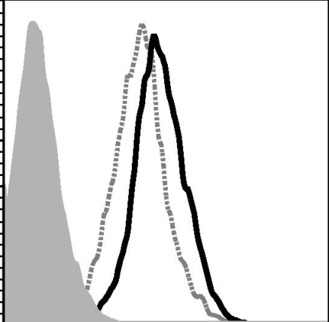



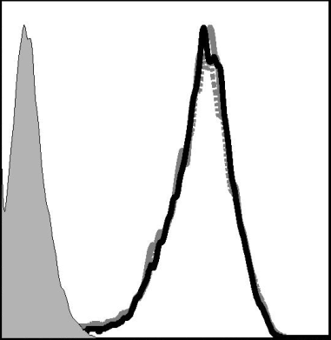



Supplementary Figure 2
Inhibition of MAPK downregulates CEACAM1 expression – additional cell lines
The effect of selective MAPK inhibition was tested in additional cell lines.
BRAF-mutant (Skmel-5) and wild type (013mel) melanoma cells were exposed for 48h to 1µM Vemurafenib (VEM) or volume and concentration equivalent of DMSO.
CEACAM1 expression was tested with flow cytometry. Shaded histograms- secondary reagent only; Black line- DMSO treated cells; Dotted line- Vemurafenib treated cells. The effect of Vemurafenib was verified by testing pERK and total ERK using antibody-specific immunoblotting. Actin served as house keeping gene. The results here concur with those depicted in Figure 2.
SKmel-5 – 48h
DMSO VEM
pERK
BRAF V600E
ERK
Actin
10⁰
10¹
10²
10³
10⁴
CEACAM1
013mel – 48h
DMSO VEM
pERK
BRAF W.T
ERK
Actin
10⁰
10¹
10²
10³
10⁴
CEACAM1

