Slide 1
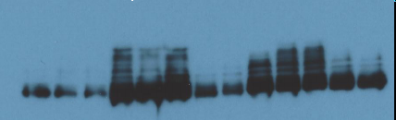

Supplementary Figure 3
526mel
Vem
Res
526mel
Anti CEACAM1
Anti actin
DMSO
VEM
SEL
310µM VEM
MAPK pathway controls CEACAM1 expression at the protein level – Immuno Blotting
The effect of selective MAPK inhibition was tested in additional methods (Immunoblotting). CEACAM1 expression was tested using Immunoblotting with specific mAb in BRAF-mutant 526mel melanoma cells that were exposed for 48h to 1µM Vemurafenib (VEM), Selumetinib (SEL) or volume and concentration equivalent of DMSO. In addition, 526mel Vemumrafenib Resistance (Vem Res) cells were tested as well. Actin served as house keeping control. Figure shows a representative blot.

