Slide 1
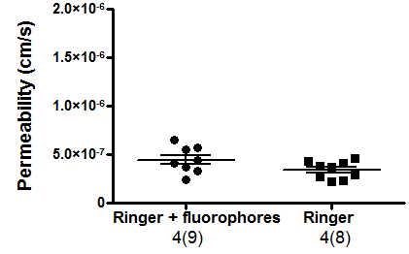
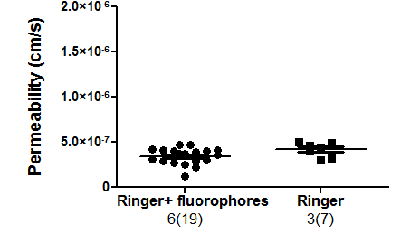
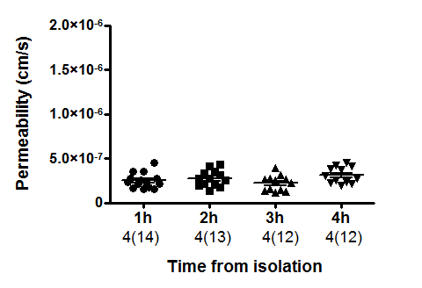
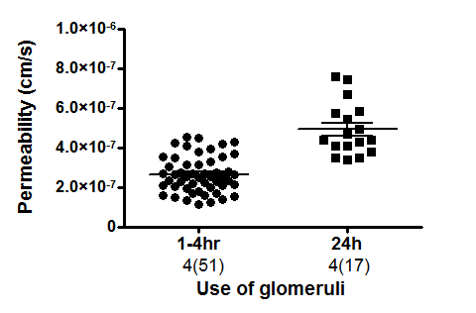
A
Rats
B
Mice
n.s
n.s
C
D
n.s
***
Supp figure 2. The affect of perfusion with Ringer alone and of time on Ps’alb

