Slide 1
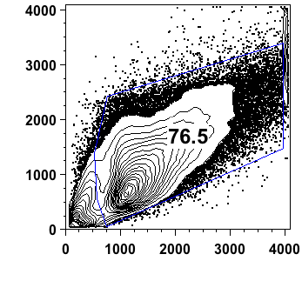
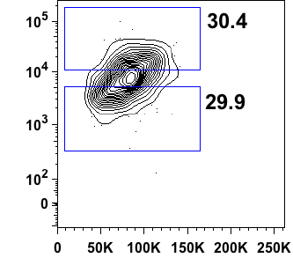
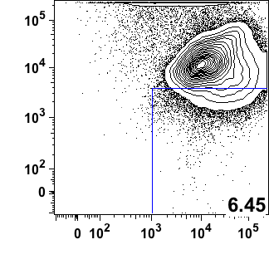
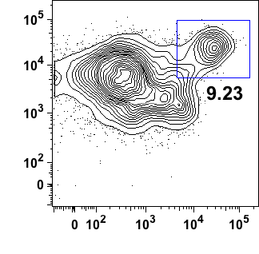
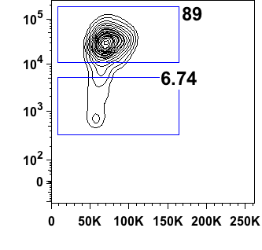
A
Day 11 Spin-EB
(Adherent)
HE
SSC
tdTomato
Non-HE
FSC
FSC
Day 24 tdTom⁺
Hematopoietic Control
CD41/CD43/
CD45/CD73
CD144
tdTomato
GFP
CD31
FSC
B
Day 11 Spin-EB
(Non-adherent)
HP
SSC
CD43
CD43
FSC
CD34
tdTomato
Supplemental Figure 1. FACS sorting strategy of Day 11 hESC-RUNX1c-tdTomato-derived cells. (A) Representative flow cytometry plots used to distinguish HE from non-HE within the adherent fraction of hESC-RUNX1c-tdTomato cells. Day 24 non-adherent hematopoietic cells also derived from hESC-RUNX1c-tdTomato cells in a parallel differentiation are also shown to establish positive gating controls of tdTomato expression. (B) Representative flow cytometry plots used to sort early hematopoietic progenitor cells from the non-adherent fraction of hESC-RUNX1c-tdTomato cells.

Slide 2
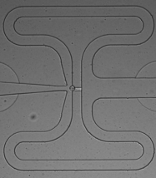

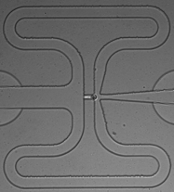
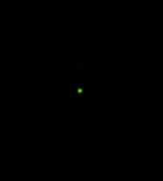
A
B
Phase
GFP
tdTomato
 | HE | Non-HE | HP
Live | 83 | 64 | 76
Dead | 11 | 20 | 4
Doublet | 4 | 0 | 6
Mapped | 55 | 47 | 35
HE
Non-HE
C
R²=0.90
Single Cell Expression
Level (log FPKM+1)
HP
Bulk Expression Level (log FPKM+1)
D
RUNX1c
E
log₁₀ (p-value)
log (FPKM+1)
Supplemental Figure 2. Fluidgm C1 Capture and quality control of single-cell RNASeq data. (A) Representative images of 96-well microfluidic capture chambers, which served as the initial point of cell quality control. Within each fluidic capture point, cells were assessed for 1) singularity, 2) GFP⁺ expression, and 3) absence of red-fluorescent ethidium homodimer-1 stain (dead stain). Furthermore, HE and HP sorted populations were validated for tdTomato^{dim} expression, while non-HE were validated for tdTomato⁻ expression. Cells that failed these quality control criteria were excluded from cDNA library preparation. (B) Statistics of Fluidigm C1 capture and HiSeq 2500 sequencing. A total of 55 HE, 47 non-HE, and 35 HP were considered validated for subsequent analyses. (C) Total gene expression across individual cells were plotted and compared to the gene expression of similarly collected bulk RNASeq sample controls. R²=0.90. Each dot represents a single gene, while the blue cloud surrounding each gene reflects the variance across individual cells. (D) Normalized log-transformed FPKM values for the RUNX1c isoform averaged across all cells in HE and non-HE populations. **p<0.01 as compared to HE and assessed using student’s t-test, error bars represent SEM. (E) Top 15 canonical pathways derived from the Ingenuity Pathway Analysis gene ontology algorithms for the HE and non-HE populations.

Slide 3
Housekeepers
Cardiovascular
Erythroid
Expression Level (log FPKM+1)
Lymphoid
Myeloid
HE
HP
Non-HE
Supplemental Figure 3. Supplemental violin plots of single-cell RNASeq gene expression. Normalized log-transformed FPKM values of key genes associated with cardiovascular development, erythroid, lymphoid, and myeloid cell phenotypes. Traditional housekeeper gene expression (GAPDH, ACTB and GPI) are also shown to demonstrate homogeneous expression and frequency across HE, non-HE, and HP populations.

Slide 4
A
B
Supplemental Figure 4. Significance level of principal components. Output of Seurat p-value calculations of principal components as assessed from the (A) total gene list and (B) blood and endothelial gene restricted subset list. In brief, significance testing of principal components is assessed by Jackstraw analysis⁷⁷. Each subplot compares p-values of genes within the principal component via Jackstraw analysis (horizontal axis) as compared to a theoretical p-values from a random population sampling (vertical axis). Principal components with p<0.05 were subsequently used in t-SNE analysis and clustering classifications as described in Figure 3D.

Slide 5
A
B
Supplemental Figure 5. Gene identification from statistically significant principal components. Visualization of principal component scores and gene symbol from each statistically significant principal component identified in Supplemental Figure 4 for (A) total gene list and (B) blood and endothelial gene restricted list subset.

Slide 6
Cluster 2
Cluster 3
Cluster 4
HE_1 | HE_37 | HP_11 | NonHE_23 |  | HE_15 | NonHE_41 |  | HE_55
HE_10 | HE_38 | HP_13 | NonHE_25 |  | HE_23 | NonHE_42 |  | HP_24
HE_11 | HE_39 | HP_14 | NonHE_30 |  | HE_34 | NonHE_43 |  | HP_2
HE_12 | HE_4 | HP_15 | NonHE_32 |  | HP_12 | NonHE_44 |  | HP_33
HE_13 | HE_40 | HP_17 | NonHE_34 |  | HP_16 | NonHE_46 |  | NonHE_16
HE_14 | HE_41 | HP_19 | NonHE_35 |  | HP_18 | NonHE_6 |  | NonHE_19
HE_16 | HE_42 | HP_20 | NonHE_38 |  | HP_27 | NonHE_7 |  | NonHE_24
HE_17 | HE_43 | HP_21 | NonHE_4 |  | HP_29 | NonHE_8 |  | NonHE_27
HE_18 | HE_44 | HP_22 | NonHE_40 |  | NonHE_1 |  |  | NonHE_29
HE_19 | HE_45 | HP_23 | NonHE_5 |  | NonHE_11 |  |  | NonHE_37
HE_2 | HE_46 | HP_26 | NonHE_9 |  | NonHE_13 |  |  | NonHE_45
HE_20 | HE_47 | HP_28 |  |  | NonHE_14 |  |  | NonHE_47
HE_21 | HE_48 | HP_3 |  |  | NonHE_15
HE_22 | HE_49 | HP_31 |  |  | NonHE_17
HE_24 | HE_5 | HP_34 |  |  | NonHE_18
HE_26 | HE_51 | HP_35 |  |  | NonHE_2
HE_27 | HE_52 | HP_4 |  |  | NonHE_20
HE_28 | HE_53 | HP_5 |  |  | NonHE_21
HE_29 | HE_54 | HP_6 |  |  | NonHE_26
HE_3 | HE_6 | HP_7 |  |  | NonHE_28
HE_30 | HE_7 | HP_8 |  |  | NonHE_3
HE_32 | HE_8 | HP_9 |  |  | NonHE_31
HE_33 | HE_9 | NonHE_10 |  |  | NonHE_33
HE_35 | HP_1 | NonHE_12 |  |  | NonHE_36
HE_36 | HP_10 | NonHE_22 |  |  | NonHE_39
Supplemental Figure 6. Cell identification of distinct clusters as determined by t-SNE analysis. Cells assigned to cluster 2, 3, and 4 from the Total gene list t-SNE analysis are listed based on original single-cell sequencing classification. Cluster 2 comprises a majority of HE while Clusters 3 and 4 both comprise a majority of non-HE.

Slide 7
4
3
2
2
1
Z-score
0
-1
-2
1
Supplemental Figure 7. Visualization of gene expression based on single-cell t-SNE assignment. Heat map of differentially regulated marker genes as defined by cell clustering, as described in Figure 4A. Individual cells assigned to each cluster are plotted as cluster assignment on the vertical axis.

Slide 8
A
HOXA1
HOXA2
HOXA3
HOXA4
Not
Expressed
Not
Expressed
Not
Expressed
Not
Expressed
HOXA5
HOXA6
Not
Expressed
Not
Expressed
Expression Level (log FPKM+1)
HE
HP
Non-HE
B
HOXB1
Not
Expressed
Expression Level (log FPKM+1)
HE
HP
Non-HE
Supplemental Figure 8. Violin plots of single-cell RNASeq expression of HOXA and HOXB locus genes. A) Normalized log-transformed FPKM gene expression values for HOXA locus genes. Genes that did not have any detectable level of expression are listed as “not-expressed.” B) Normalized log-transformed FPKM gene expression values for HOXB locus genes.

Slide 9
A
2’ Ab only
DAPI
B
S100A4
DAPI
Supplemental Figure 9. S100A4 expression demonstrates mesenchymal cell differentiation from hESCs exposed to hemato-endothelial microenvironments. Representative immunofluorescent image of hESC-RUNX1c-tdTomato at Day 9 of differentiation for the fibroblast specific surface antigens S100A4 (right panel, red). Unstained controls with secondary antibody only as also shown (left pane.). Nuclei are counterstained with DAPI (blue). Original magnification is 40x.

