Slide 1
Supplemental Table 1. Oligonucleotide sequences used for mRNA expression analysis by qPCR.
Primer name | Forward Primer 5’- 3’ | Reverse Primer 5’-3’
KLK3 | 5’-gtgcttgtggcctctcg-3’ | 5’-agcaagatcacgcttttgttc-3’
TMPRSS2 | 5’-cgctggcctactctggaa-3’ | 5’-ctgaggagtcgcactctatcc-3’
AR | 5’- AAGGCTATGAATGTCAGCCCA-3’ | 5’-CATTGAGGCTAGAGAGCAAGGC-3’
SRC1 | 5’-tgcagcagaatgtcttccag-3’ | 5’-aaagttggcctcaccttgg-3’
SRC2 | 5’-ACCTGGTAAGAAGGTGTATTCAGAAG-3’ | 5’-TGCCTCTTAGCATAGGACACAGA-3’
SRC3 | 5’-tcaacccacttccttcagaga-3’ | 5’-acatactcatgccgcctacc-3’
ROCK1 | 5’-GAAACAGTGTTCCATGCTAGACG-3’ | 5’-GCCGCTTATTTGATTCCTGCTCC-3’
β-Actin | 5’-CACCATGTACCCTGGCATT-3’ | 5’-GTACTTGCGCTCAGGAGGAG-3’

Slide 2
A
***
***
***
***
***
***
***
***
*
***
***
microRNA expression (log2)
**
Normal Prostate
Primary Cancer
B
Normal Prostate
Primary Cancer
***
***
***
**
microRNA expression (log2)
***
***
*
**
*
C
***
*
*
**
*
**
*
***
***
***
*
microRNA expression (log2)
Normal Prostate
Primary Cancer
Supplemental
Figure 1
Notes:
* p< 0.01
** P <0.001
*** P < 0.0001
Fix 24.1-5p to 24-1-5p

Slide 3
Supplemental Figure 1
D
E
F

Slide 4
Supplemental Figure 1
G
*
*
* p< 0.05 by one way ANOVA with Dunns
multiple comparison test for each column

Slide 5
Supplemental Figure 2
miR-143-5p
miR-204
miR-143-3p
BCR-free survival
BCR-free survival
BCR-free survival
p= 0.6361
p= 0.0982
p= 0.1211
Top 75%
Top 75%
Top 75%
Bottom 25%
Bottom 25%
Bottom 25%
Time (months)
Time (months)
Time (months)
miR-24-1-5p
miR-222-3p
BCR-free survival
BCR-free survival
p= 0.4976
p= 0.5056
Top 75%
Top 75%
Bottom 25%
Bottom 25%
Time (months)
Time (months)

Slide 6
Supplemental Figure 3
CPDB Pathways

Slide 7
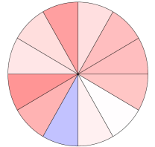
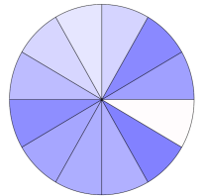
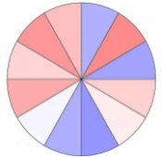
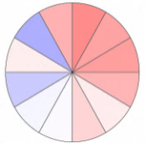
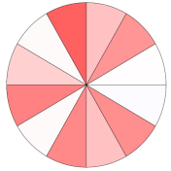
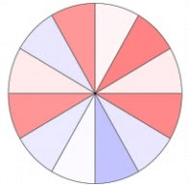
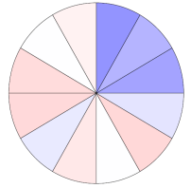
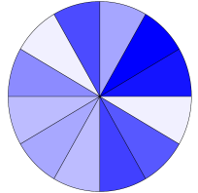
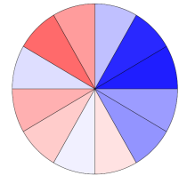
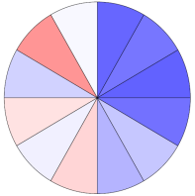
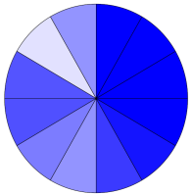
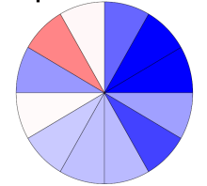
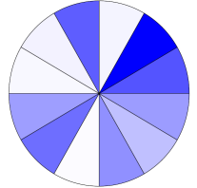
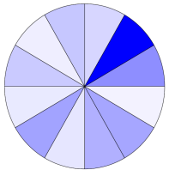
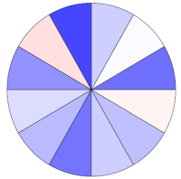
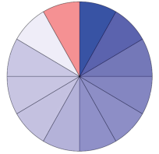
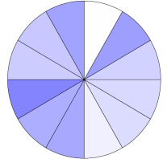
Supplemental Figure 4 A
RTK
PIP₂
PIP₃
PDK1
AKT
mTORC2
IRS1
PI3K
PTEN
S473
FOXO3A
PTEN
p-PRAS40
T308
TSC1/TSC2
p21
p27
BIM
Cell Cycle/G1-S Transition
PRAS40
p21
p27
BIM
p53
m
TORC1
CDK4
CDK4
4EBP1
p70S6K
p-p70S6K
eiF4E
p4EBP1 T37/46
p53
CDC2
Rb
p4EBP1 S65
S6
CDC2
pRB S807/811
p-S6 S235/236
p-S6 S240/244
SRC3
AR
INPP4B
SRC3
INPP4B
AR

Slide 8
Suppl Fig 4
B
miR
C
miR
NT
135a-5p
NT
31
Notes:
16pt bold Arial font in AI black color text

Slide 9
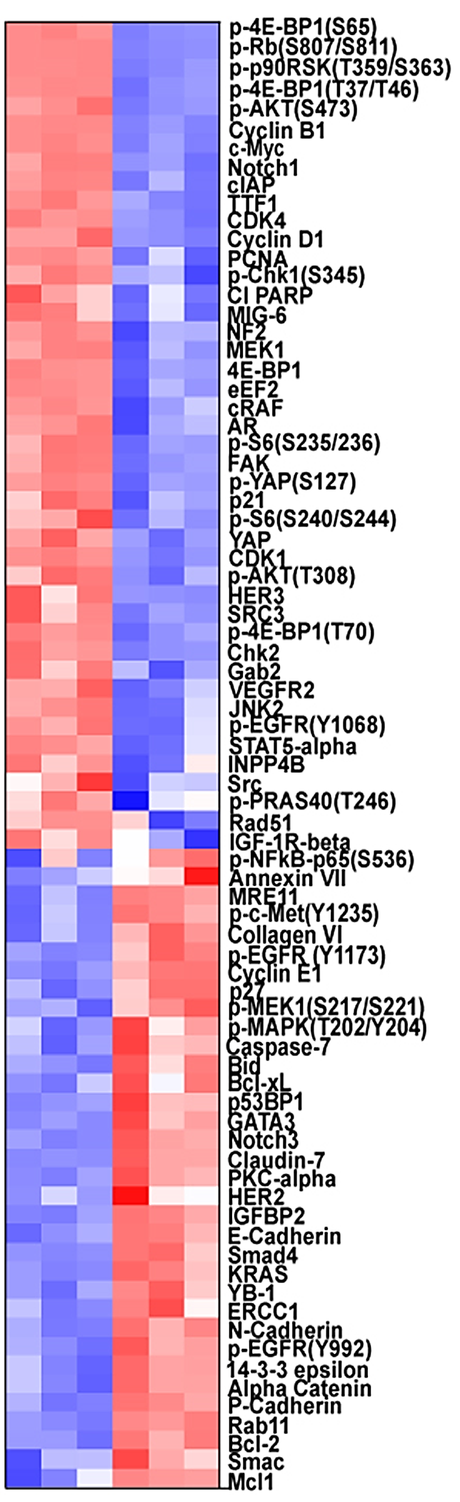
D
miR
E
miR
Suppl Fig 4
NT
1
NT
221-5p

Slide 10
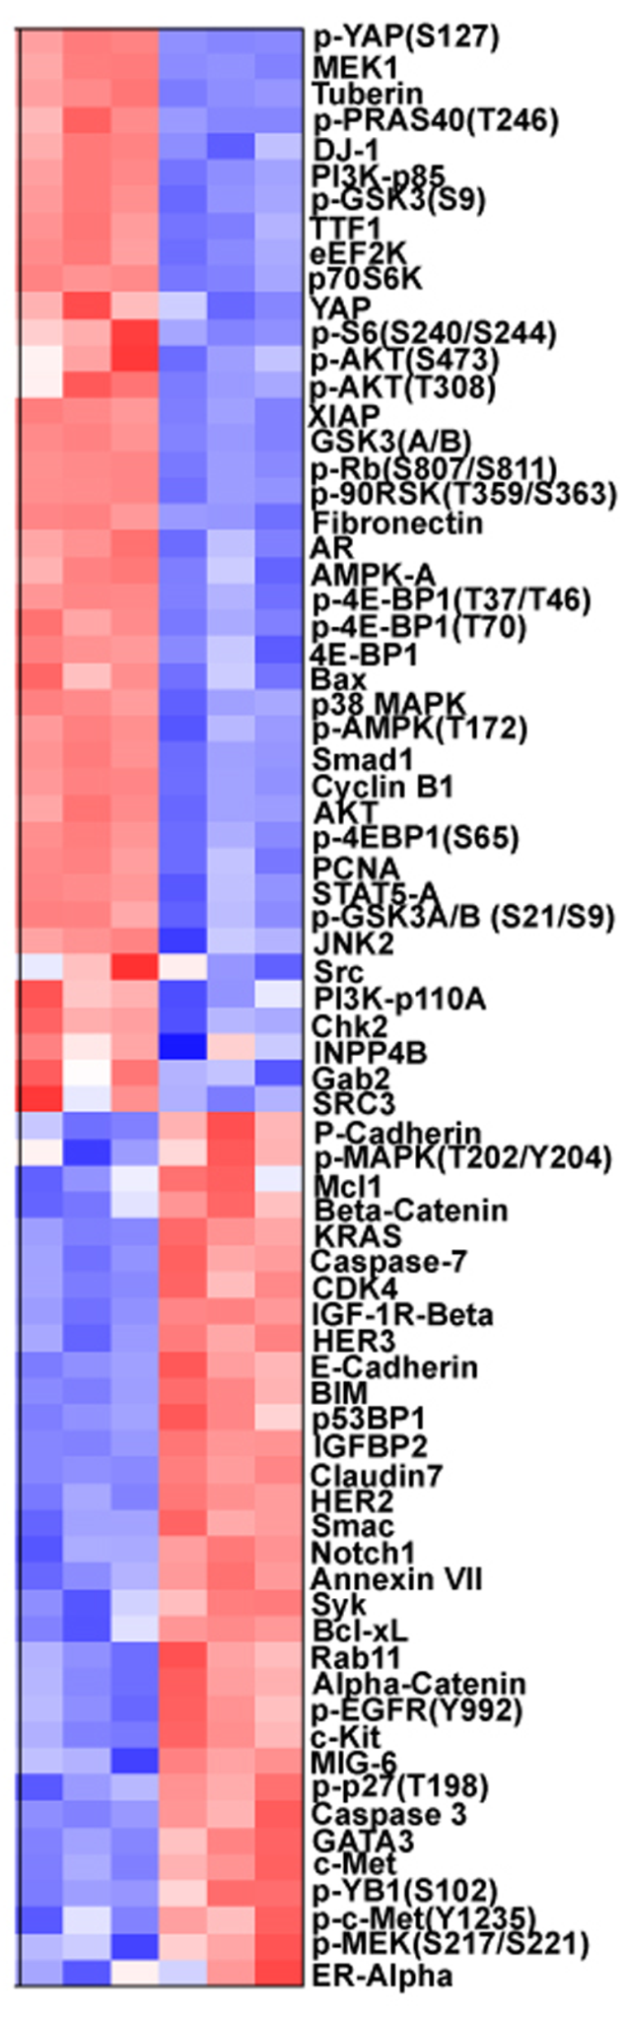
F
miR
G
miR
Suppl Fig 4
NT
133a
NT
133b

Slide 11
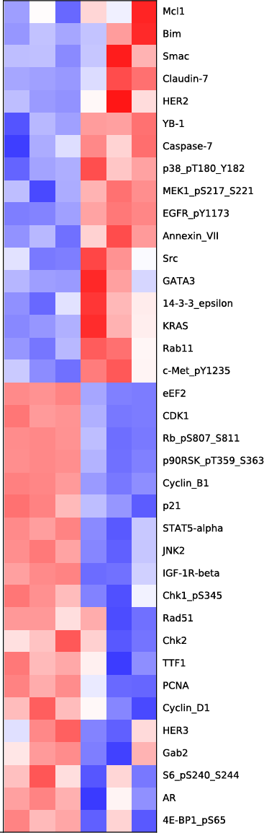
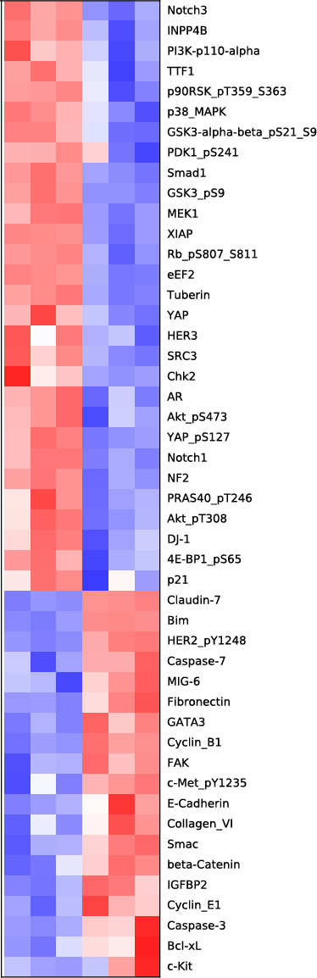
H
miR
I
miR
Suppl Fig 4
NT
143-3p
NT
24-1-3p

Slide 12
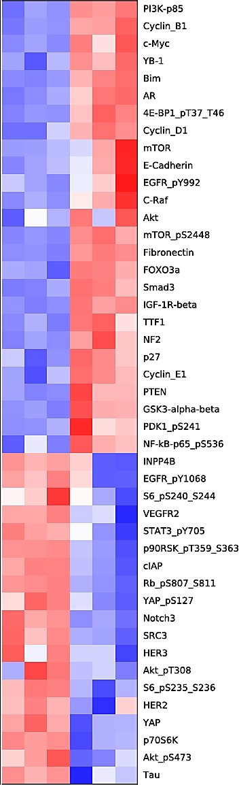
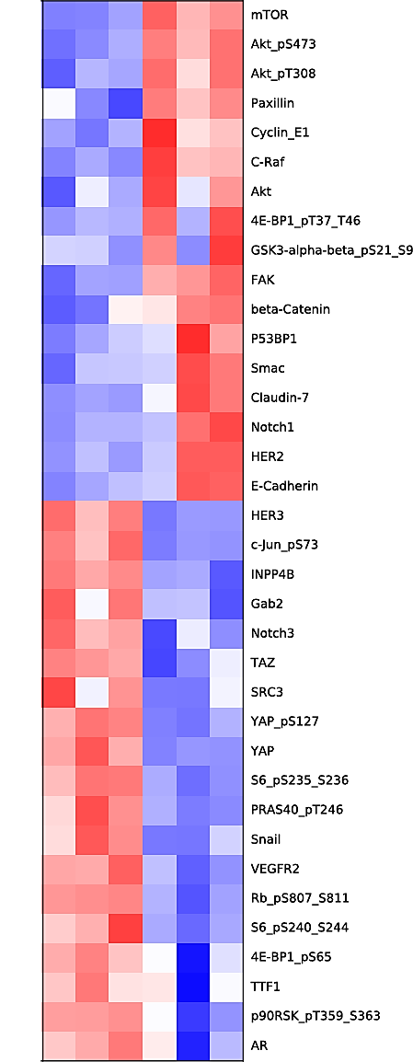
J
miR
K
miR
Suppl Fig 4
NT
145-3p
NT
205

Slide 13
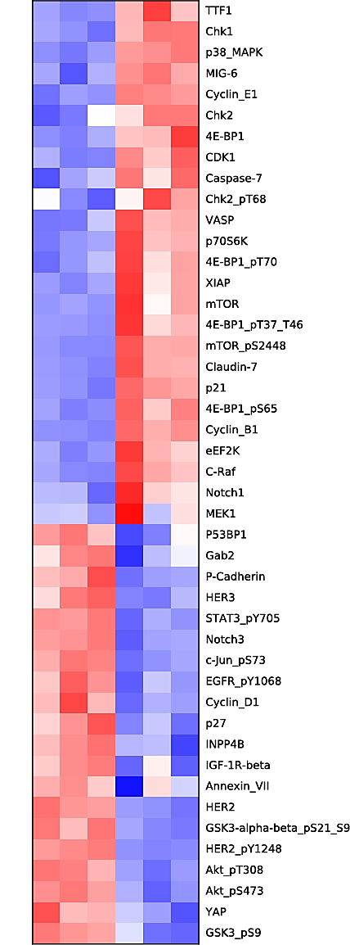
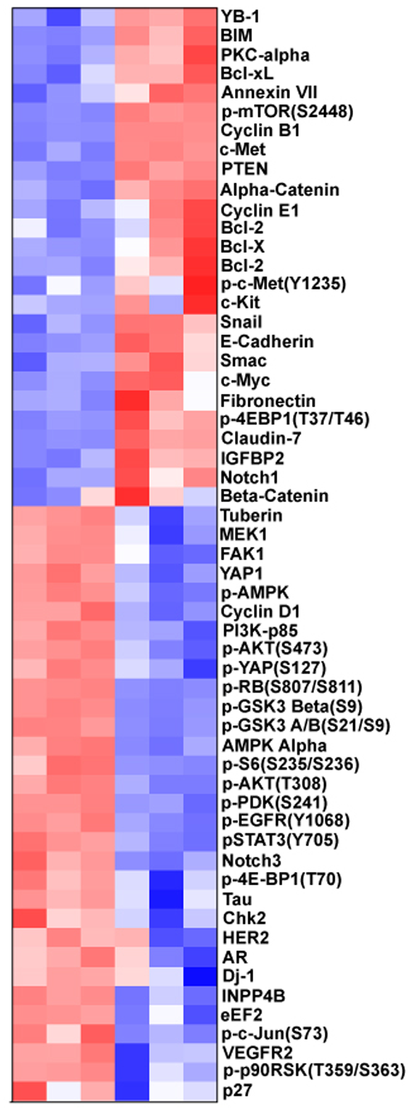
L
miR
M
miR
Suppl Fig 4
NT
221-3p
NT
222-3p

Slide 14
Supplemental Figure 5
A
* p<0.05
*
B
* p<0.05
*

Slide 15
Supplemental Figure 6: Correlation w/ other Signatures
A
 | miR-1 | miR-133a | miR-133b | miR-135a-5p | miR-143-5p | miR-145-3p | miR-205 | miR-221-3p | miR-221-5p | miR-222-3p | miR-31
LNCAP-siAR-B | 0.39 | 0.56 | 0.56 | NS | 0.47 | 0.51 | 0.43 | 0.50 | 0.46 | 0.47 | 0.42
LNCAP-siAR-A | 0.27 | 0.46 | 0.46 | NS | 0.35 | 0.40 | 0.45 | 0.34 | 0.34 | 0.41 | 0.46

Slide 16
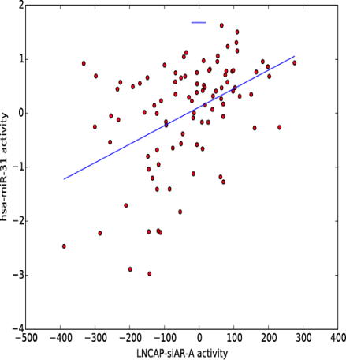
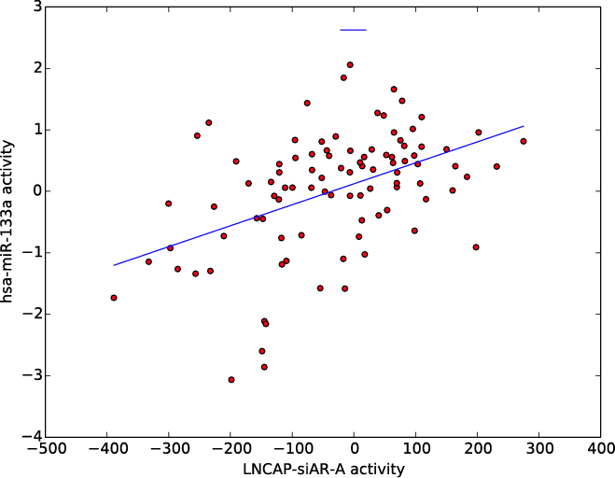
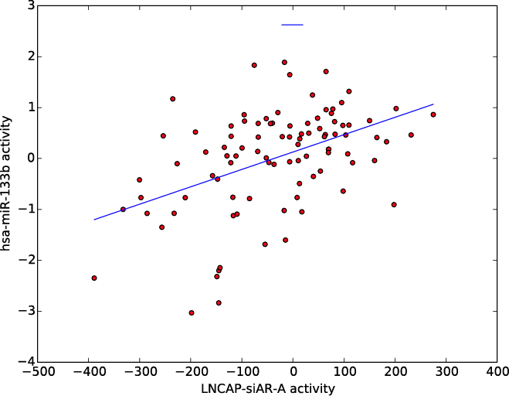
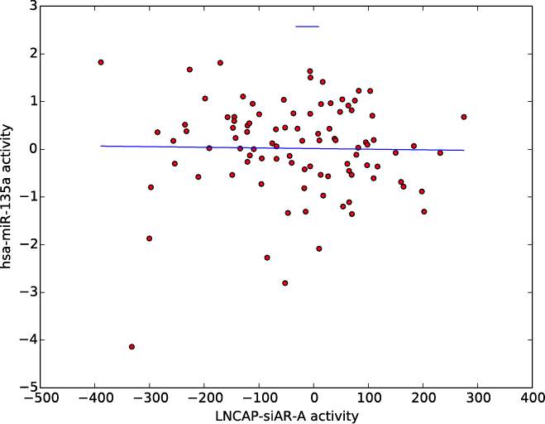
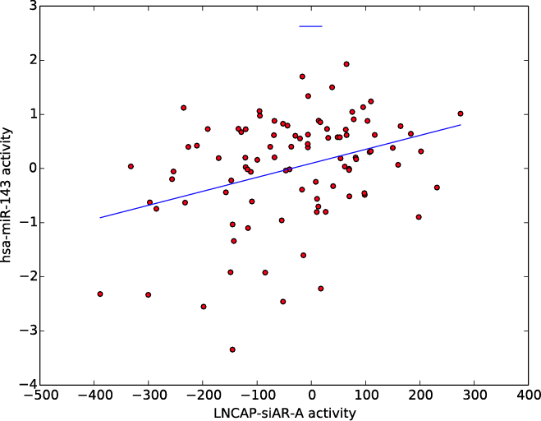
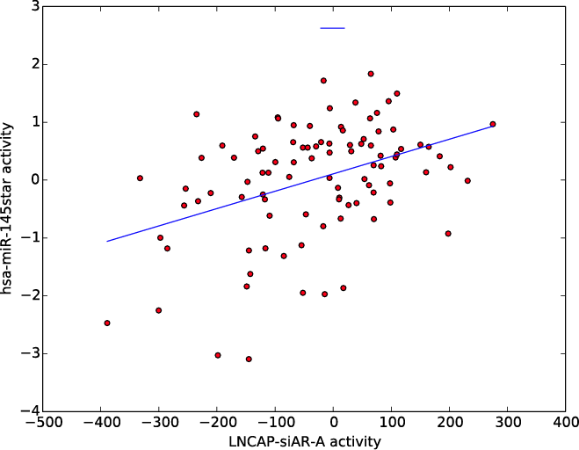
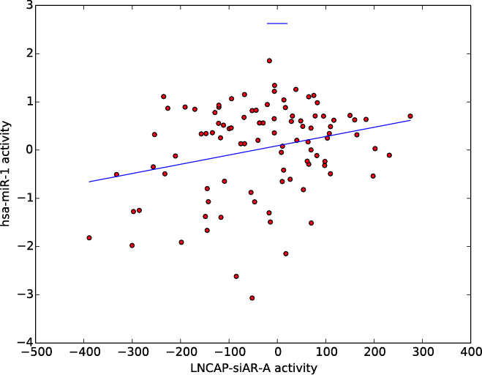
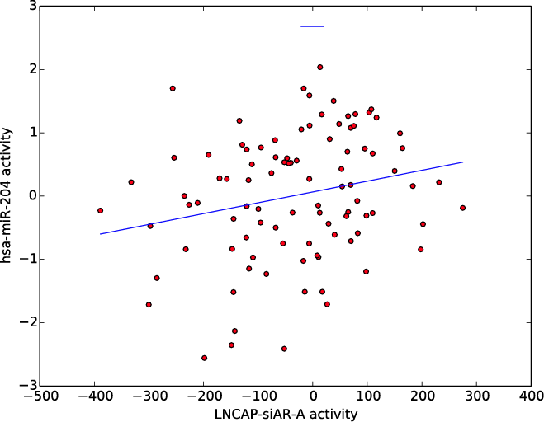
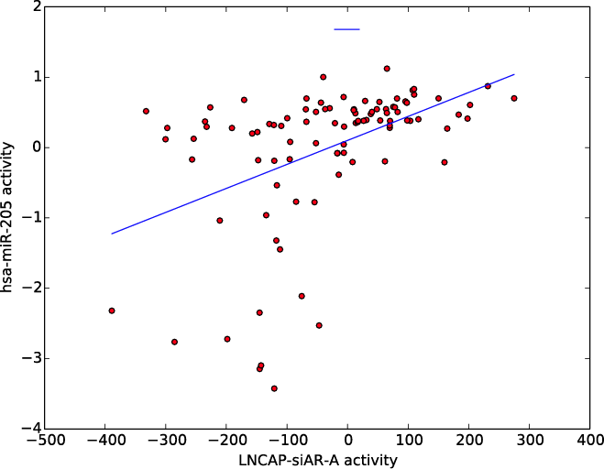
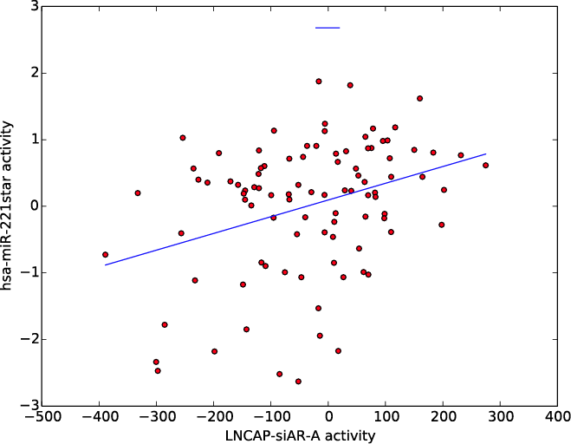
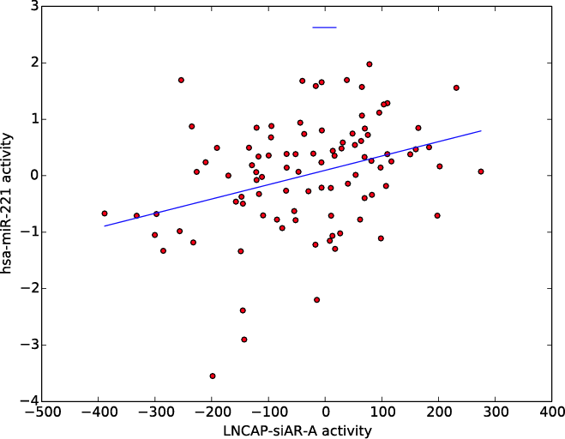
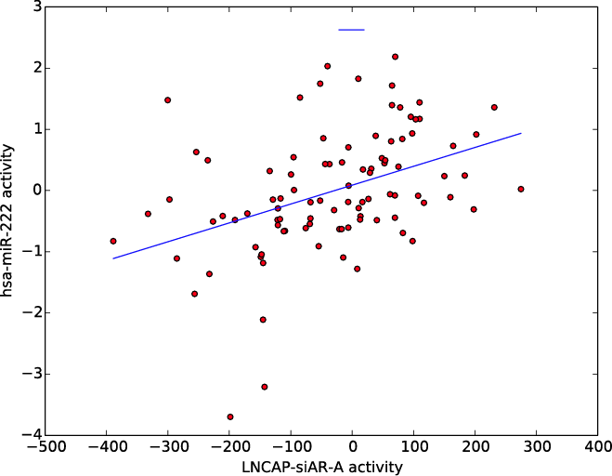
Suppl Fig 6B
r =0.46
p< 0.01
r =0.46
p< 0.01
r =0.46
p< 0.01
hsa-miR-31
hsa-miR-133a
hsa-miR-133b
si-AR (A) signature score
si-AR (A) signature score
si-AR (A) signature score
hsa-miR-135a-5p
hsa-miR-143-5p
hsa-miR-145-3p
r =-0.02
p= 0.86
r =0.35
p< 0.01
r =0.40
p< 0.01
si-AR (A) signature score
si-AR (A) signature score
si-AR (A) signature score
hsa-miR-1
hsa-miR-204
hsa-miR-205
r =0.27
p= 0.01
r =0.23
P=0.03
r =0.45
p< 0.01
si-AR (A) signature score
si-AR (A) signature score
si-AR (A) signature score
hsa-miR-221-5p
hsa-miR-221-3p
hsa-miR-222-3p
r =0.34
p< 0.01
r =0.34
p<0.01
r =0.41
p< 0.01
si-AR (A) signature score
si-AR (A) signature score
si-AR (A) signature score

Slide 17
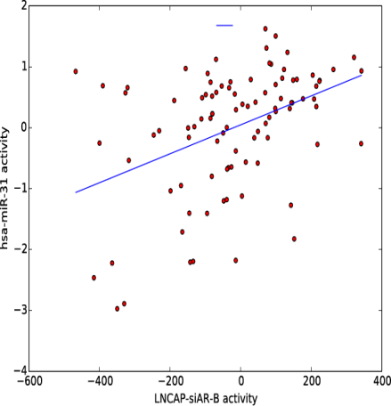
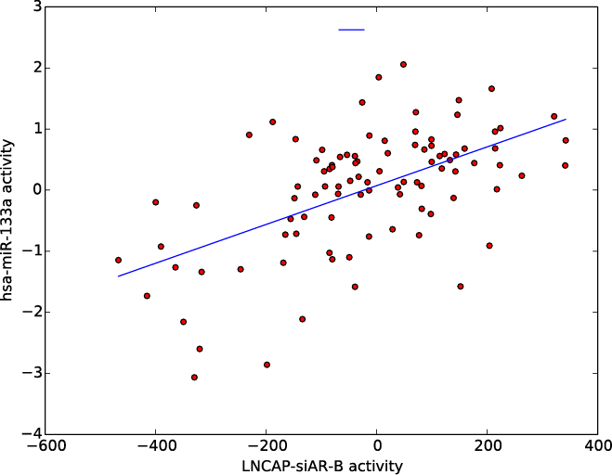
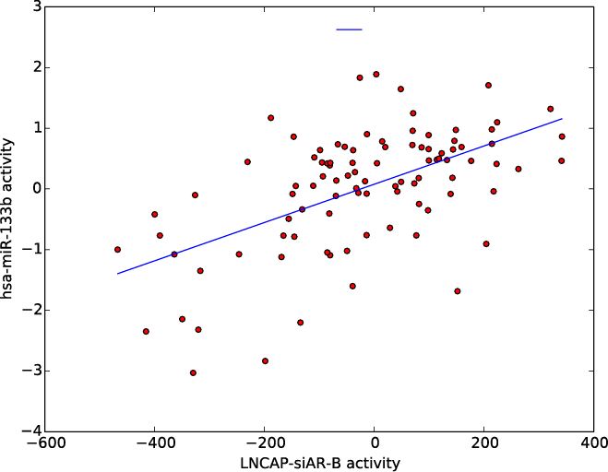
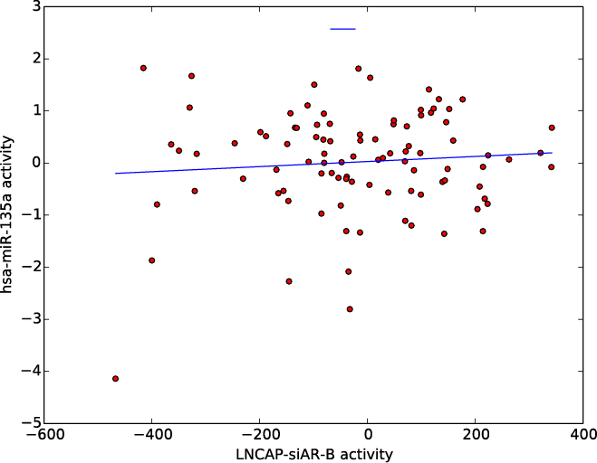
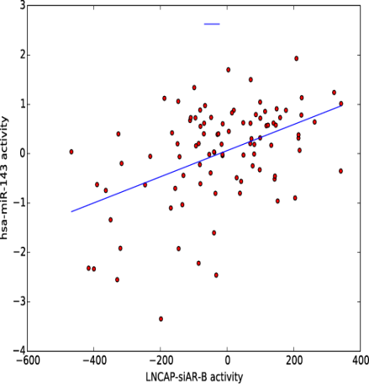
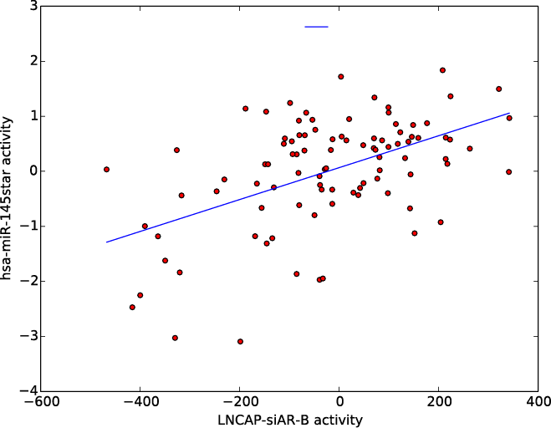
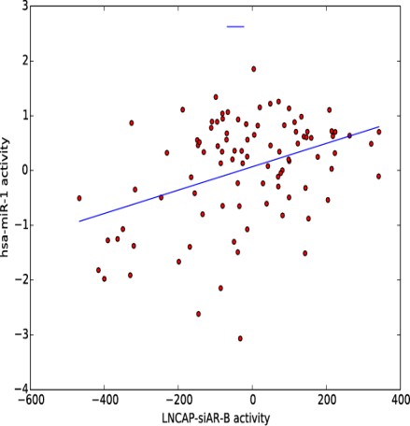
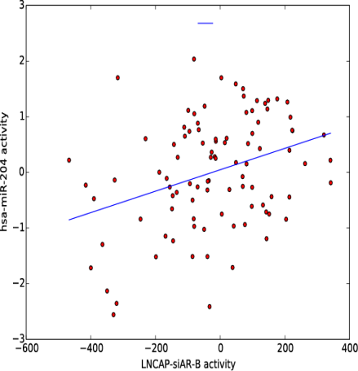
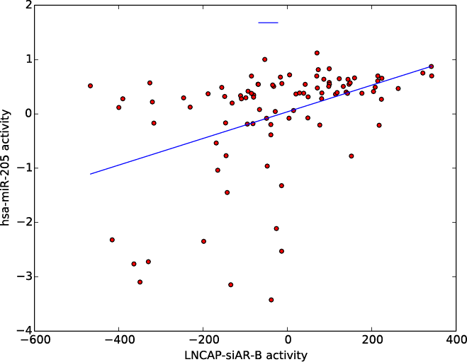
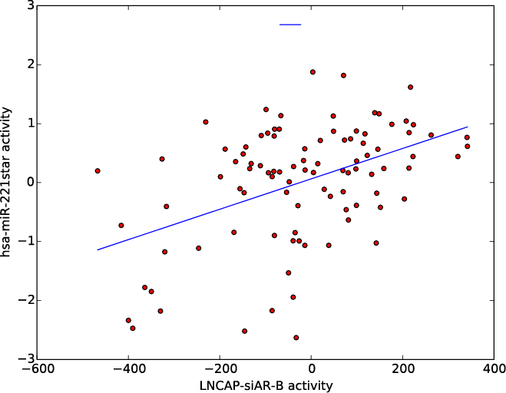
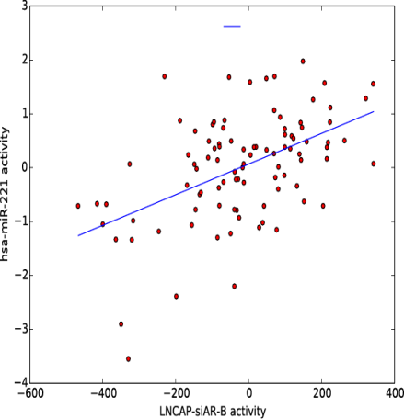
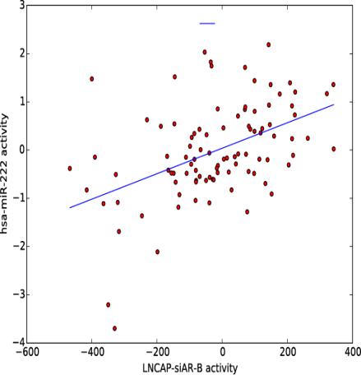
Suppl Fig 6C
hsa-miR-133a
hsa-miR-133a
hsa-miR-133b
r =0.42
p< 0.01
r =0.56
p< 0.01
r =0.56
p< 0.01
si-AR (B) signature score
si-AR (B) signature score
si-AR (B) signature score
hsa-miR-135a-5p
hsa-miR-143-5p
hsa-miR-145a-3p
r = 0.09
p= 0.40
r = 0.47
p= <0.01
r = 0.51
p< 0.01
si-AR (B) signature score
si-AR (B) signature score
si-AR (B) signature score
hsa-miR-1
hsa-miR-204
hsa-miR-205
r = 0.39
p< 0.01
r = 0.34
p< 0.01
r = 0.43
p< 0.01
si-AR (B) signature score
si-AR (B) signature score
si-AR (B) signature score
r = 0.46
p< 0.01
r = 0.50
p< 0.01
r = 0.47
p< 0.01
hsa-miR-221-5p
hsa-miR-221-3p
hsa-miR-222-3p
si-AR (B) signature score
si-AR (B) signature score
si-AR (B) signature score

Slide 18
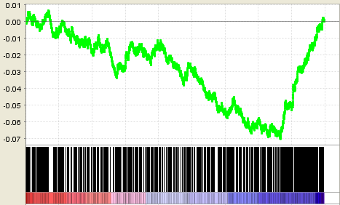

Suppl Fig 6D
Genes
upregulated by AR
(downregulated by si-AR-A)
Genes
upregulated by AR
(downregulated by si-AR-B)
Enrichment Score
NES=-1.94
q<0.0181
Enrichment Score
NES=-2.54
q<0.0001
Genes
induced by miR135a
Genes
suppressed by miR135a
Genes
induced by miR135a
Genes
suppressed by miR135a
Correlation of miR135a-induced gene expression changes with changes induced by AR (detected by using AR siRNAs A and B)

Slide 19

Supplemental Figure 7
Chandran Metastasis Up
NES=-1.8821
q<0.0888
Enrichment Score
Genes
induced by miR-135a-5p
Genes
suppressed by miR-135a-5p

Slide 20
Supplemental Figure 8

Slide 21



Supplemental Figure 9
A
27 kb
PrEC
(0-70)
H3K4Me3
LNCaP
(0-70)
H3K4Me3
PrEC
(0-30)
H3K27Me3
LNCaP
(0-30)
H3K27Me3
miR-222
miR-221
B
153 kb
PrEC
(0-50)
H3K4Me3
LNCaP
(0-50)
H3K4Me3
PrEC
(0-50)
H3K27Me3
LNCaP
(0-50)
H3K27Me3
MIB
miR133A1
miR1-2
C
85 kb
PrEC
(0-85)
H3K4Me3
LNCaP
(0-85)
H3K4Me3
PrEC
(0-50)
H3K27Me3
LNCaP
(0-50)
H3K27Me3
miR-31
miR31HG

Slide 22
Supplemental Figure 10
A
B
C

Slide 23
Supplemental Table 2. Proteomic signature for 12 SiM-miRNAs transfected into LNCaP cells.
Supplemental Table 3. Evaluation of direct SiM-miRNA effects on the proteomic changes assayed via RPPA

Slide 24
Supplemental Table 4. Prediction of SiM-miRNAs on steroid receptor coactivators.
Note: Using a union of five leading prediction algorithms: TargetScan, miRanda, PicTar, DianaLab, and miRDB, we queried whether the SiM-miRNAs could target p160 coactivators SRC1, SRC2 and SRC3. Table shows that SRC1 is predicted by 3 independent algorithms to be targeted by miR-135a-5p.
Union of DianaLab, TargetScan, PicTar, miRanda, mirDB
Gene | hsa-miR-1-5p | hsa-miR-133a-3p | hsa-miR-133b | hsa-miR-135a-5p | hsa-miR-143-3p | hsa-miR-143-5p | hsa-miR-205-5p | hsa-miR-221-3p | hsa-miR-221-5p | hsa-miR-222-3p | hsa-miR-24-1-5p | hsa-miR-31-5p
NCOA1 | 2 | 0 | 0 | 3 | 1 | 2 | 3 | 0 | 0 | 1 | 2 | 0
NCOA2 | 1 | 0 | 0 | 0 | 0 | 0 | 0 | 0 | 0 | 0 | 0 | 0
NCOA3 | 3 | 0 | 0 | 0 | 0 | 1 | 2 | 0 | 0 | 0 | 0 | 0
Supplemental Table 5. AGO HITS-CLIP and AGO PAR-CLIP analysis.

Slide 25
Supplemental Table 6. Comparison of H3K4Me3 and H3K27Me3 signal at the miR-135a-5p, miR-221-5p, miR-1, and miR-31 loci in PrEC and LNCaP cells
miRNA | Site | Reads H3K4me3 PrEC | Reads H3K4me3 LNCaP | P-value | Reads H3K27me3 PrEC | Reads H3K27me3 LNCaP | P-value
miR-135a-5p | chr12 97856241- 97859472 | 99/651 | 32/655 | 1.274e-08 | 45/663 | 98/843 | 0.003536
miR- 221-5p | chrX 45625956- 45631024 | 486/785 | 32/392 | 4.203e-38 | 7/235 | 8/477 | 0.277
miR-1 | chr18 19319997- 19322746 | 209/840 | 91/436 | 0.221 | 5/484 | 26/736 | 0.0082
miR-31 | chr9 21554820- 21560351 | 1234/2461 | 43/722 | 1.752e-67 | 26/392 | 188/1263 | 7.860e-05

