Slide 1
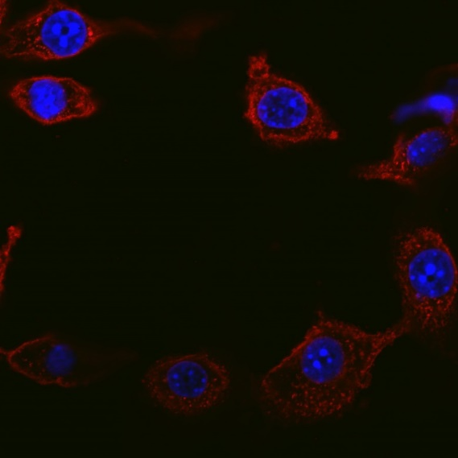
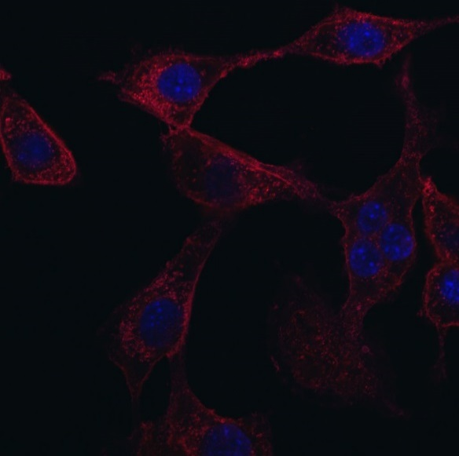
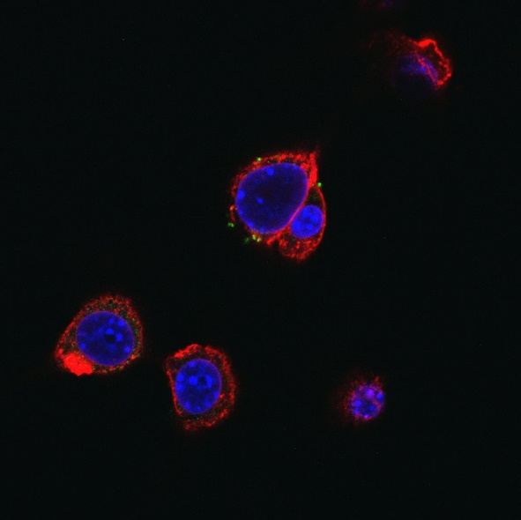
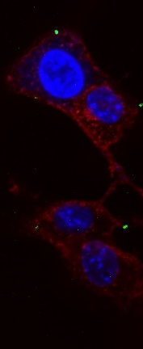
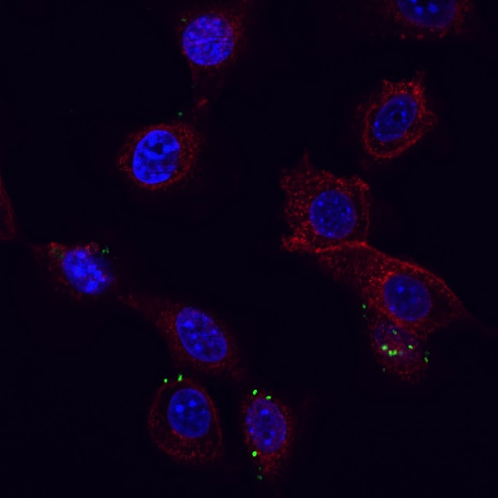
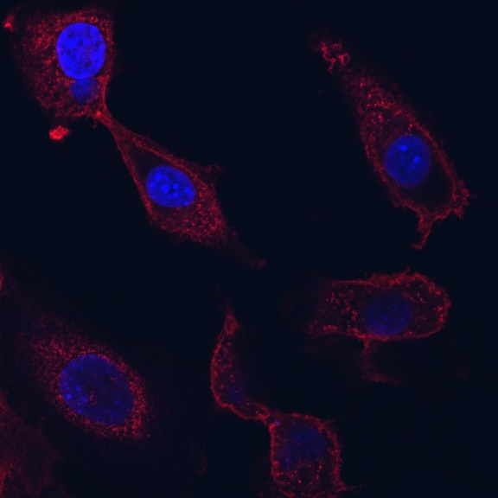
Groza et al. Suppl. Fig. 1
CT26 cells
3h
4h
5h
WGA CRT DAPI
300 µM oxali
300 µM oxali +BGs
Supplementary Figure 1. Kinetic of the impact of BGs on the CRT exposure after oxaliplatin treatment in cell culture. Immunofluorescent staining of CRT exposure (green) of CT26 cells after treatment with 300 µM oxaliplatin (oxali) alone or in combination with 500 BGs/cell was evaluated by confocal microscopy after the indicated incubation times. Membranes and nuclei were stained with wheat germ agglutinin (red) and DAPI (blue), respectively. 40x magnification is shown.

Slide 2
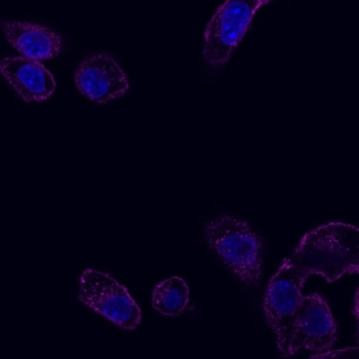
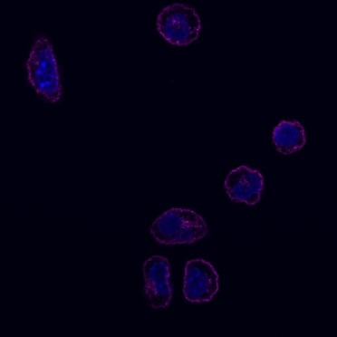
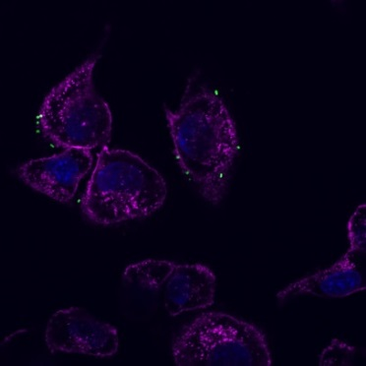
Groza et al. Suppl. Fig. 2
A
ID8 ovarian carcinoma cells
WGA CRT DAPI
WGA
CRT
control
A.
300 µM oxali
B.
300 µM oxali + BGs
B
Supplementary Figure 2. ICD induction in an ovarian carcinoma cell line. (A) Immunofluorescent staining of CRT (green), membranes (WGA, magenta) and nuclei (DAPI, blue) in ID8 cells was performed after short term treatment (4 h) with 300 µM oxaliplatin and 500 BGs/cell. Representative confocal microphotographs with a magnification of 400x are shown. (B) At least 50 cells were evaluated and CRT exposure was quantified as percentage of positive cells. Data are represented as mean value ± S.D. of quadruplicates of one representative experiment. Statistical significance calculated by one-way ANOVA and Bonferroni posttest *p< 0.05; **p<0.01; ***p<0.001, significantly different from control.

Slide 3
Groza et al. Suppl. Fig. 3
Supplementary Figure 3. BG treatment has no influence on cell viability in vitro. CT26 cells were treated for 72 h with increasing concentrations of oxaliplatin in combination with different numbers of BGs per cell. Cell viability was determined by viability assay and plotted as logarithmic dose-response curves.

Slide 4
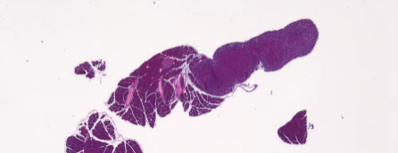
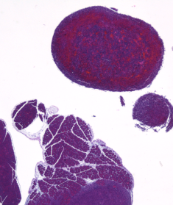
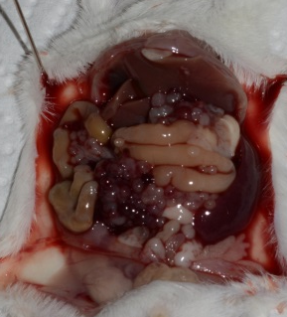
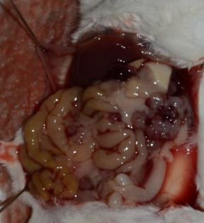
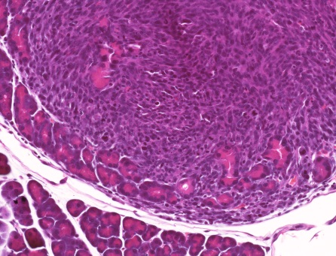
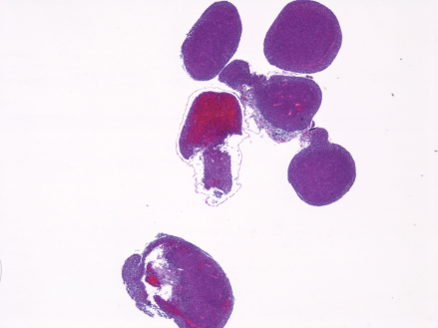
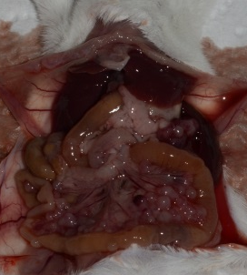
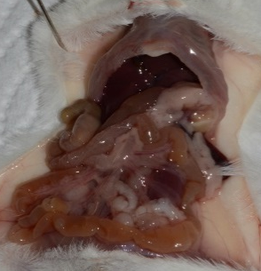
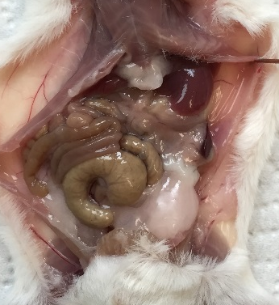
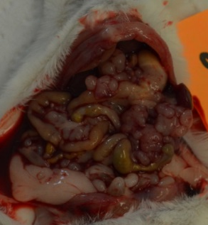
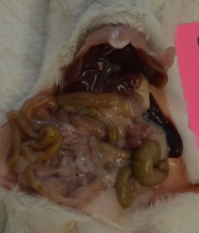
Groza et al. Suppl. Fig. 4
A
Tumors day 10 (TS1)
B
Day 10 (TS1)
solvent
BGs
Solvent
Oxaliplatin
+
2x
+
Oxali
2x
+
BGs
Combi
20x
2x
C
Rechallenged survivor mouse
day 265 (TS2)
Day 13 (TS1)
Solvent
Combi
Supplementary Figure 4. Antitumor activity against CT26 carcinosis and histomorphology of tumor and spleen. BALB/c mice were injected i.p. with 1x10⁵ CT26 cells on day 0 (D0) and treated according to TS1. (A) Representative pictures of H&E-stained tissue slices from tumor nodules are shown in the indicated magnification. Pancreatic tissue is marked with a plus. (B) Representative pictures of mouse autopsy from each group were taken upon dissection on day 10 or 13, respectively. (C) Combination-treated (TS2) survivor (compare Fig. 2E) was rechallenged i.p. on day 80 with viable 1x10⁵ CT26 cells. Upon dissection on day 265 no tumors were found.

Slide 5
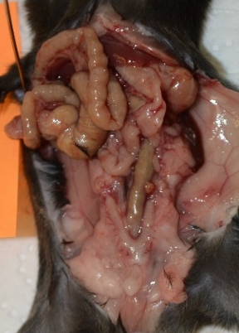
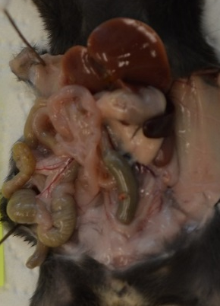
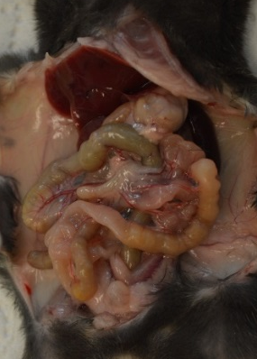
Groza et al. Suppl. Fig. 5
ID8 ovarian carcinoma (TS3)
Solvent
Oxaliplatin
Combi
Supplementary Figure 5. Antitumor activity against ID8 carcinosis. Female C57BL/6 mice were injected i.p. with 1x10⁶ ID8 ovarian carcinoma cells and treated according to TS3, with two cycles of therapy. Representative pictures of mouse autopsy from each group upon dissection on day 35. Tumor lesions are indicated by red arrows.

Slide 6
Groza et al. Suppl. Fig. 6
Solvent-treated mice
mouse #1
Dissection on day 13
day 7
day 13
mouse #2
Dissection on day 13
day 7
day 13
mouse #3
Dissection on day 13
day 7
day 13
Supplementary Figure 6. DLIT/µCT of solvent-treated animals. Male BALB/c mice were injected i.p. with 1x10⁵ CT26^{F-luc} cells on day 0. Using s.c. luciferin injection followed by DLIT combined with µCT, tumor burden was imaged on the indicated days. Depicted are µCT-scans overlapped with 3D luminescent signals (in photons per second) revealing multiple tumor nodules.

Slide 7
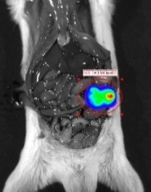
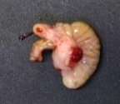
Groza et al. Suppl. Fig. 7
Oxaliplatin-treated mice
Dissection on day 24
mouse #4
day 3
day 20
day 3
day 6
day 13
day 24
mouse #5
Dissection on day 19
day 3
day 6
day 13
day 19
mouse #6
Dissection on day 27
(a)
day 3
day 6
day 13
day 20
day 27
Supplementary Figure 7. DLIT/µCT of oxaliplatin-treated animals. Male BALB/c mice were injected with 1x10⁵ CT26^{F-luc} cells intraperitoneally (i.p.) on day 0 and treated according to TS2 with OS as endpoint. Using s.c. luciferin injection followed by DLIT combined with µCT, tumor burden was imaged on indicated days. Depicted are µCT-scans overlapped with 3D- luminescent signals (in photons per second) revealing the individual tumor nodules. Luminescent signals were confirmed to be tumors, by comparison of anatomical localization upon dissection (as seen in picture (a)) and histopathology of tissues.

Slide 8
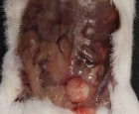
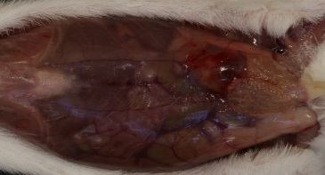
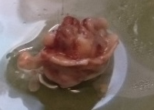
Groza et al. Suppl. Fig. 8
Combination-treated mice
mouse #7
x10⁵
End of experiment on day 36
day 3
day 6
day 13
day 20
day 36
Aorta punctation during drug application on day 6
mouse #8
day 3
day 6
DLIT signal <LOD
End of experiment on day 36
mouse #9
day 3
day 6
day 13
day 20
day 36
(a)
(b)
Supplementary Figure 8. DLIT/µCT of combination-treated animals. Male BALB/c mice were injected i.p. with 1x10⁵ CT26^{F-luc} cells on day 0 and treated according to TS2. Animals were sacrificed on day 36. Using s.c. luciferin injection followed by DLIT combined with µCT, tumor burden was imaged on indicated days. Depicted are µCT-scans overlapped with 3D- luminescent signals revealing the tumor nodules. Red arrows point to signals of tumors responding to therapy. Red shapes show tumors at superficial sites in the abdomen. Luminescent signals were confirmed as malignant tissue by comparison of anatomical localization upon dissection (as seen in pictures (a): tumor In situ after section and (b): same tumor after fixation appears to be nestled in abdominal skin) and histopathology of tissues.

Slide 9
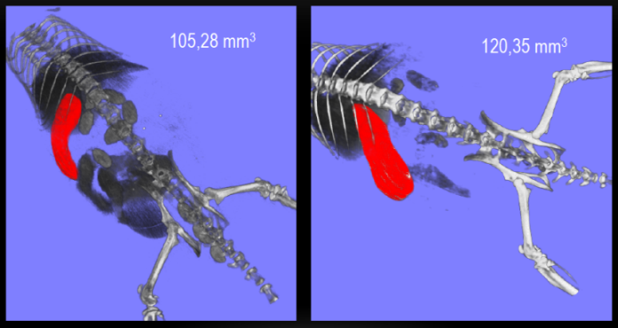
Groza et al. Suppl. Fig. 9
A
B
C
Spleen volume
Before treatment
After combination treatment
Supplementary Figure 9. Tumor and spleen growth quantification from 3D imaging. Male BALB/c mice were injected i.p. with 1x10⁵ CT26^{F-luc} cells on day 0 and treated according to TS2. Experiment was terminated on day 36. (A) Using s.c. luciferin injection, followed by DLIT/µCT, the tumor burden was quantified as luminescent signal intensity integrated over the signal voxels. (B) Spleen volume was calculated for each mouse from 3D imaging signals and its progression plotted against time. Each line represents one animal. (C) Spleen (red shape) volume measurement was visualized for one combination-treated mouse using Amira imaging software .

Slide 10
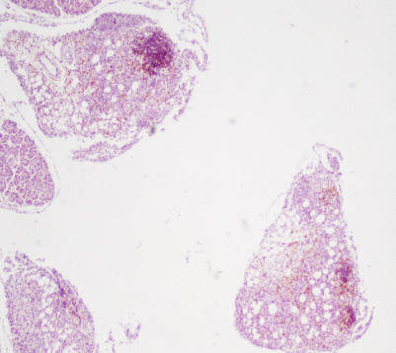
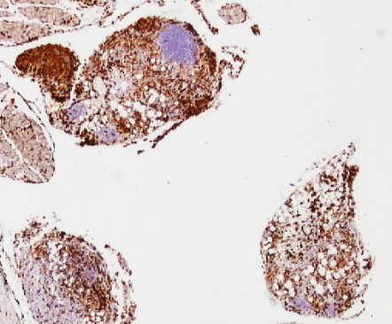
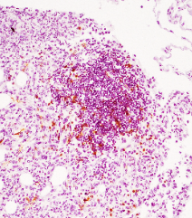
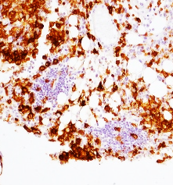
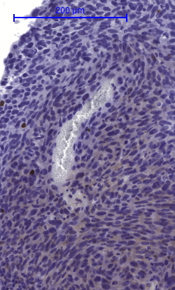
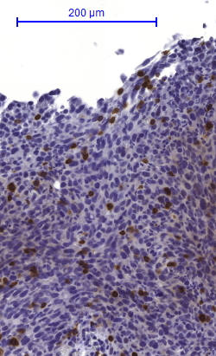
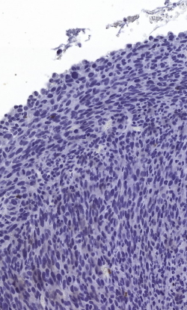
Groza et al. Suppl. Fig. 10
A
Tumors mouse #8
CD3
F4/80
4x
4x
10x
10x
B
Tumors day 10 (TS1)
Solvent
Oxali
BGs
Supplementary Figure 10. Exploring of immune cell infiltration in tumor tissue. (A) Tumor tissue slides from mouse #8, were stained for the T-cell marker CD3 and the macrophage marker F4/80. Infiltration of T-lymphocytes and macrophages is shown in two tumor nodules (4x and 10x magnification). (B) Paraffin-embedded tumors the first in vivo experiment (compare Fig. 2B) were stained for the T-cell marker CD3, slides scanned and quantified using Definiens software. The amounts of CD3+ cells in tumor are expressed as percentage of the total cell number. Statistical significance was calculated by nonparametric one-way ANOVA and Bonferroni correction (*p<0.05 compared to solvent-treated control).
BGs
Combi

Slide 11
Groza et al. Suppl. Fig. 11
Lymphoid cells day 11
Tumor
Spleen
Supplementary Figure 11. Impact of the combination treatment on lymphoid cells in tumor and spleen. Male BALB/c mice were injected i.p. with 1x10⁵ CT26 cells on day 0 and treated according to TS3. Animals were sacrificed on day 11 and tumor as well as spleen tissue collected. Single cell suspensions were stained with a panel of lymphoid-cell markers and evaluated by multicolour-flow cytometry. Comparison of therapy-induced changes of immune cell populations from the lymphoid lineage is shown as mean percentages ± SEM. Each point represents one individual mouse. Statistical analysis was performed by unpaired t test (*p<0.05).

Slide 12
Groza et al. Suppl. Fig. 12
Myeloid cells day 11
Tumor
Spleen
Supplementary Figure 12. Impact of the combination treatment on myeloid cells in tumor and spleen. Male BALB/c mice were injected i.p. with 1x10⁵ CT26 cells on day 0 and treated according to TS3. Animals were sacrificed on day 11, tumor and spleen tissue collected. Single cell suspensions were stained with a panel of myeloid-cell markers and evaluated by multicolor flow cytometry. Comparison of therapy-induced changes of immune cell populations of the myeloid lineage is shown as mean percentages ± SEM. Each point represents one individual mouse. Statistical analysis was performed by unpaired t test (*p<0.05).

Slide 13
Groza et al. Suppl. Fig. 13
Blood cells (day 6)
A
Lymphoid cells
B
Myeloid cells
Supplementary Figure 13. Impact of the combination treatment on immune cells in blood samples. Male BALB/c mice were injected i.p. with 1x10⁵ CT26 cells on day 0 and treated according to TS3. Blood samples were collected from the submandibular vein on day 6 and stained with a panel of (A) lymphoid and a panel of (B) myeloid cell markers and evaluated by multicolor flow cytometry. Comparison of therapy-induced changes on blood immune cells is shown as mean percentages ± SEM. Each point represents one individual mouse. Statistical analysis was performed by unpaired t test (*p<0.05).

