Slide 1
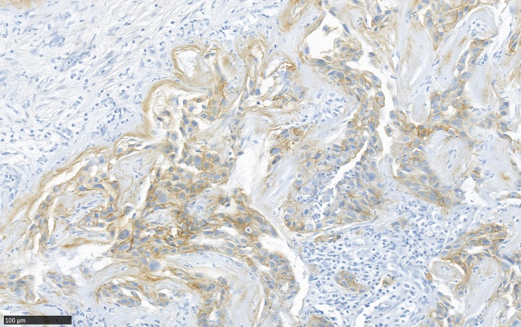
Supplementary Figure S1. EGFR expression by tumor cells. The immunohistochemistry performed with a anti-EGFR antibody (clone 3C6, Roche-Ventana) shows a membranous expression of EGFR by tumor cells (magnification x200). It is a representative staining of patient 8.

