Slide 1
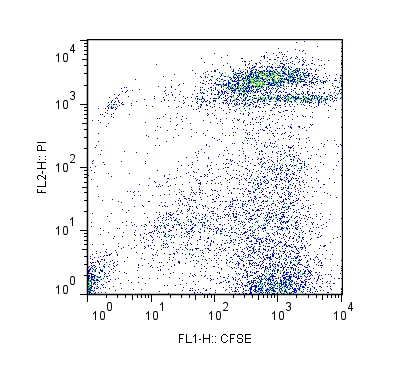
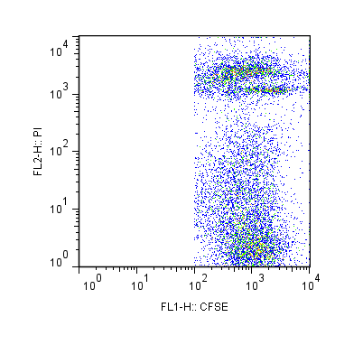
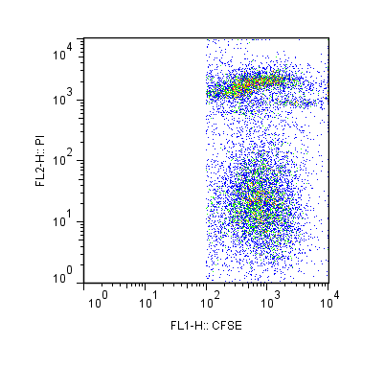
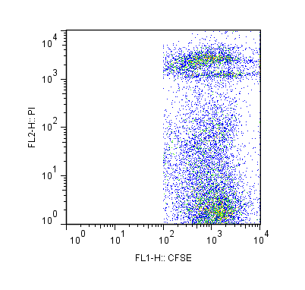
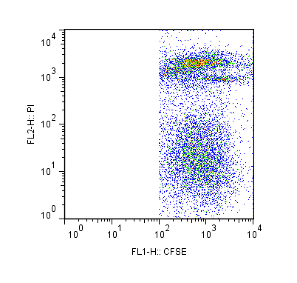
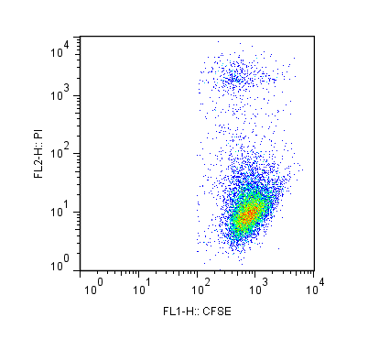
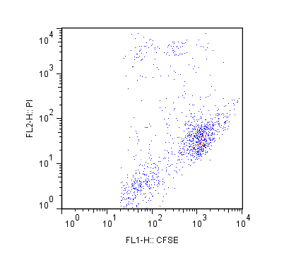
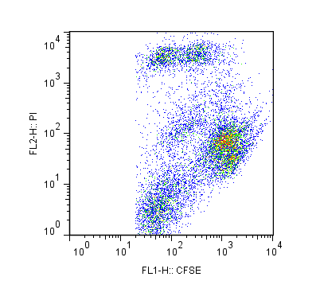
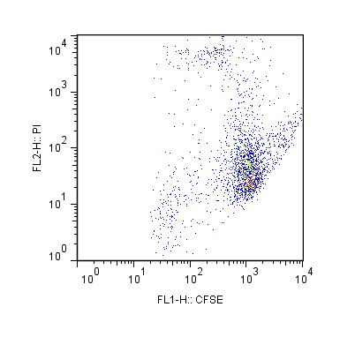
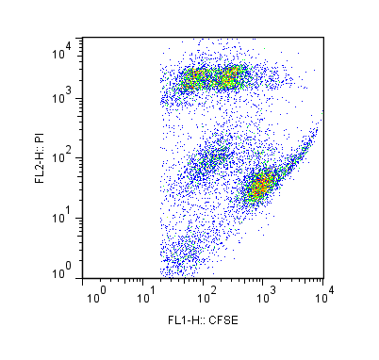
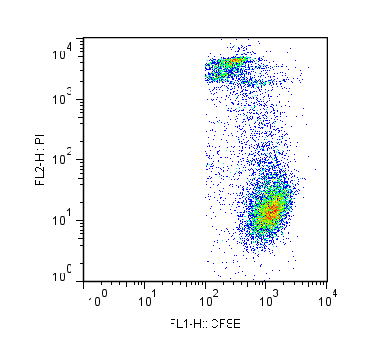
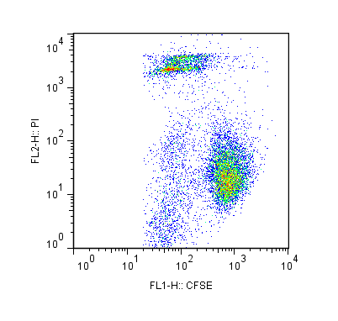
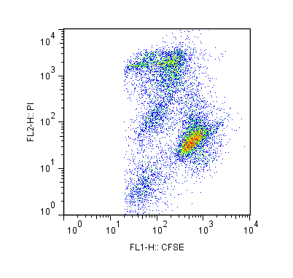
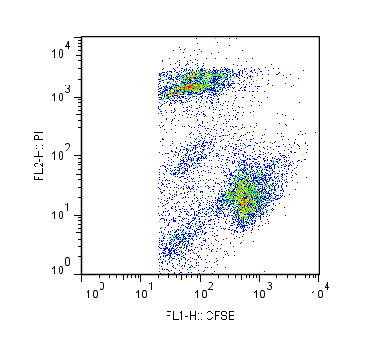
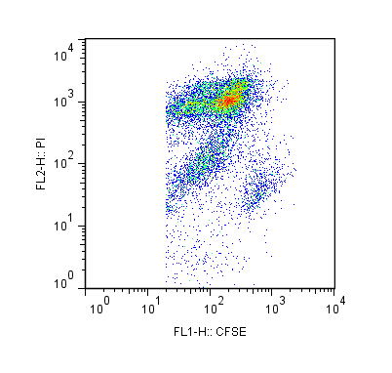
HBEC-A
Fig. S1
32.4%
36.9%
31.4%
40.0%
43.7%
UMUC-3
10.2%
16.8%
35.7%
29.4%
52.3%
PI
TCCSUP
20.8%
28.9%
45.9%
38.9%
81.7%
CFSE
（CFSE)
not co-cultured
ZOL(-) E:T=1:1
ZOL(+) E:T=1:1
ZOL(-) E:T=10:1
ZOL(+) E:T=10:1
Notes:
Supplementary Fig. 1 Cytotoxic effects of γδT cells against UBC cells and normal UB cells with or without 5 μM ZOL pretreatment. Raw data and the gating strategy for Fig. 2B are shown. UBC and UB cells stained with 0.5 μM CFSE (not co-cultured) indicate baseline apoptotic cancer cells as CFSE itself is cytotoxic against cells. Red squares represent the apoptotic UBC and UB cell (CFSE⁺/PI⁺) population. Representative data from three independent experiments are shown.

Slide 2
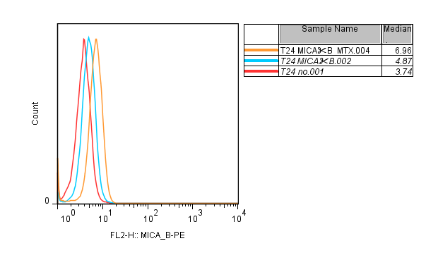
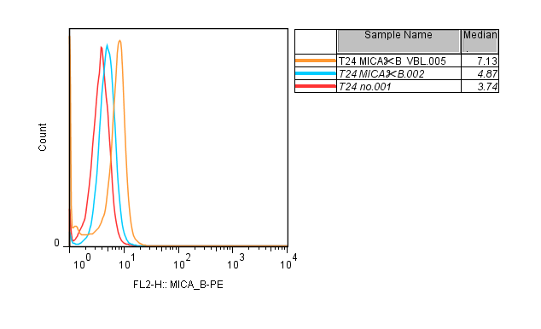
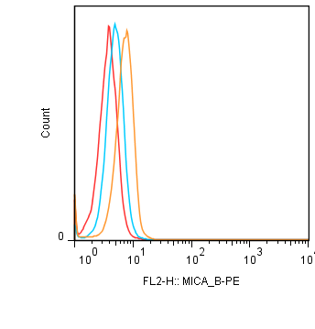
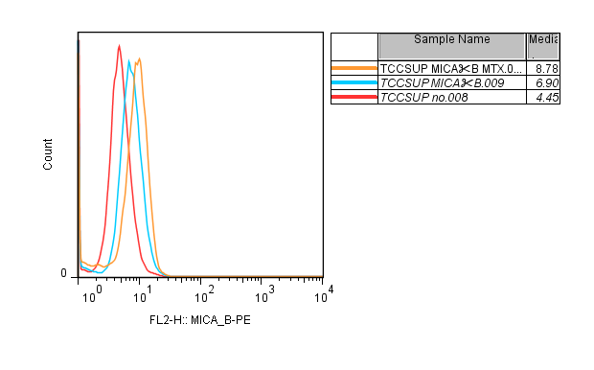
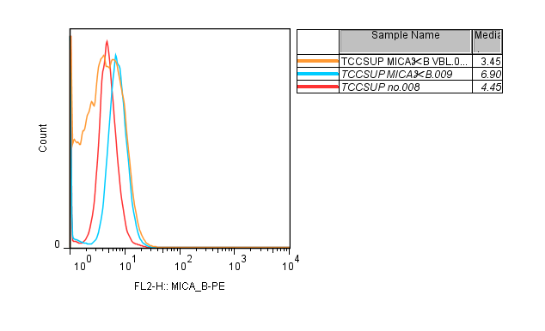
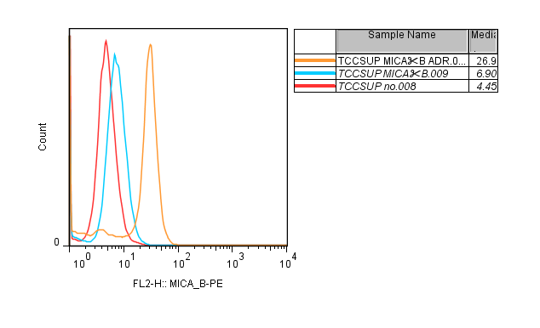
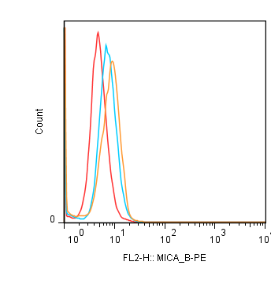
Fig. S2
T24
MTX
VBL
ADR
MMC
MICA/B
TCCSUP
MTX
VBL
ADR
MMC
MICA/B
Notes:
Supplementary Fig. 2 Effect of treatment of UBC cells with various anticancer agents (MTX, VBL, ADR, and MMC) on the expression of MICA/B, NKG2D ligands. The UBC cell lines T24 and TCCSUP at 1×10⁶ cells were incubated with 100 nM (determined by a WST-8 assay) of each anticancer agent for 24 h and examined for the cell surface expression of MICA/B. Red line: background control; blue line: no treatment; orange line: agent treatment.

Slide 3
Fig. S3
T24
TCCSUP
Notes:
Supplementary Fig. 3 Pretreatment with anticancer agents (GEM, MTX, VBL, ADR, and MMC) in combination with ZOL didn’t increase cancer cell death in the absence of γδT cells. The UBC cell lines T24 and TCCSUP at 1×10⁶ cells were incubated with anti-cancer agents at lower concentrations ( GEM and ZOL at 5 μM, MTX, VBL, ADR, and MMC were at 100 nM) for 24 h, as determined by the WST-8 assay. Flow cytometric analysis revealed PI positive cells as apoptotic cancer cells. Data represent the mean ± SD of triplicate wells. Statistical significance is displayed as N.S.: not significant.

Slide 4
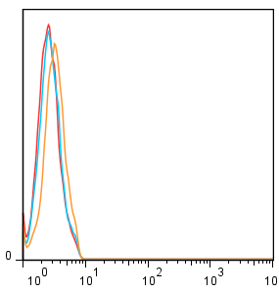
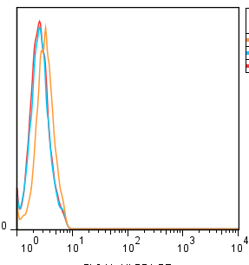
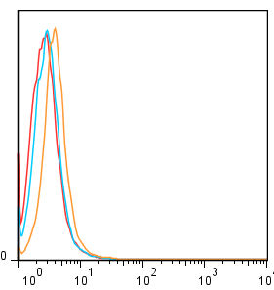
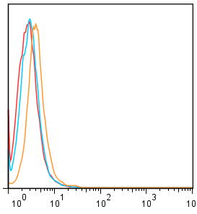
Fig. S4
ULBP 1
ULBP 2/5/6
ULBP 1
ULBP 2/5/6
Notes:
Supplementary Fig. 4 Effect of treatment of UBC cells with ZOL and/or GEM on the expression of ULBB1 and ULBP2/5/6, which are NKG2D ligands. The UBC cell lines T24 and TCCSUP at 1×10⁶ cells were incubated with 5 μM (determined by a WST-8 assay) of ZOL and/or GEM for 24 h and examined for the cell surface expression of ULBB1 and ULBP2/5/6. Representative histograms were shown. Red line: background control; blue line: no treatment; orange line: GEM treatment. Data represent the mean ± SD of triplicate wells. Statistical significance is displayed as ** for P<0.01.

Slide 5
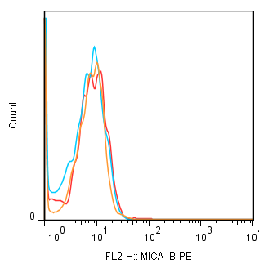
Fig. S5
N.S
MICA/B
Notes:
Supplementary Fig. 5 Effect of treatment with GEM on the expression of MICA/B in normal bladder cell line, HBEC-A . The HBEC-A cells were incubated with 5 μM GEM for 24 h and examined for the cell surface expression of MICA/B. Representative histogram was shown. Red line: background control; blue line: no treatment; orange line: GEM treatment. Statistical significance is displayed as N.S.: not significant.

Slide 6
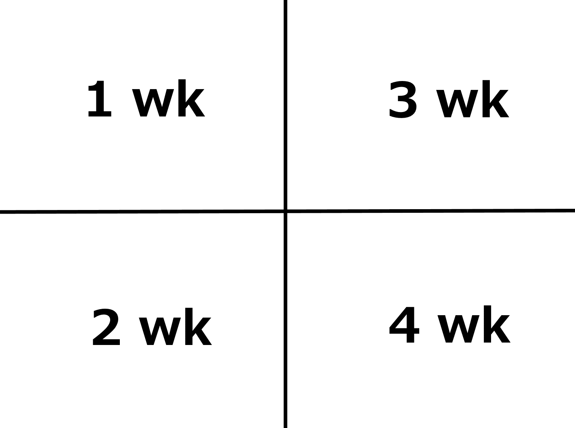
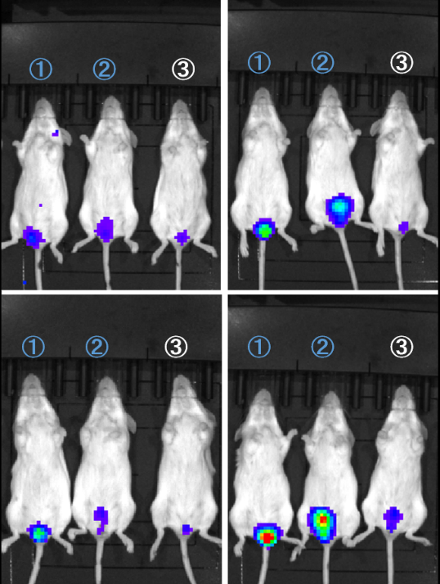
Fig. S6
Notes:
Supplementary Fig. 6 Effects of weekly repeat intravesical treatment with γδT cells in combination with 5 μM ZOL (on days 7, 14, 21, and 28) dissolved in 150 μl PBS in combination with 5 μM gemcitabine weekly pretreatment (on days 6, 13, 20, and 27) dissolved in 200 μl PBS by body i.p. Numbers in white denote γδT cell and ZOL intravesical-treated mice in combination with gemcitabine, whereas numbers in blue denote gemcitabine-treated and PBS intravesical injected mice. The bioluminescense intensity of mice in white numbers was markedly inhibited compared with that of those in blue at 4 weeks. Representative data from at least five experiments are shown.

