Slide 1
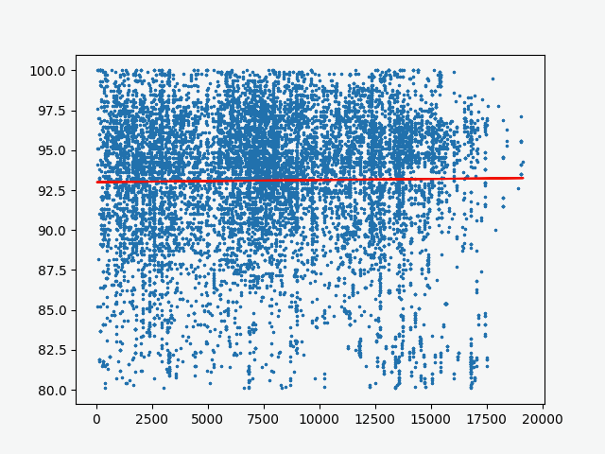
Pairwise 16s rRNA similarity
Pairwise distance isolated (miles)

