Slide 1
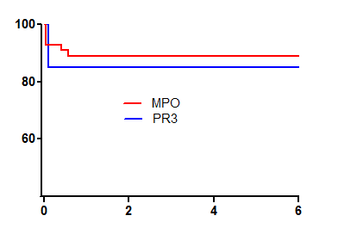
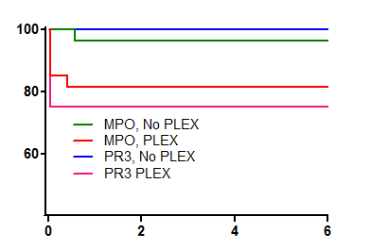
Renal Survival (%)
P= 0.62
Months
Number at risk
MPO 55 49 48 48
PR3 20 17 17 17
Renal Survival (%)
P= 0.11
Months
Number at risk
MPO, No PLEX 28 27 26 26 MPO, PLEX 27 22 22 22
PR3, No PLEX 8 8 8 8
PR3, PLEX 12 9 9 9

