Slide 1
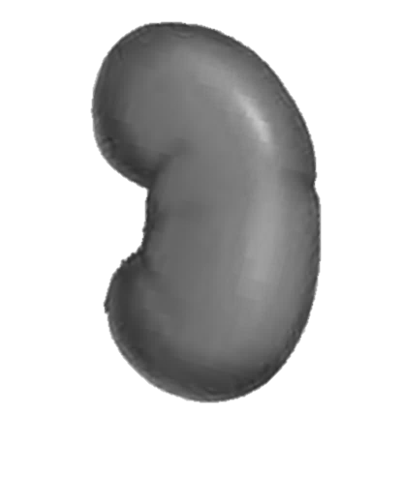
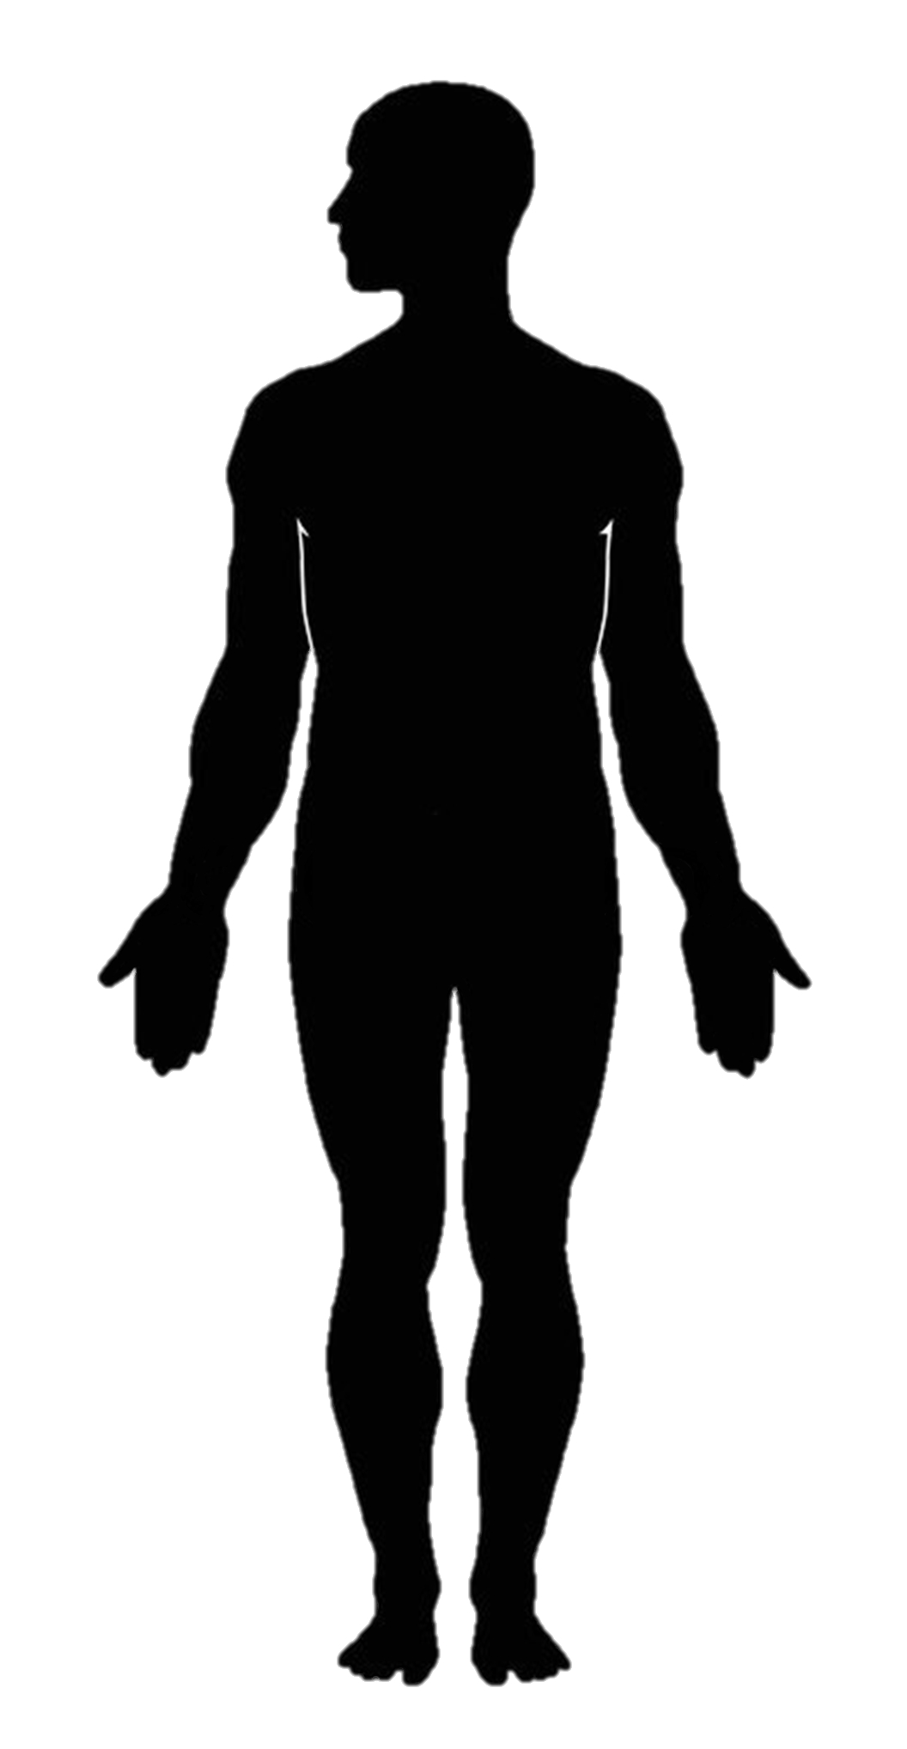

Figure S1
Kidney Biopsy
- Histological processing
- Microscopy
- Digitization
- Image resizing
- Image normalization
Inputs
Output
Labels
Model Training
Patient phenotype
CNN framework
(Inception V3)
Fine tuning:
Data augmentation
Sensitivity analysis
Clinical and Laboratory Charts
Trained CNN model
Model Testing
Prediction
Patient phenotype
New kidney biopsy image
(Figure S1) Flowchart representing the project workflow. A kidney biopsy from a patient is first obtained. Histological processing is performed on the biopsy followed by microscopy and biopsy slide digitization. The biopsy image is then resized and normalized and fed into the Inception V3 architecture as input for model training. Detailed clinical chart review is performed to extract clinical phenotypes of the same patient, serving as the categorical output for the CNN model. This process is repeated on all the patients in the registry with a kidney biopsy and a known clinical phenotype. Fine tuning operations are then performed to generate a trained CNN model. Testing phase involves using the trained CNN model to make predictions on a new kidney biopsy image that was not used for model training.

