Slide 1
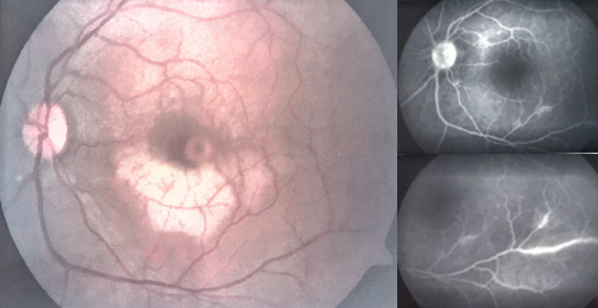
Image 2. Retinal Fluorangiography

