Slide 1
A
B
400
200
300
150
200
Glucose (mg/dL)
IRI (IU/mL)
100
100
50
0
0
0
15
30
60
90
120 (min)
0
15
30
60
90
120 (min)
Supplement Figure 1

Slide 2
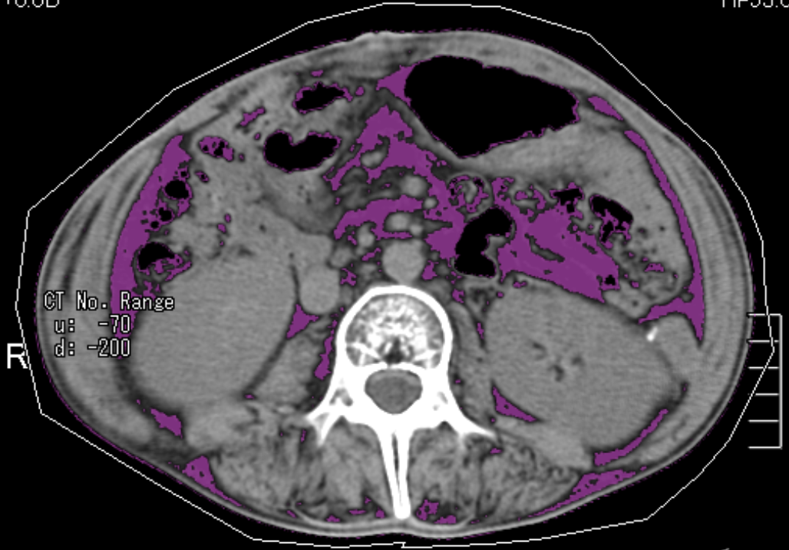
Supplement Figure 2

Slide 3
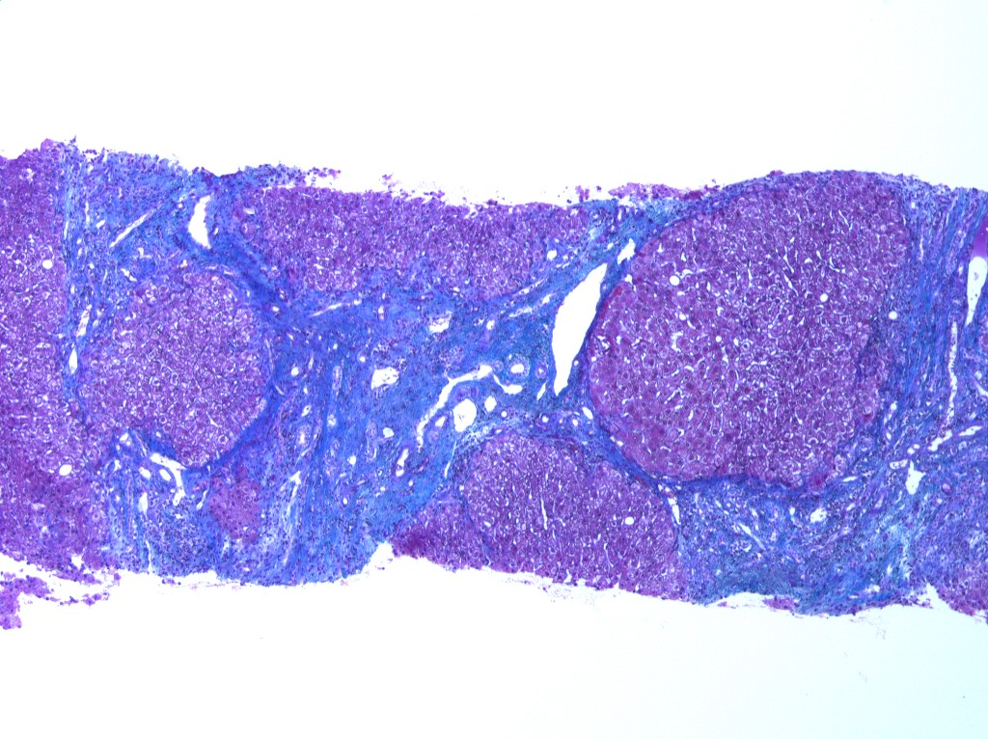
Supplemental Figure 3
Notes:
Azan stain

Slide 4
1.2
1.0
0.8
0.6
Relative expression
0.4
0.2
0
Cebpa
Cebpb
Cebpd
Pparg
Supplemental Figure 4

