Slide 1
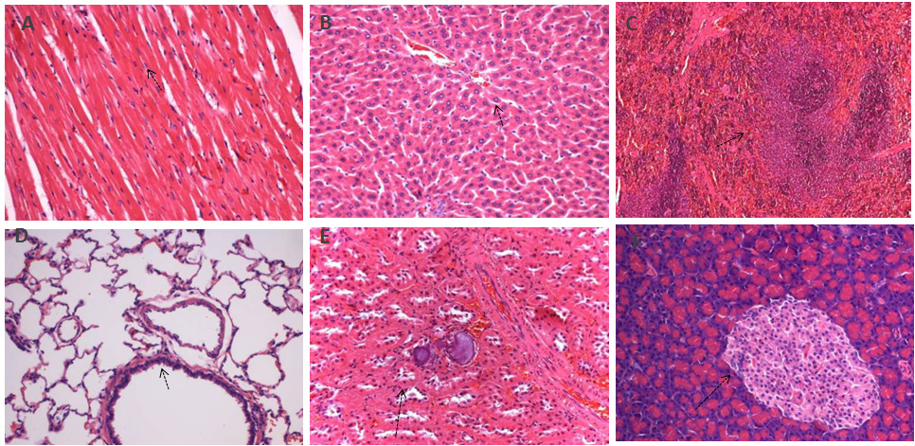
Fig.1 Histopathological analysis of organs stained with H&E
Histopathology showing normal morphology from the acute toxicity test. (A) heart, (B) liver, (C) spleen,
(D) lung, (E) kidney, (F) pancreas; scale bar = 100μm

Slide 2
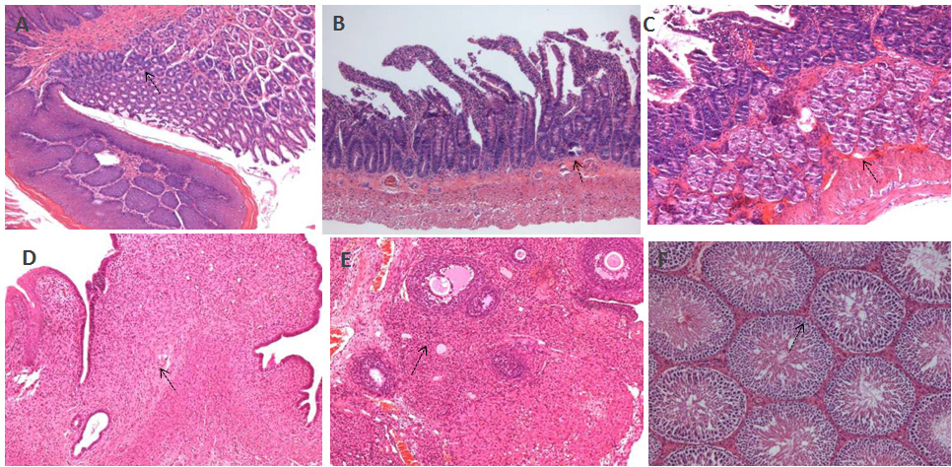
Fig.2 Histopathological analysis of organs stained with H&E
Histopathology showing normal morphology from the acute toxicity test. (A) stomach, (B) jejunum,
(C) duodenum, (D) uterus, (E) ovaries, (F) orchis; scale bar = 100 μm

Slide 3
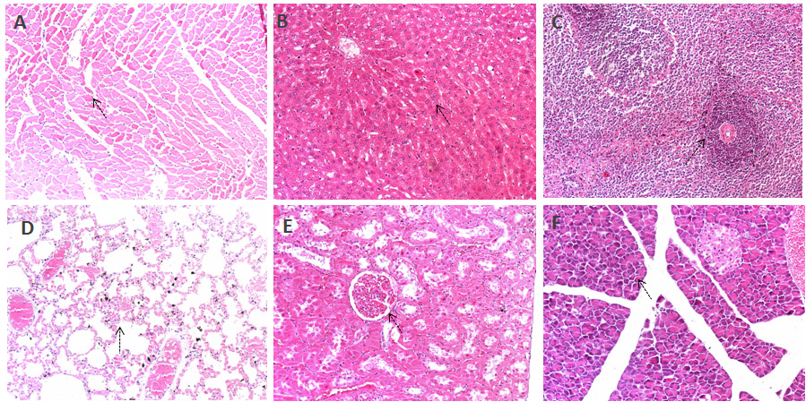
Fig.3 Histopathological analysis of organs stained with H&E
Histopathology showing normal morphology from eight dead rats. (A) heart, (B) liver, (C) spleen,
(D) lung, (E) kidney, (F) pancreas; scale bar = 100μm

Slide 4
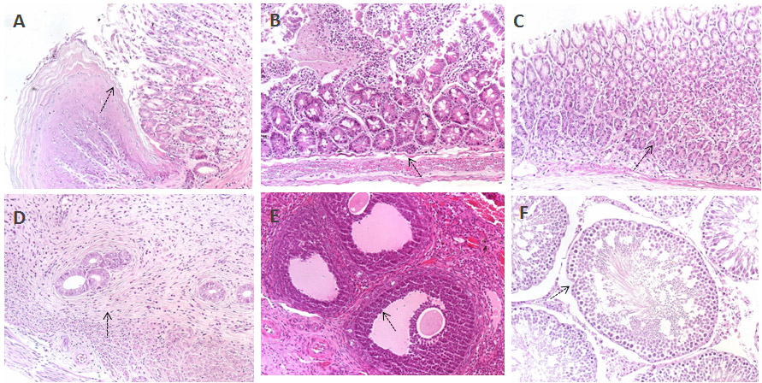
Fig.4 Histopathological analysis of organs stained with H&E
Histopathology showing normal morphology from eight dead rats. (A) stomach, (B) jejunum,
(C) duodenum, (D) uterus, (E) ovaries, (F) orchis; scale bar = 100 μm

