Slide 1
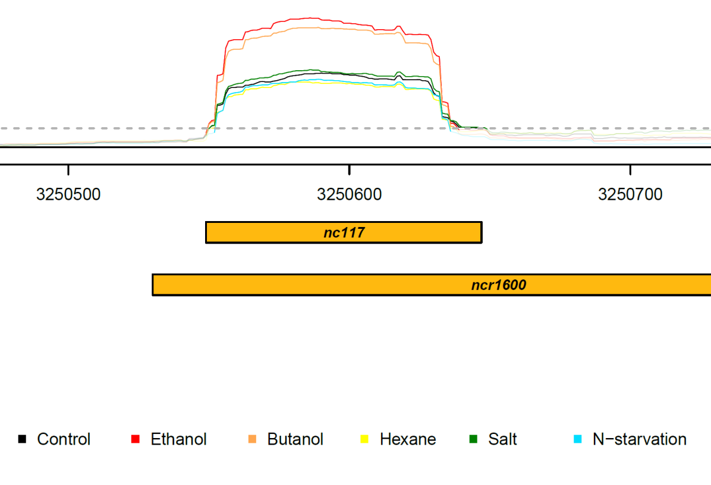
Suppl. Figure S1
nc117-before
ncr1600
5’ TSS reported
3’ RACE determined in this study
nc117-final
3250530
3250631

Slide 2
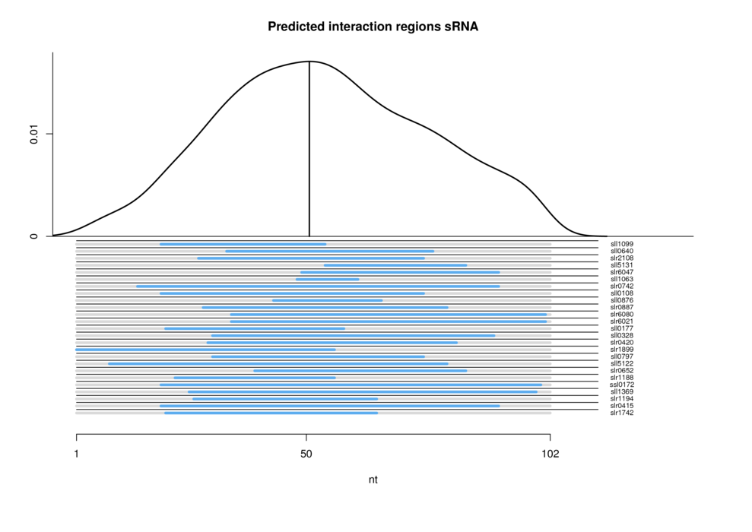
Suppl. Figure S2

Slide 3
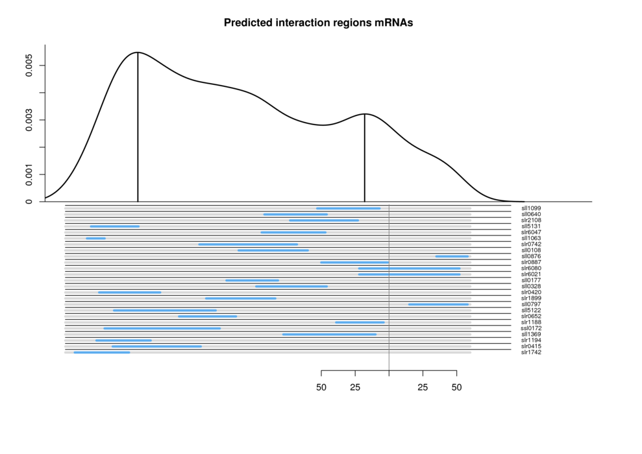
Suppl. Figure S3

