Slide 1
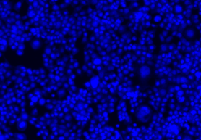
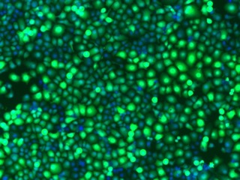
a
GFP
DAPI
Merge
b
c
HSC-2
d
Si-PRC1
Si-NC
Blank
Cal-27
f
g
e
Si-PRC1
Si-NC
Blank
HSC-2

