Slide 1
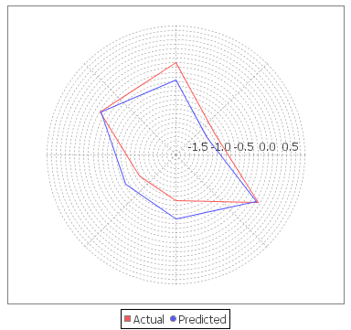
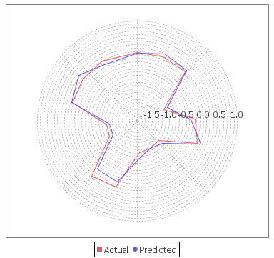
Supplementary Figures
A
B
Figure S1

Slide 2
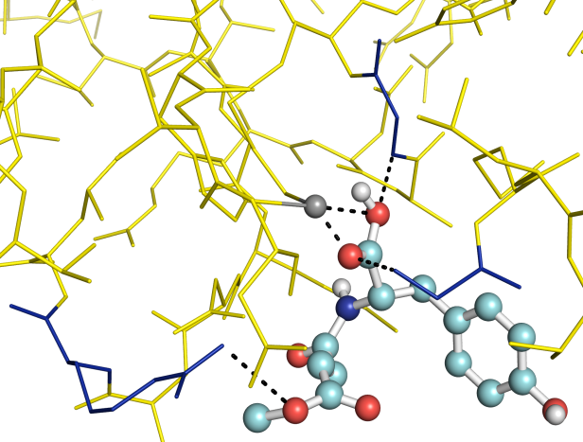
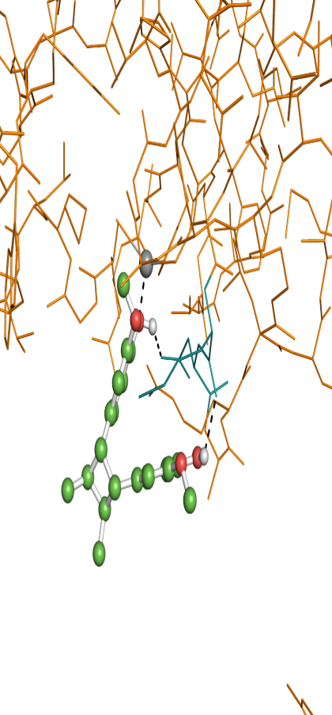
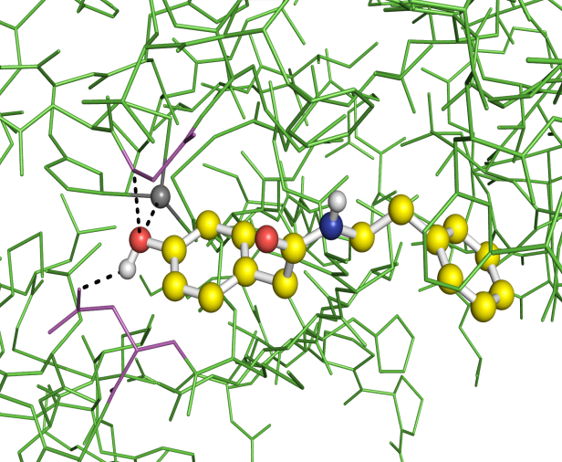
A
B
Zn2⁺
Gly60
2.1
Asp37
Zn2⁺
2.6
1.9
2.3
Met36
2.6
Gly92
2.1
Arg39
2.9
C
D
Gly92
2.9
Zn²⁺
2.0
2.3
Asp37
E
F
Figure S2

Slide 3
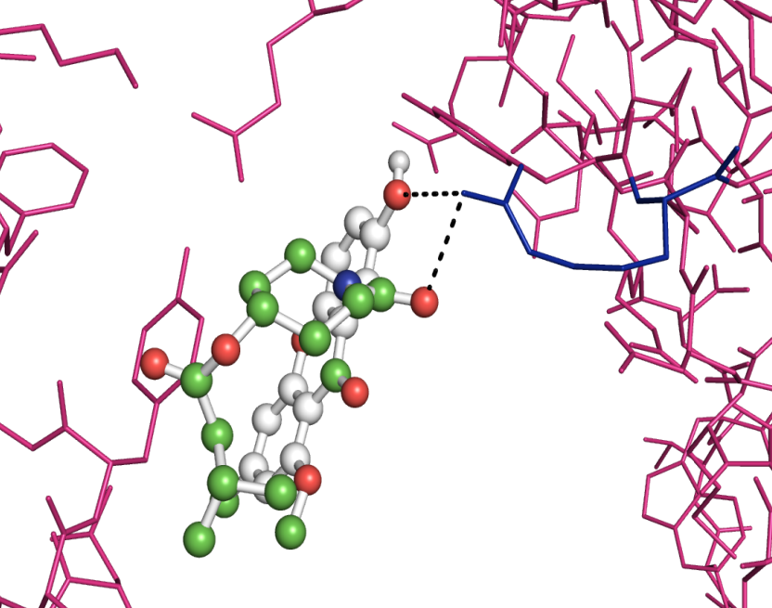
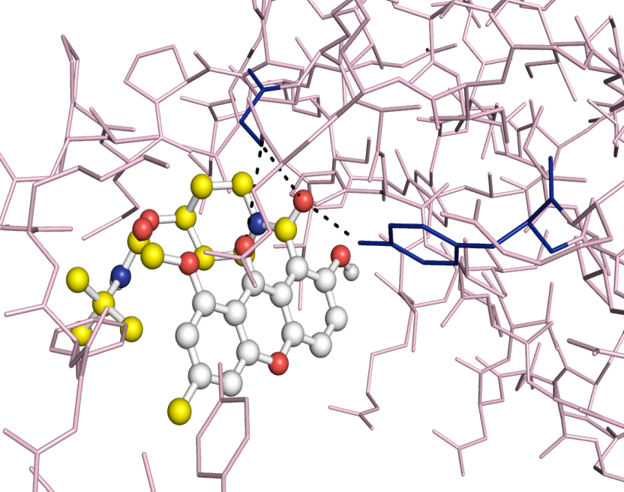
A
B
3.2
Gly51
3.4
3.4
3.2
3.1
Arg44
Tyr43
C
D
Figure S3

Slide 4
Secondary Structure
Structure = A-Helix + B-Sheet + B-Bridge + Turn
A
B
C
D
E
F
G
H
Figure S4

Slide 5
A
Native β-CA1
β-CA1-6B
β-CA1-P-25
β-CA1-P-50
β-CA1-INH
β-CA1-6A
β-CA1-12
β-CA1-15
B
C
D
Figure S5

