Slide 1
Table S1. Pathways tested and effects of specified drugs on IFN γ-stimulated NO production of M1 macrophages with and without 2-DG
Pathway | Drug (dose) | Effect without 2-DG | Effect with 2-DG
AMP-activated protein kinase | AICAR (0-2mM) Compound c (0-20uM) | ⬇ ⬇ | ⬇
Glycosylation | DON (0-100uM) | ⬆
Hydrgen preoxide | H2O2 (0-100uM) | ⬇ | ⬇
Substrates | Pyruvate (0-10mM) Lactate (0-20mM) | − ⬇
Mitogen-activated protein kinases | SB203580 (0-10uM) | ⬇ | ⬇
Reactive oxygen species | Tempo (0-10mM) Mito-tempo (0-500uM) | ⬇ ⬇
Mammalian target of rapamycin (mTOR) signaling pathway | Torin 2 (0-1uM) | ⬆ | ⬇
Phosphoinositide 3-kinases (PI3K) | Wortmannin (0-1000nM) | −
Protein Kinase C | Bisindolylmaleimide IV (0-1500nM) OAG (0-100uM) PMA (0-100nM) | ⬇ ⬇ | − −
Pentose phosphate pathway (PPP) | vas 2870 (0-20uM) | ⬇
⬆ increase, ⬇ decrease, − neutral effect on IFN γ-stimulated NO production

Slide 2
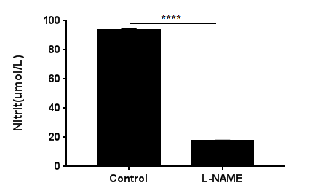
Figure S1
Notes:
Figure S1, related to Figure 1

Slide 3
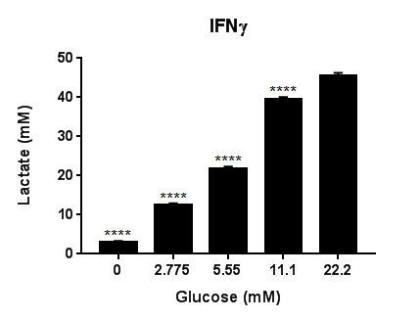
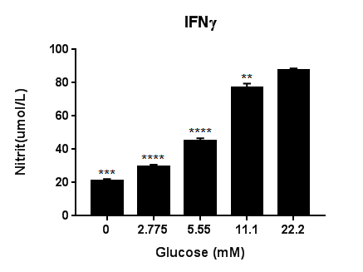

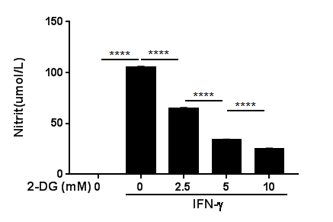
Figure S2
a
b
Glucose (mM) 0 2.775 5.55 11.1 22.2
c
LPS
IFN-γ
d
6h
12h
6h
12h
2-DG - - + - + - + - +
iNOS
HIF-1α
HK-Ⅱ
LDHa
β-actin
Raw264.7
Notes:
Figure S2, related to Figure 2

Slide 4









Figure S3
a
b
IFN-γ (min) 5 15 30 60 120 180
IFN-γ - + + +
2-DG - - + - + - + - + - + - +
2-DG(mM) 0 0 10 40
p-stat1
p-stat1
stat1
Raw264.7
stat1
β-actin
β-actin
c
d
IFN-γ (min) 30 60 180 360
IFN-γ (min) 30 60 180 360
2-DG (mM) 0 0 1.25 10 0 1.25 10 0 1.25 10 0 1.25 10
2-DG (mM) 0 0 5 40 0 5 40 0 5 40 0 5 40
iNOS
iNOS
p-stat1
p-stat1
stat1
stat1
GAPDH
GAPDH
Notes:
Figure S3, related to Figure 3

Slide 5
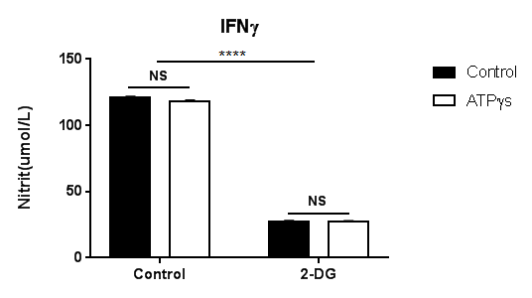
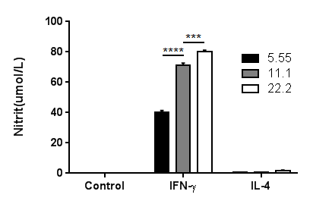
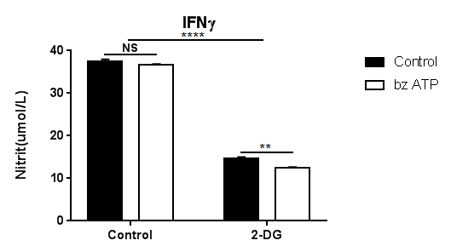
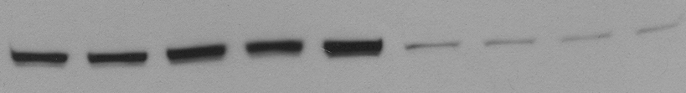

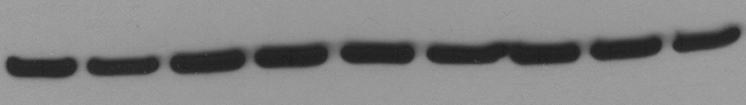
Figure S3
e
f
g
h
IFN-γ + + + + + + + + +
2-DG - - - - - + + + +
- oATP ATPγS BzATP ATP oATP ATPγ BzATP ATP
p-stat1
stat1
GAPDH
i
IFN-γ
Oligo - - - - - - - + + + + + +
Glu (mM) - 0 0.346875 0.69375 1.3875 2.775 11.1 0 0.346875 0.69375 1.3875 2.775 11.1
p-stat1
stat1
β-actin
Notes:
Figure S3, related to Figure3

Slide 6
Figure S4
a
b

Slide 7
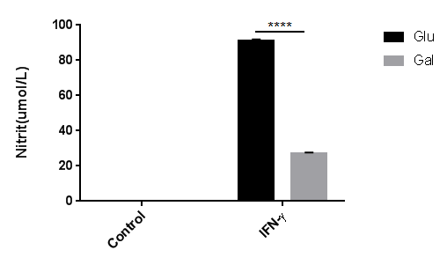
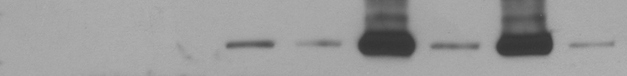
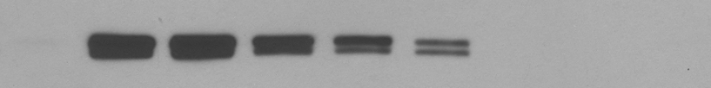
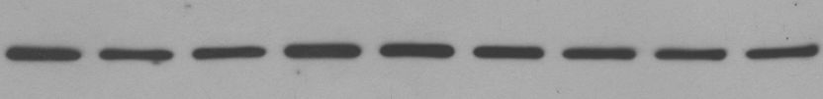
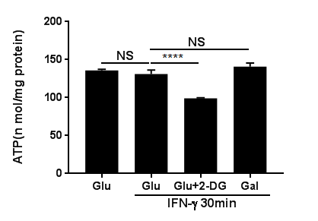
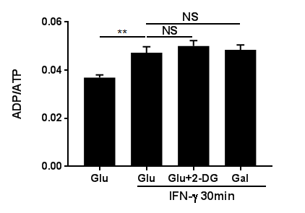
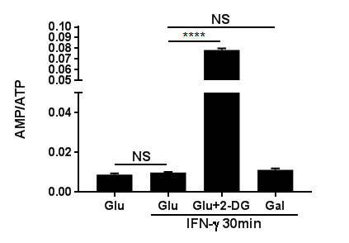
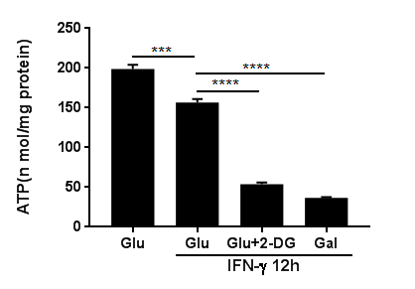
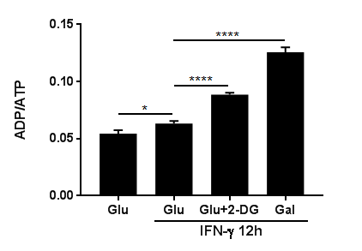
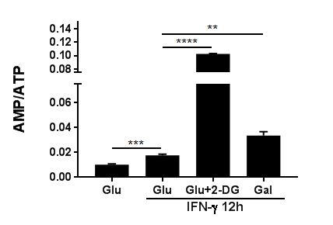
Figure S6
a
IFN-γ
b
Time (hour) 0.5 3 12 24
Glu Gal Glu Gal Glu Gal Glu Gal
iNOS
p-stat1
β-actin
c
d
e
f
g
h
Notes:
Figure S6, related to Figure 6

Slide 8
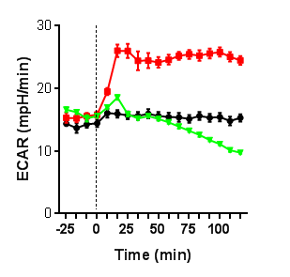
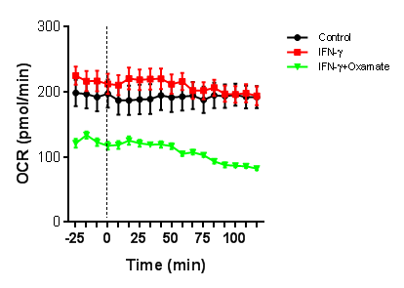
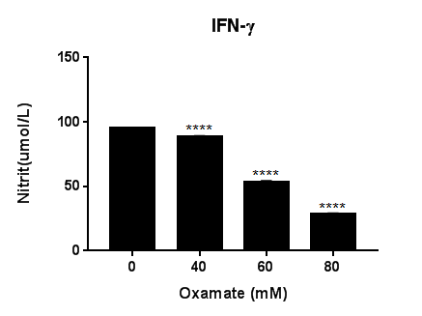


Figure S7
a
b
c
d
LPS
IFN-γ
6h
12h
6h
12h
oxamate - - + - + - + - +
iNOS
HIF-1α
HK Ⅱ
LDHa
β-actin
Notes:
Figure S7, related to Figure 7

Slide 9
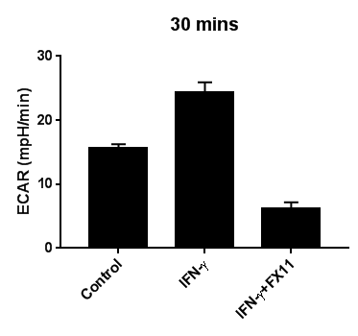

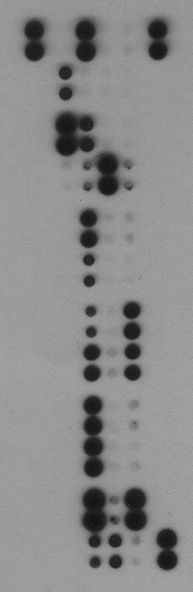
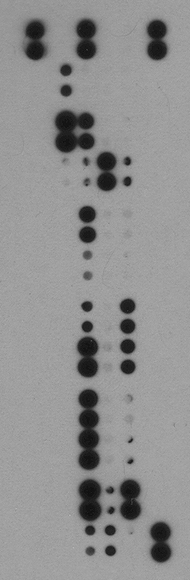

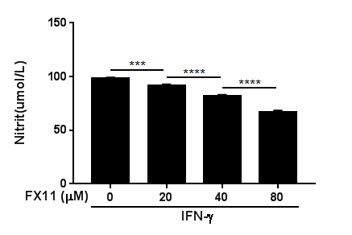



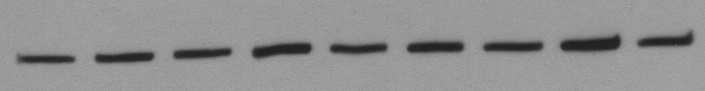





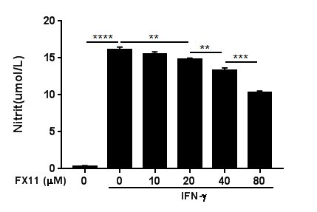





Figure S7
e
f
g
CXCL13
C5/C5a
G-CSF
CXCL1
CCL12
IL-1α
IL-1β
IL-27
Control FX11 [80uM]
IFN-γ
h
LPS
IFN-γ
i
j
6h
12h
6h
12h
LPS
IFN-γ
FX11 - - + - + - + - +
FX11 - - + - +
iNOS
iNOS
HIF-1α
HIF-1α
HK-Ⅱ
HK Ⅱ
LDHa
LDHa
IL-1β
β-actin
β-actin
RAW264.7
BMDM
k
l
m
IFN-γ (min) 30 60 180 360
IFN-γ
FX11 - - + - + - + - +
Time (min) 30 60 90
p-stat1
DMSO UK5099 DMSO UK5099 DMSO UK5099
stat1
p-stat1
β-actin
β-actin
Notes:
Figure S7, related to Figure 7

Slide 10
Table S1
Raw264.7 were stimulated with IFN-γ in the presence of the different concentrations of the indicated drugs for 18 hours, the supernatant was taken for nitric oxide tests. These experiments were done in the culture medium with 1g/L glucose.

Slide 11
Figure S1, related to Figure 1
Nitric oxide production of Raw264.7 cells after stimulation with IFN-γ for 18 hours with or without 1-hour pre-treatment with L-NAME (5mM). ****p<0.0001. Data are representative of three independent experiments (n=6, mean ± sem).

Slide 12
Figure S2, related to Figure 2
(a to d ). Lactate production (c, n=6) and nitric oxide production (d, n=6) of Raw264.7 cells after stimulation with IFN-γ for 18 hours in the presence of different glucose concentrations (0-22.2mM). ** p<0.01, *** p<0.001, **** p<0.0001. Data are representative of three independent experiments on nitric oxide production (mean ± sem).
(c). Immunoblot analysis of specified proteins in Raw264.7 cells after stimulation with LPS or IFN-γ for 6 or 12 hours +/- 1 hour pre-treatment with 2-DG (10mM). Data are representative of two independent experiments.
(d). Nitric oxide (NO) production by Raw264.7 after stimulation with IFN-γ for 18 hours with and without 1 hour pre-treatment with 2-DG (0-10mM). **** p<0.0001. Data are representative of three independent experiments (n=6, mean ± sem).

Slide 13
Figure S3, related to Figure 3
(a). Immunoblot analysis of specified proteins in Raw264.7 cells as a function of IFN-γ stimulation duration and 1 hour pre-treatment with vehicle or 2-DG (10mM). Data are representative of two independent experiments.
(b). Levels of specified proteins in Raw264.7 cells after stimulation with IFN-γ for 30 minutes with or without 1-hour pre-treatment with 2-DG at outlined concentrations.
(c) and (d). Levels of specified proteins in Raw264.7 cells, cultured in medium with 5.55mM (c) or 22.2mM (d) glucose, after stimulation with IFN-γ for the presented time intervals and different concentrations of 2-DG.
(e). Nitric oxide production of Raw264.7, unstimulated (control) or stimulated with IFN-γ or IL-4 for 18 hours in presence of different glucose concentrations . *** p<0.001. Data are representative of three experiments(n=6, mean ± sem).
(f and g). Nitric oxide production of Raw264.7 cells after stimulation with IFN-γ for 18 hours with or without 1-hour pre-treatment with 2-DG (10mM), ATPγs (f, n=6) or BzATP (g, n=4). **** p<0.0001; NS, no significant difference. Data are representative of two experiments. (mean ± sem).
(h). Levels of listed proteins in Raw264.7 cells stimulated with IFN-γ for 30 minutes with or without pretreatment with oATP (200uM), ATPγs (100uM), BzATP (100uM) and ATP (1mM) for 1 hour (±10mM 2-DG)
(i). Immunoblot analysis of specified proteins in BMDMs after stimulation with IFN-γ for 1 hour in medium containing different concentrations of glucose with or without 1 hour pre-treatment with oligomycin (1µM). Data are representative of two independent experiments.

Slide 14
Figure S4, related to Figure 4
(a). Cell viability of Raw264.7 after stimulation with IFN-γ for different time points with or without 1 hour pretreatment with 2-DG (10mM) or Fx11 (80μM). Data are representative of two independent experiments (n=6, mean ± sem)
(b). Cell viability of BMDMs after stimulation with IFN-γ in medium containing glucose or galactose or no glucose at the indicated time intervals. Data are representative of two independent experiments (n=6, mean ± sem)

Slide 15
Figure S6, related to Figure 6
(a). Levels of specified proteins in Raw264.7 cells after stimulation with IFN-γ for indicated time intervals in medium containing glucose or galactose. Data are representative of two independent experiments.
(b). Nitric oxide (NO) production by Raw264.7 after stimulation with IFN-γ for 18 hours in medium containing glucose or galactose. Data are representative of two independent experiments.
(c)-(e). ATP production and ratios of ADP/ATP and AMP/ATP of Raw264.7, measured by HPLC, after stimulation with IFN-γ for 30 minutes +/- 1 hour pre-treatment with glucose, glucose+2-DG (10mM) or galactose. Data are represent as mean ± sem (n=5).
(f)-(h). ATP production and ratios of ADP/ATP and AMP/ATP of Raw264.7, measured by HPLC, after stimulation with IFN-γ for 1 hour +/- 1 hour pre-treatment with glucose, glucose+2-DG (10mM) or galactose. Data are represent as mean ± sem (n=5).

Slide 16
Figure S7, related to Figure 7
(a) and (b). Real-time changes in ECAR (a) and OCR (b) of BMDMs, unstimulated (control) or stimulated with IFN-γ with and without pretreatment with 80mM Oxamate for 1 hour, vertical line indicates time of injection of IFN-γ. Data are representative of two independent experiments (n=5, mean ± sem)
(c). Levels of specified proteins in Raw264.7 cells after incubation with LPS or IFN-γ for 6 or 12 hours +/-1 hour pre-treatment with oxamate (80mM)
(d). NO production by Raw264.7 after stimulation with IFN-γ for 18 hours +/- 1 hour pre-treatment with oxamate (0-80mM). **** p<0.0001. Data are representative of two independent experiments(n=6, mean ± sem).
(e) and (f). ECAR of BMDMs after stimulation with LPS (e, n=5) or IFN-γ (f, n=5) for 30 minutes +/- 1 hour pre-treatment with FX11 (80uM).
(g). Cytokine production of BMDMs after stimulation with LPS or IFN-γ for 18 hours +/- 1 hour pre-treatment with FX11 (80uM).
(h). Immunoblot analysis of specified proteins in Raw264.7 cells after stimulation with LPS or IFN-γ 6 or 12 hours +/- 1 hour pre-treatment with FX11 (80uM). Data are representative of two independent experiments.
(i). Immunoblot analysis of specified proteins in BMDMs after stimulation with LPS or IFN-γ for 12 hours +/- 1 hour pre-treatment with FX11 (80uM). Data are representative of two independent experiments.
(j). NO production of Raw264.7 cells (n=6) after stimulation with IFN-γ for 12 hours +/- 1 hour pre-treatment with FX11 (80uM). *** p<0.001, **** p<0.0001. . Data are representative of four independent experiments(n=6, mean ± sem).
(k). NO production of BMDMs (n=4) after stimulation with IFN-γ (n=4) for 18 hours +/- 1 hour pre-treatment with FX11 (80uM). * p<0.05, ** p<0.01, *** p<0.001, **** p<0.0001. Data are representative of two independent experiments (mean ± sem).
(l). Immunoblot analysis of specified proteins in BMDMs as a function of time of IFN-γ stimulation +/- 1 hour pre-treatment with FX11 (80uM). Data are representative of two independent experiments.
(m). Levels of specified proteins in Raw264.7 cells after stimulation with IFN-γ for indicated time intervals +/- 1-hour pre-treatment with UK5099 (100uM)

