Slide 1
Supplementary Figure S1

Slide 2
Supplementary Figure S2

Slide 3
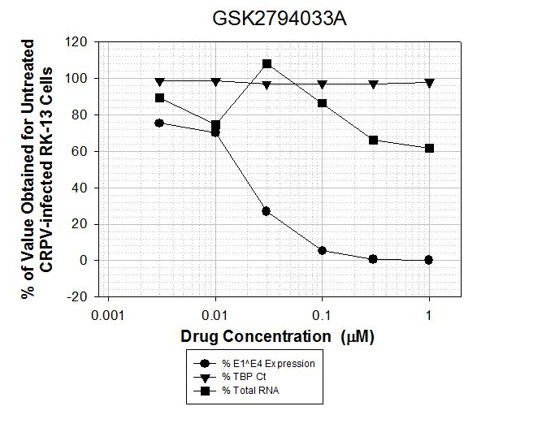
Supplementary Figure S3
A. Effect on HPV11 E1^E4 mRNA and Total RNA ( 1µM, n=1)
 | HPV11 E1^E4 mRNA (% inhibition) | Total cell RNA (% inhibition)
GSK 2794033A | 100 | 33.5
Data show percent inhibition calculated relative to cultures infected with virus alone.
B. Effect on CRPV E1^E4 mRNA and Total RNA ( Titration, n=1)

Slide 4
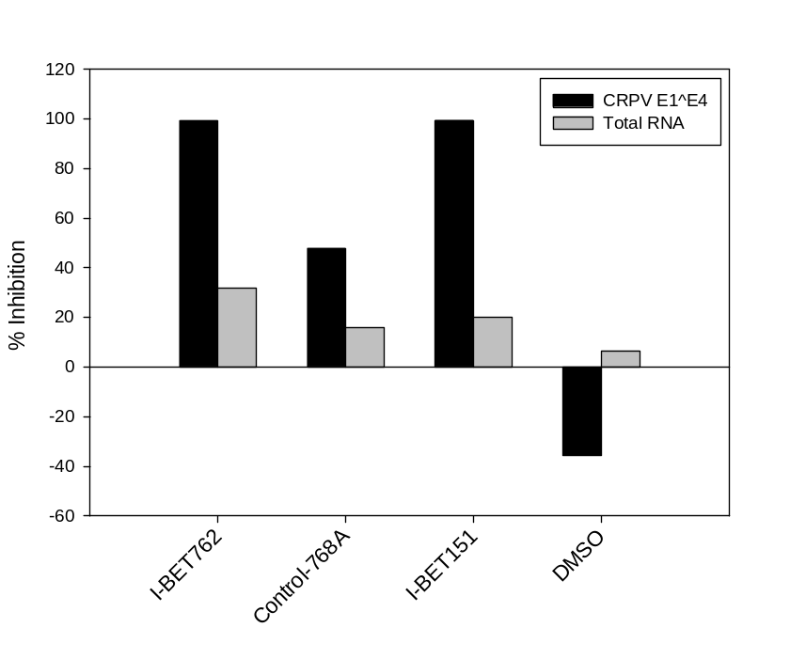
Supplementary Figure S4
A
B

Slide 5
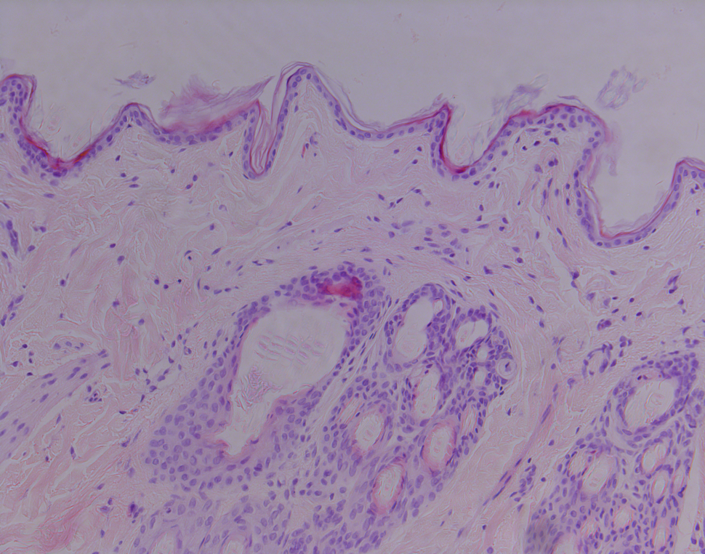
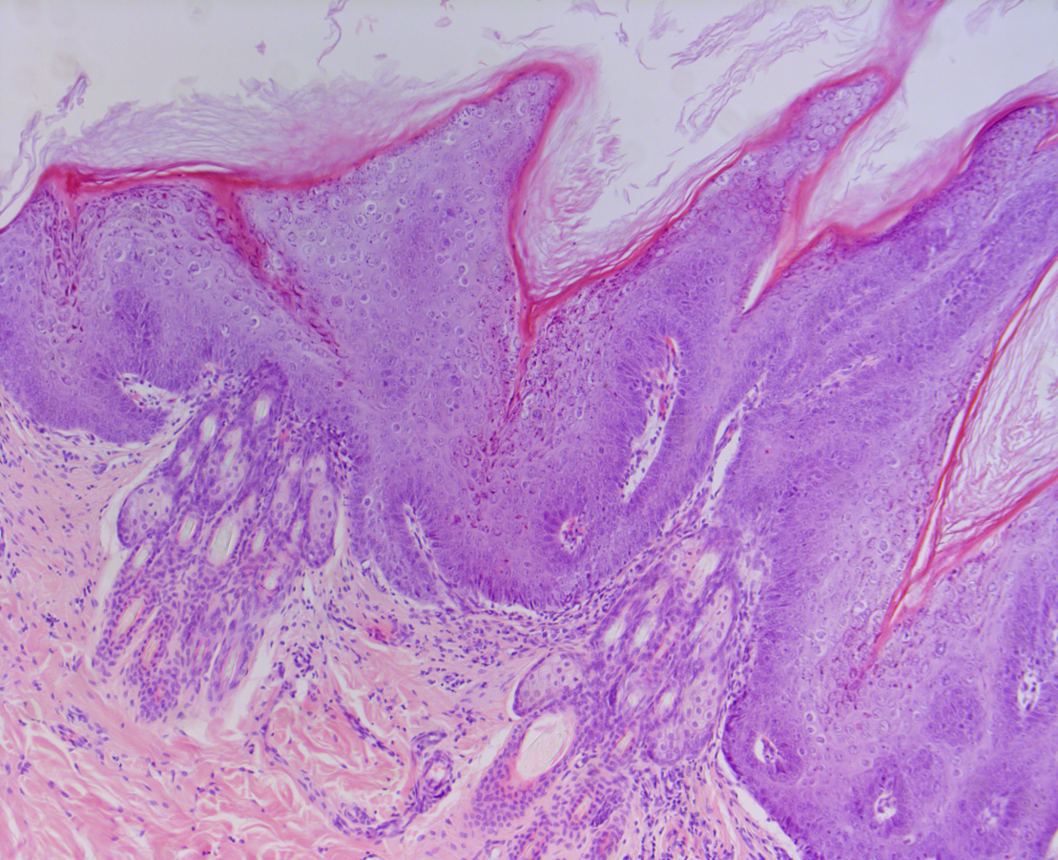
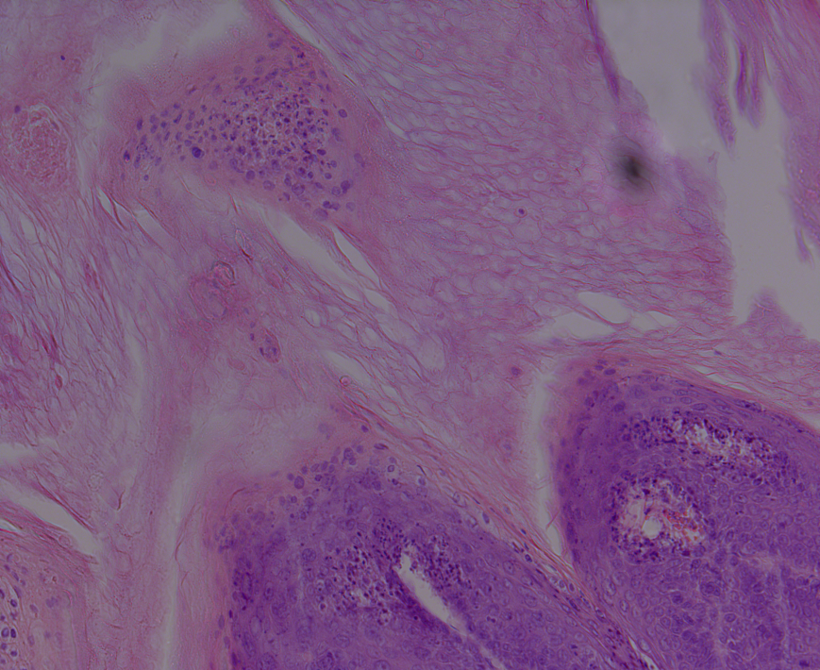
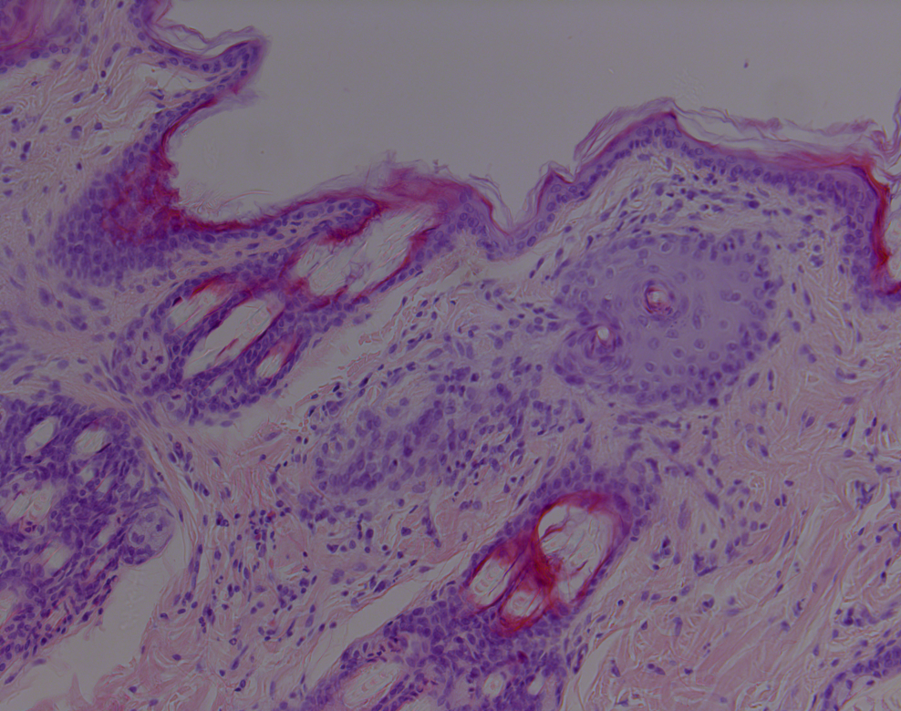
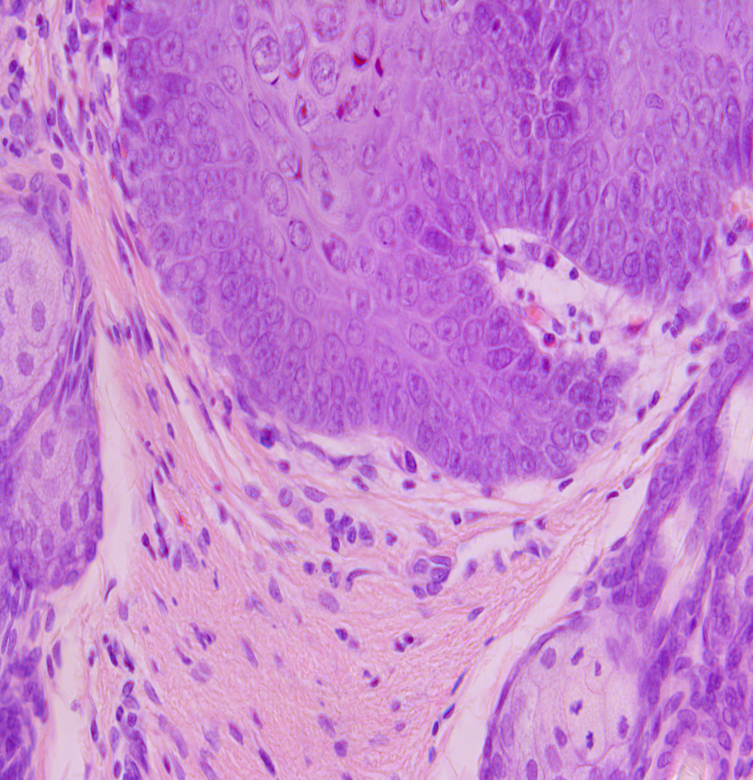
Supplementary Figure S5
3422L1
wtCRVP papilloma treated with vehicle
3425L1
wtCRPV papilloma treated with vehicle
Naïve skin histology
4
5
2
4
1
2
3
3415L1
Wt-CRPV papilloma treated 1.5% (w/v) I-BET762
Example sections to illustrate histopathology
Key:
1 = Cell infiltrate located in the upper dermis / epidermal area (widespread)
2 = Acanthosis / Epidermal thickening
3 = Presence of Koilocytes
4 = Thickening of stratum corneum
5 = Parakeratosis
40x magnification of Green
highlighted area
3
1

Slide 6
Supplementary Figure S6

Slide 7
Supplementary Figure S7

