Slide 1
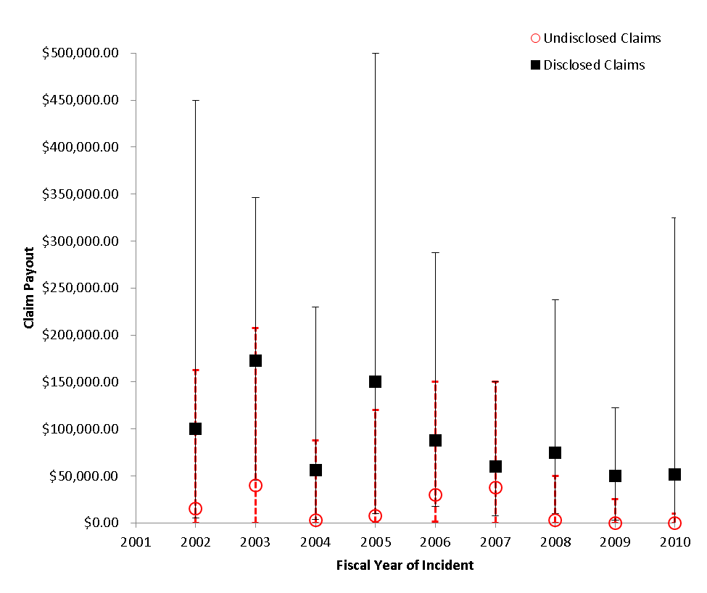
Appendix D Distribution of malpractice claim payout for closed claims by serious event disclosure status.

