Slide 1
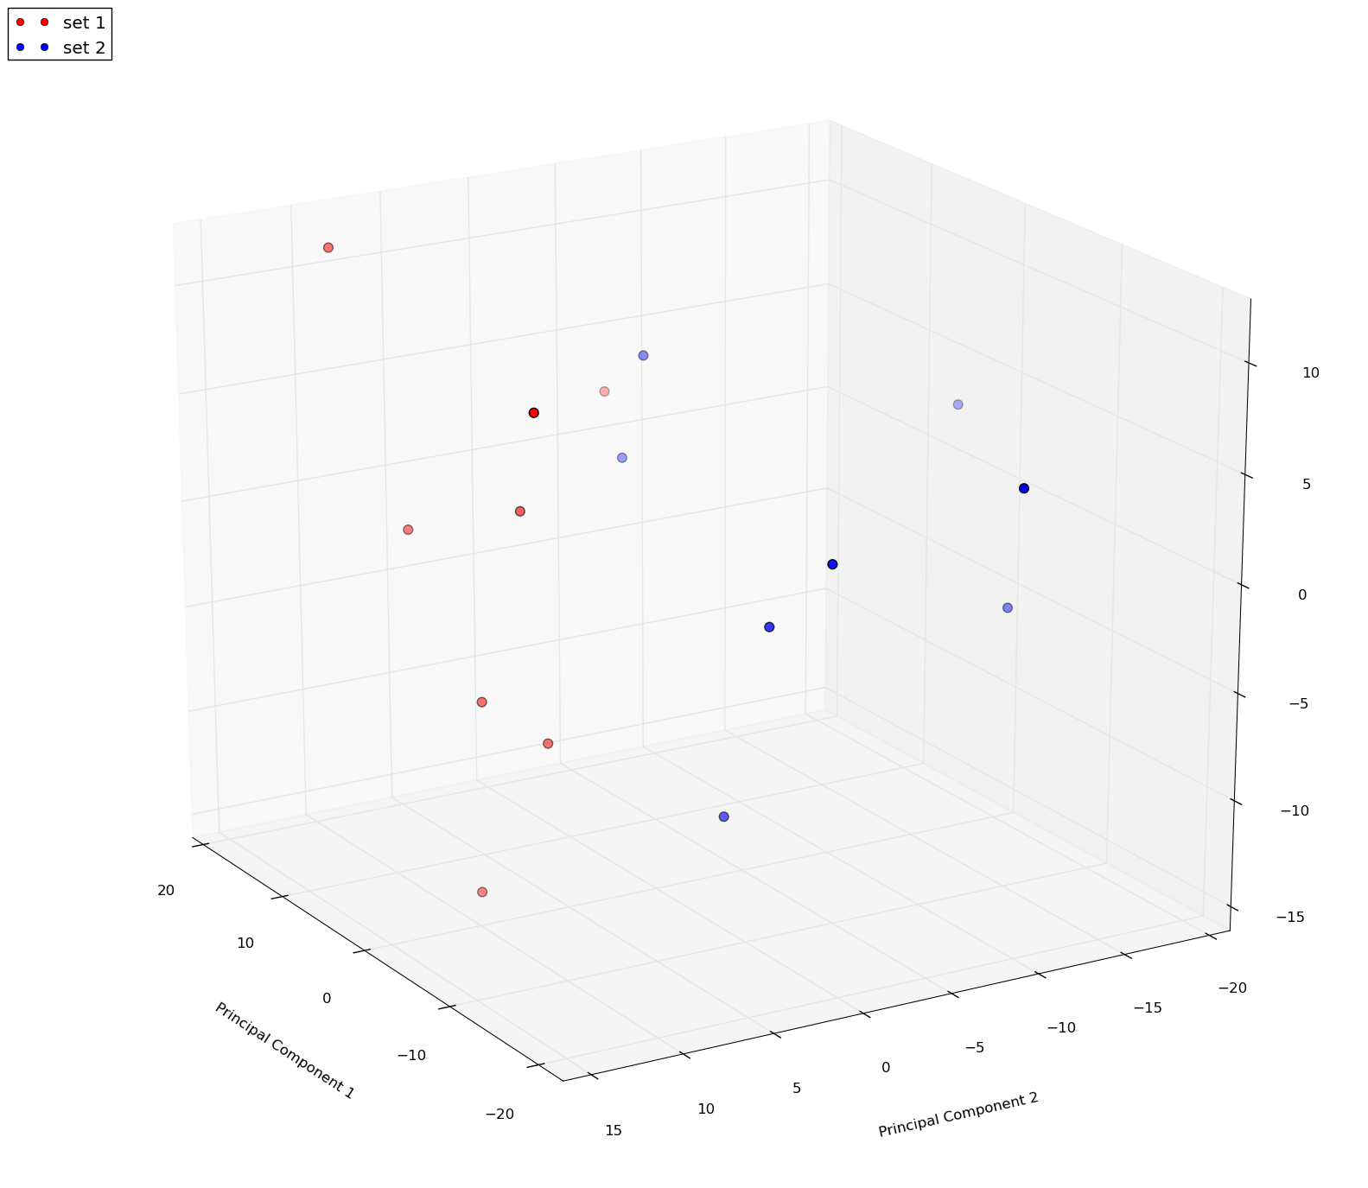
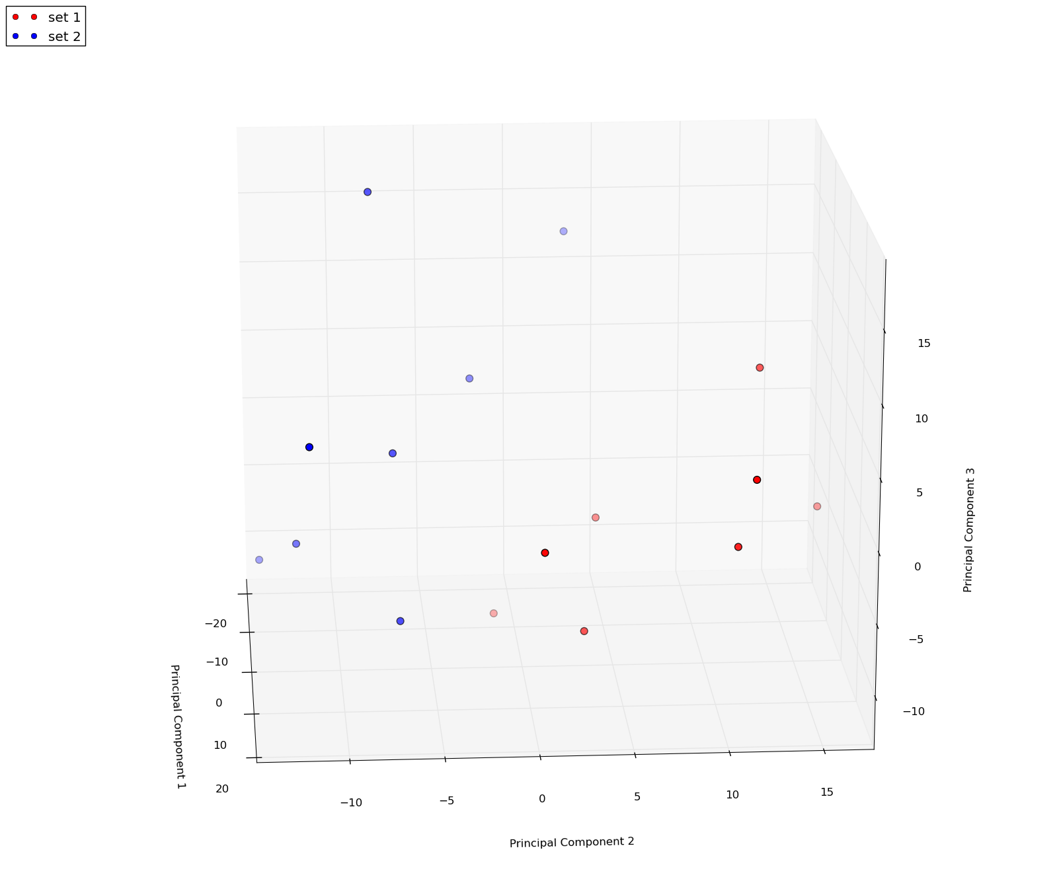
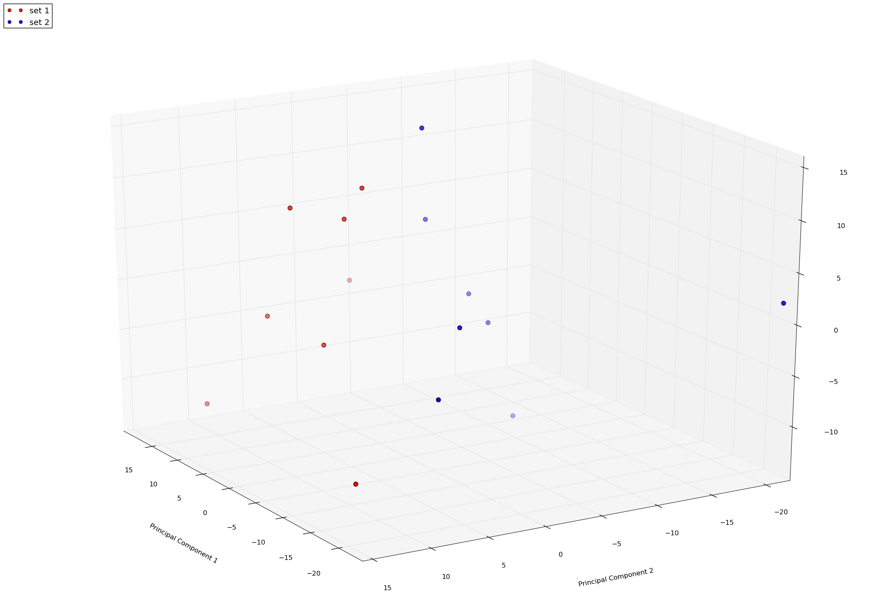
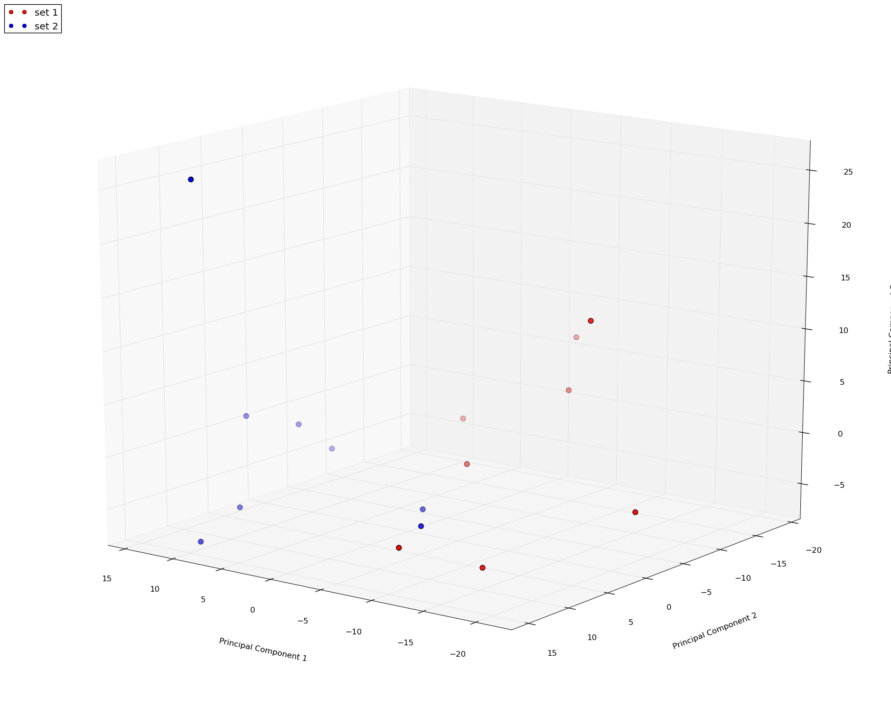
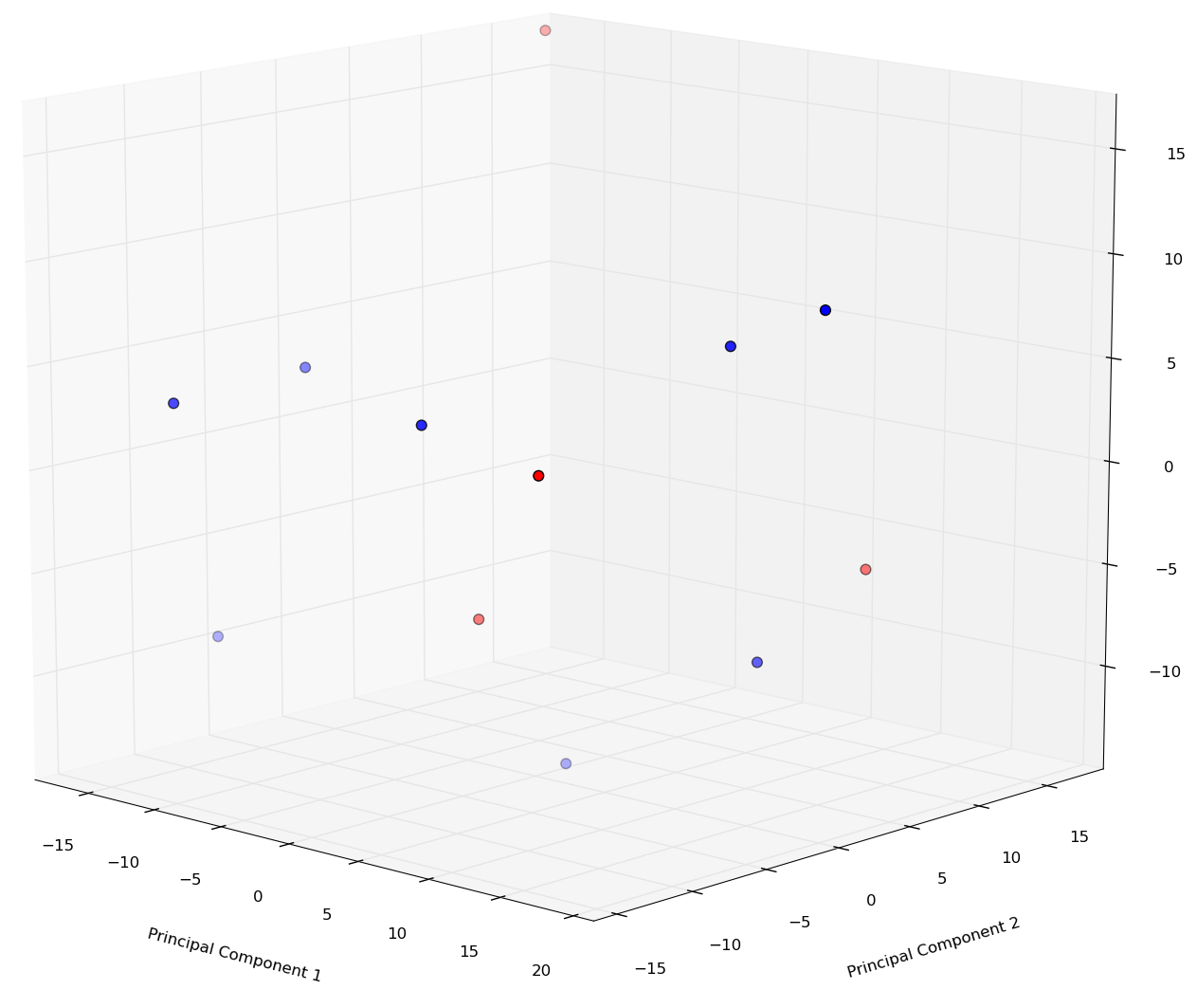
No GT3
GT3
Control
12 h
Control
12 h
Control
24 h
24 h
Control
GT3 no radiation
Control
Supplementary Figure 1. Unsupervised principal component analysis scores plots of nonhuman primate serum water-soluble metabolites exposed to ionizing radiation (ESI+).

