Slide 1
% Live cells
s
Dose (ng/ul) →
% Live cells
s
Dose (ng/ul) →
Suppl Figure 1. Cellular toxicity of OPCs and GSE 24h post-treatment at various doses as measured by Trypan Blue test

Slide 2
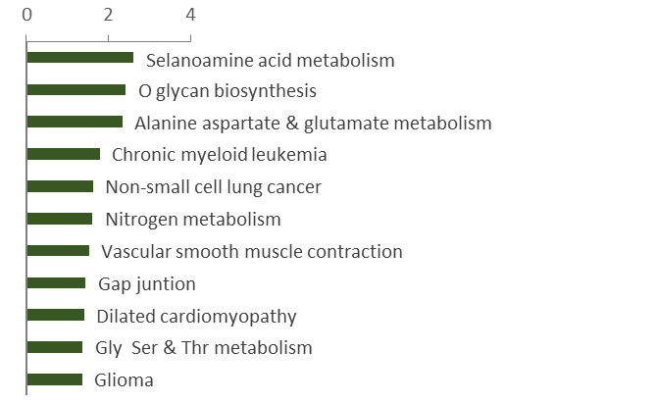
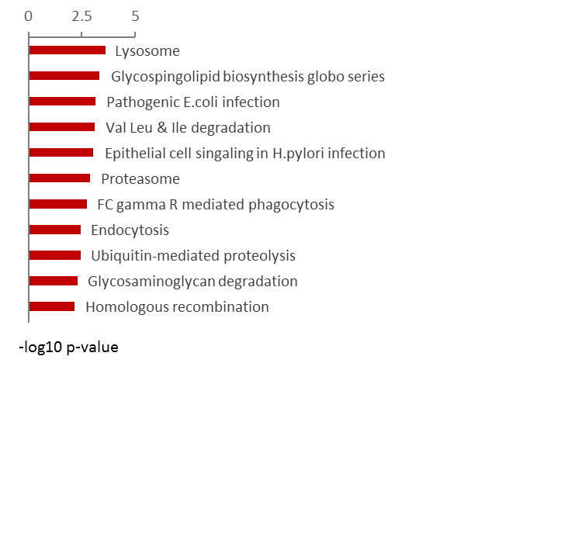
A. OPCs-regulated pathways
B. GSE-regulated pathways
-log10 p-value
Suppl Figure 2. Top pathways regulated by OPCs and GSE in 5 cell lines.

Slide 3
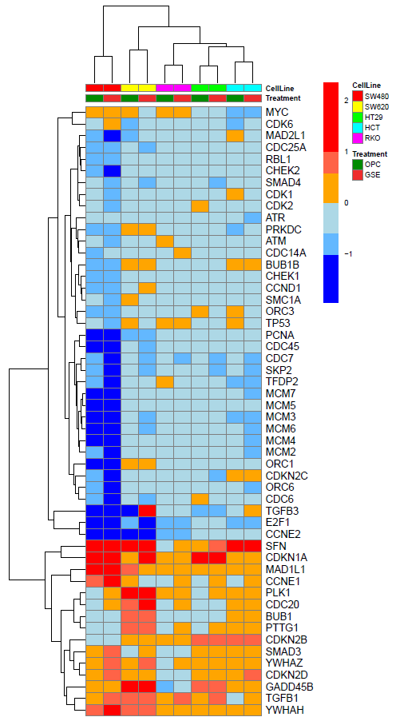
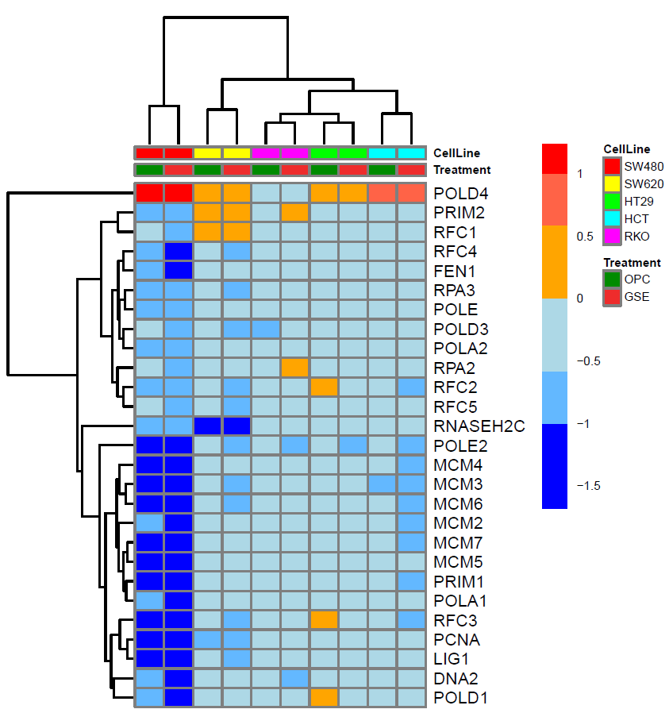
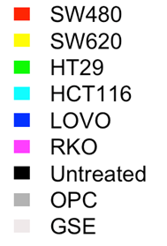
DNA Replication genes
A. Cell cycle
B.
OPCs
GSE
Suppl Figure 3: Oncoprints obtained by unsupervised clustering shows top genes regulated by OPCs and GSE in KEGG cell cycle and DNA replication pathways across all 5 CRC cell lines

Slide 4
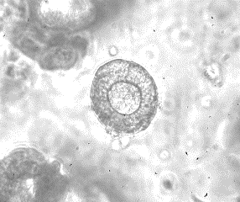
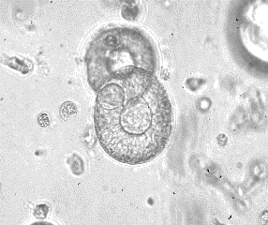
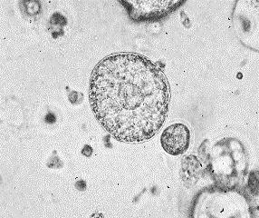
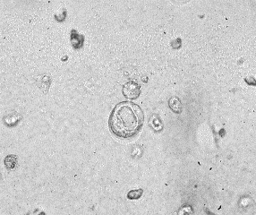
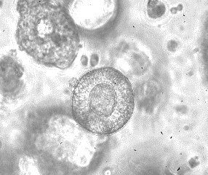
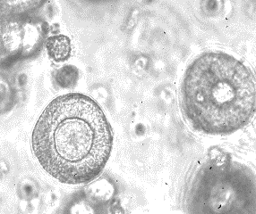
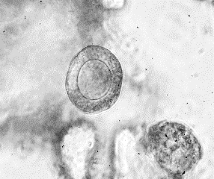
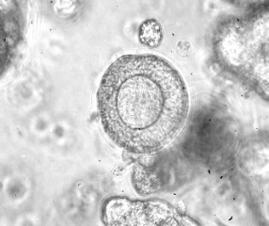
0 50 100 200
OPCs
GSE
Suppl Figure 4: Representative images of the organoids showing decrease in organoid size with OPCs- and GSE-treatments at different doses (indicated in ng/ul)

Slide 5
Cell line | MSI status | CIN | KRAS | BRAF | PI3K | TP53
SW480 | MSS | + | G12V | - | - | R273H; P309S
HT29 | MSS | + | - | V600E | P449T | R273H
SW620 | MSS | + | G12V | - | - | R273H; P309S
HCT116 | MSI | - | G13D | - | H1047R | -
RKO | MSI | - | wt | V600E | H1047R | -
LoVo | MSI | - | G13D, A14V | - | - | -
Suppl Table 1: Genetic features of the colon cancer cell line used in the study.
Abbreviations: CIN- Chromosomal instability, MSI- Microsatellite instability, MSS- Microsatellite instability

Slide 6
ZEB1-F | tgtggggtgtgagaacttga
ZEB1-R | tctgaatctgaatttgtttctacca
ZEB2-F | cgcagtgacacagccattat
ZEB2-R | gttccaggtggcaggtca
MMP2-F | ccccaaaacggacaaagag
MMP2-R | cttcagcacaaacaggttgc
EZH2-F | tgtggatactcctccaaggaa
EZH2-R | gaggagccgtcctttttca
WNT5A-F | agaacggcaagggagagg
WNT5A-R | ggcgtgattgtgcaaaaga
SNAI1-F | tacagcgagctgcaggact
SNAI1-R | atctccggaggtgggatg
E-cadherin-F | tggaggaattcttgctttgc
E-cadherin-R | cgctctcctccgaagaaac
PTEN-F | gcacaagaggccctagatttc
PTEN-R | cgcctctgactgggaatagtt
SFN-F | ccgaggtgcgtgagtacc
SFN-R | ggcctccttgatgaggtg
CDKN1A-F | aggtggacctggagactctcag
CDKN1A-R | tcctcttggagaagatcagccg
MAD1L1-F | cgggagatgagagagaccaa
MAD1L1-R | aaccagcgtctcctgcat
CCNE2-F | ccgtttacaagctaagcagca
CCNE2-R | tcttggcctggattatctgg
E2F1-F | aagggattggaggcgtaga
E2F1-R | cgccagtcaaactggtctc
TGFB3-F | caacactctgaaccctgaagc
TGFB3-R | ggtcctcccaacatagtacagg
Suppl Table 2: qPCR primer sequences used in the study

