Slide 1
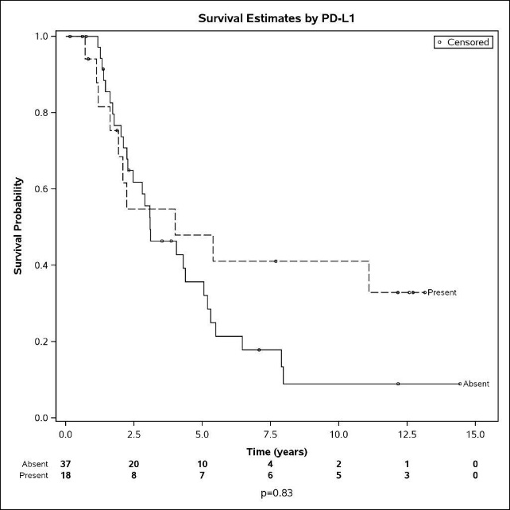
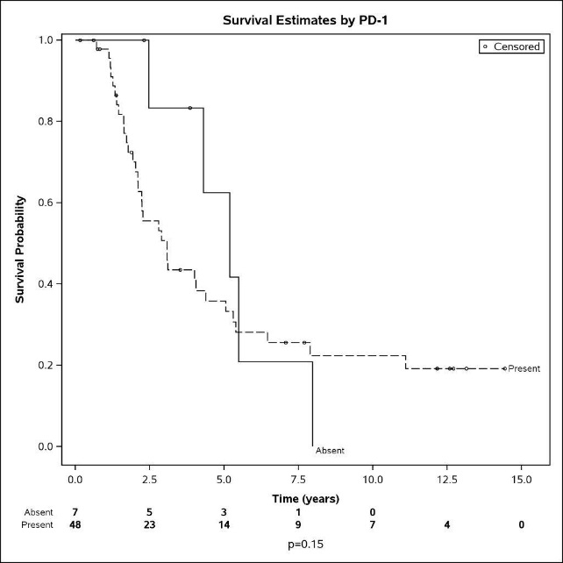
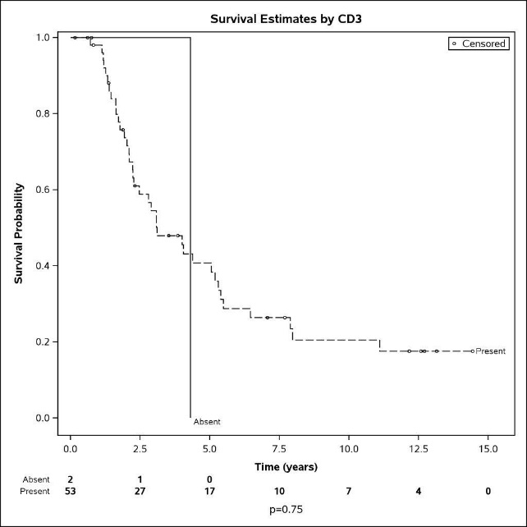
A
B
C
Additional file 3- Figure S2. Survival estimates by expression of immune molecules. Kaplan Meier survival analysis to estimate overall survival in patients expressing PD-L1 (A), PD-1 (B) and CD3 (C) in tumor sections.

