Slide 1
Supplemental Figure 1
A
B
C
D
E
F

Slide 2
Supplemental Figure 2
A
B

Slide 3
Supplemental Figure 3
A
B
C
D
E

Slide 4
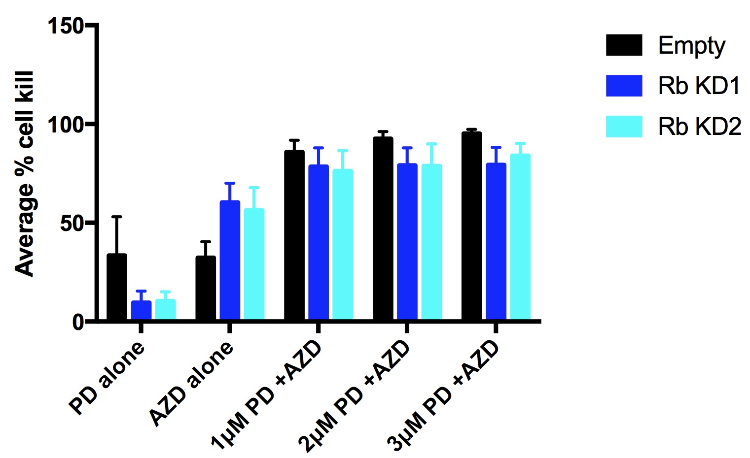
Supplemental Figure 4

Slide 5
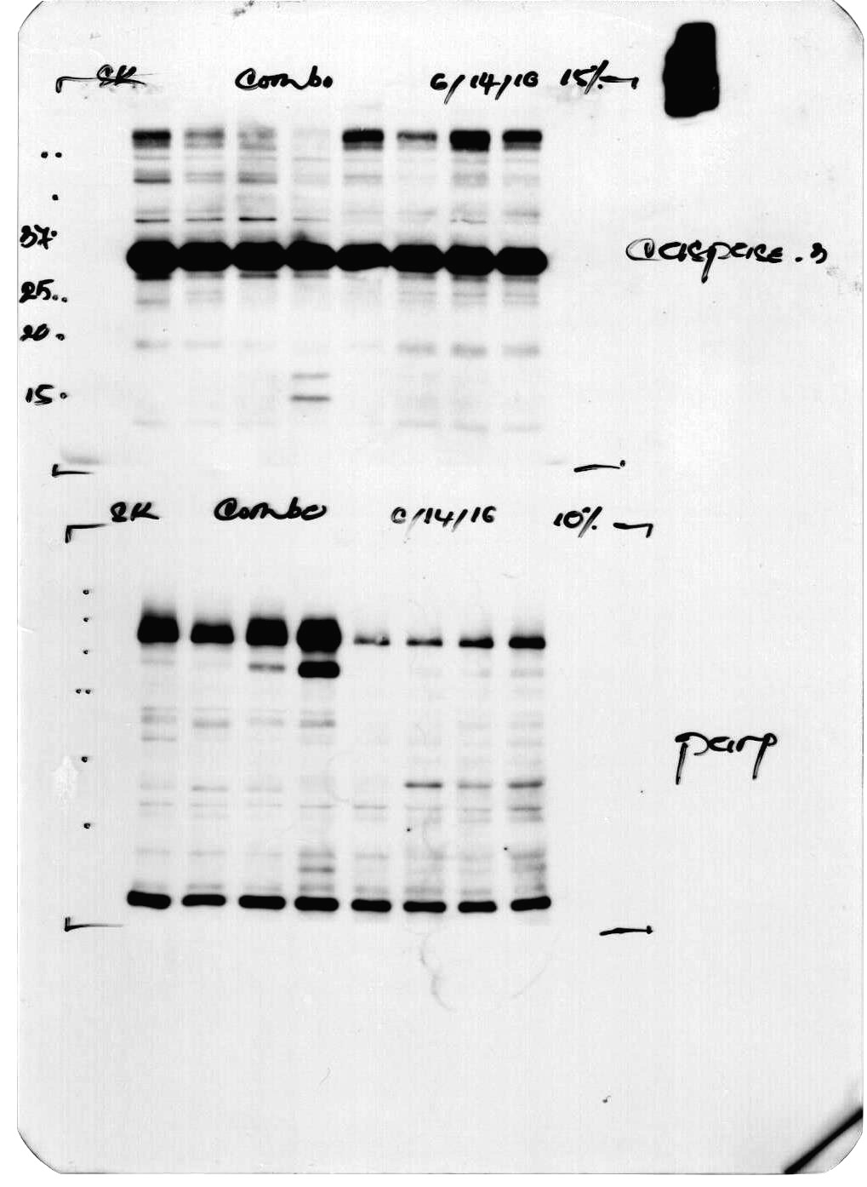
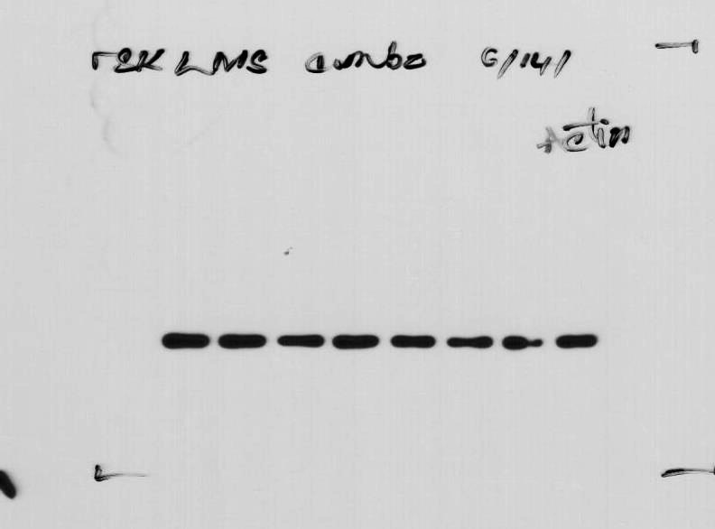
Supplemental Figure 5
Palbociclib
-
+
-
-
+
+
+
+
AZD-1775
-
-
+
-
+
+
+
+
Staurosporine
-
-
-
+
-
-
-
-
# hours recovery
for combination
0
9
12
24
PARP
Caspase-3
Actin
Ratio of cleaved PARP/total PARP
1.0
0.5
2.1
8.5
0.8
2.3
1.5
2.1

Slide 6
Supplemental Figure 6
A
B

