Slide 1
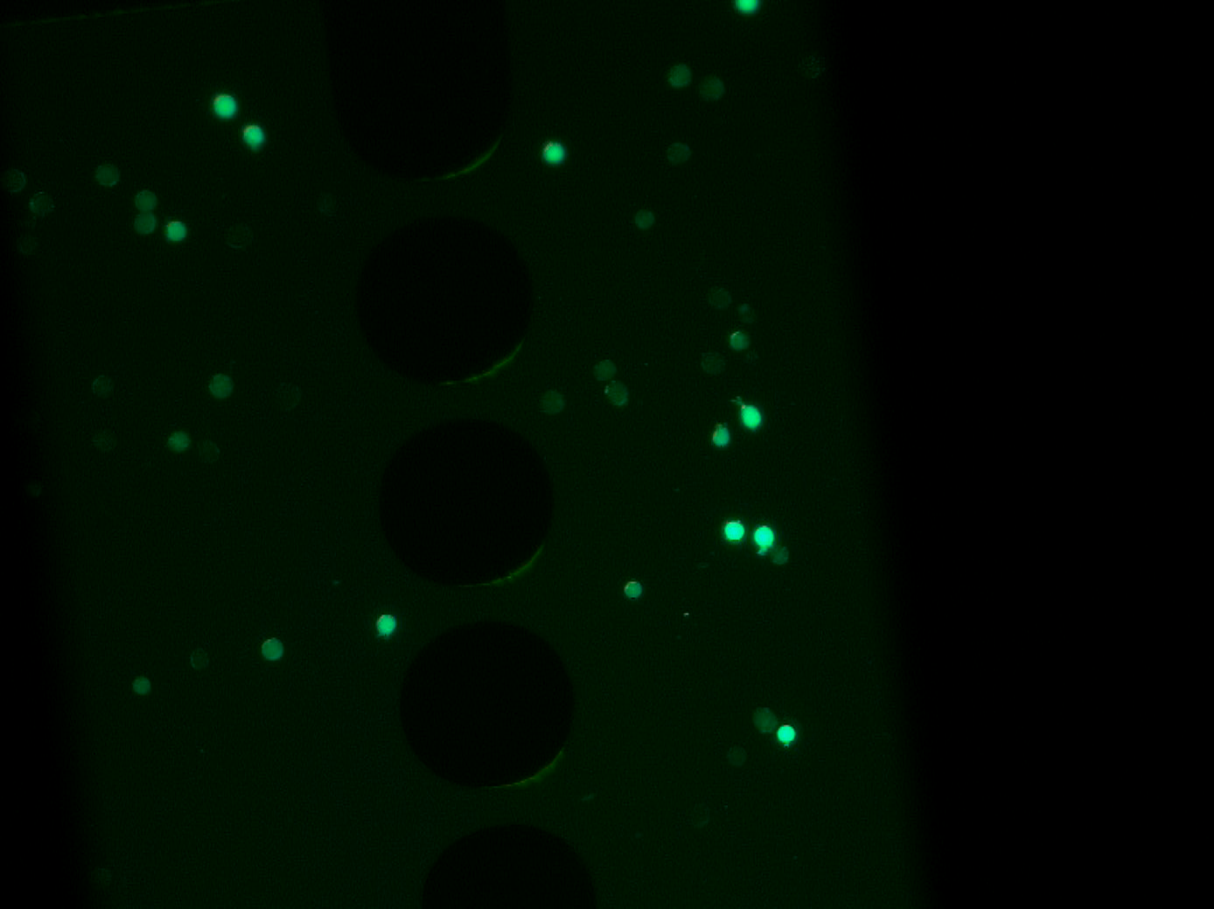
LCC1 1MHz 80Vpp 20µL/mL

