Slide 1
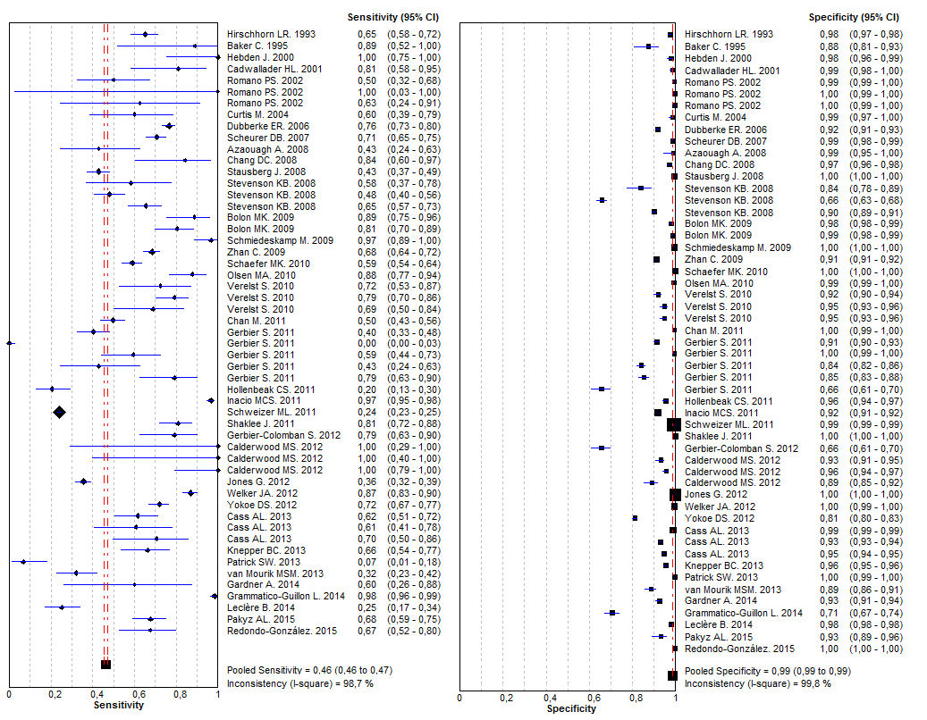
Supplementary figure_1. Forest plots of sensibility and specificity for all included studies

