Slide 1
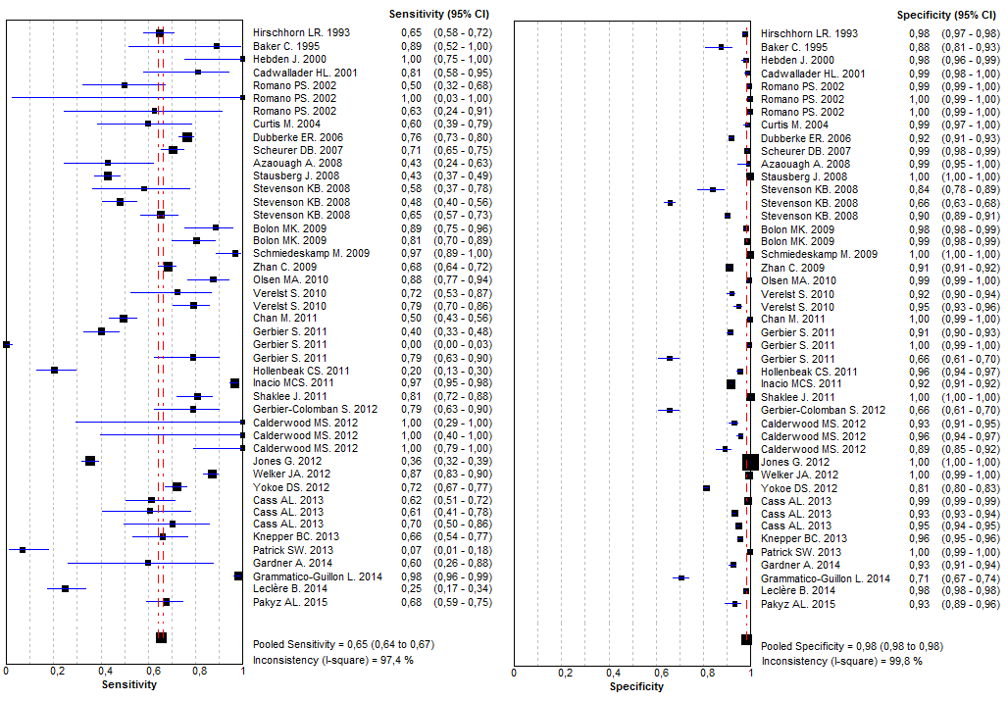
Supplementary figure_2. Forest plots of sensibility and specificity for all meta-analizable studies

