Slide 1
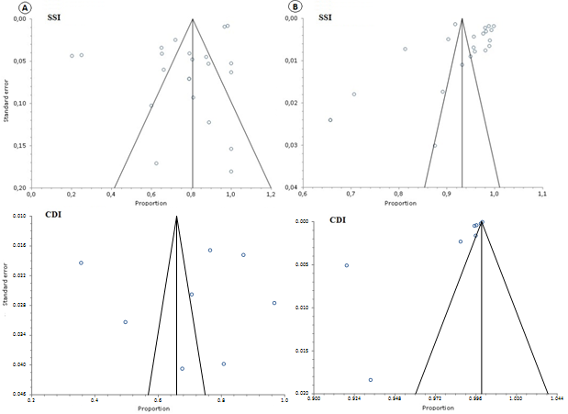
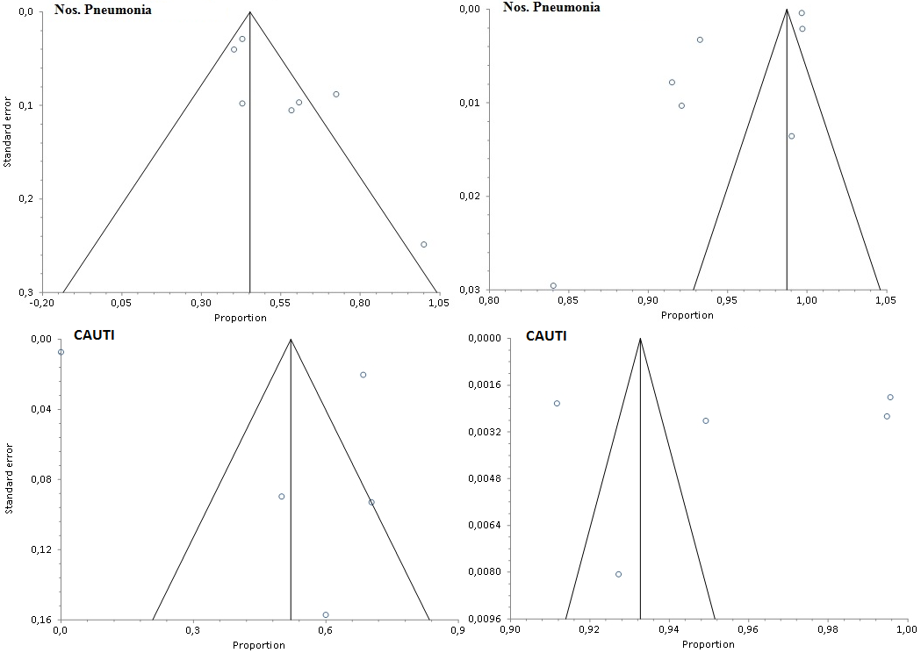
Supplementary figure_3. Begg funnel plots of studies evaluating publication bias of articles on the sensitivity and specificity of administrative coded data in evaluating hospital-acquired infections. Statistically significant publication bias was not demonstrated by Begg-Mazumdar, Egger or Harbord tests for SSI, CDI, and Nosocomial Pneumonias, but it was found for CAUTI. A:Sensitivity; B: Specificity.

