Slide 1
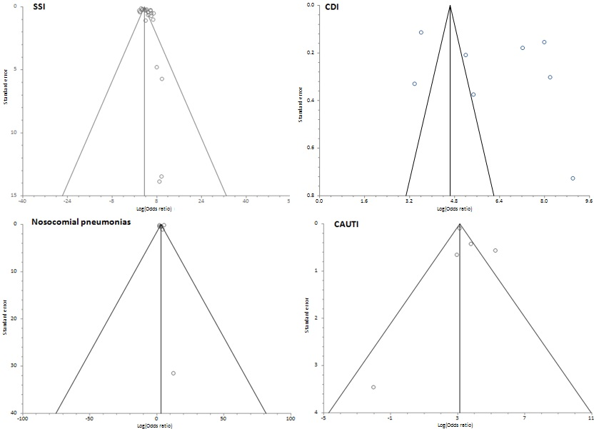
Supplementary figure_4. Begg funnel plots of studies evaluating publication bias of articles on the diagnosis odds ratio of administrative coded data in evaluating hospital-acquired infections. Statistically significant publication bias was not demonstrated by Begg-Mazumdar, Egger, or Harbord tests for SSI, CDI ,Nosocomial Pneumonias and CAUTI.

