Slide 1
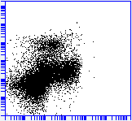
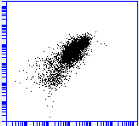
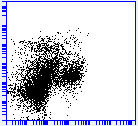
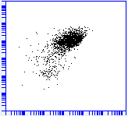
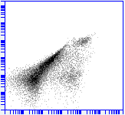
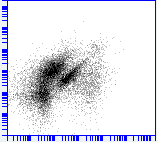
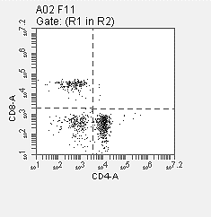
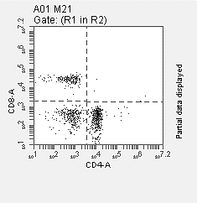
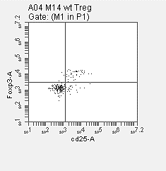
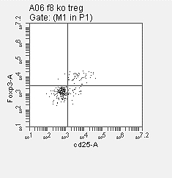
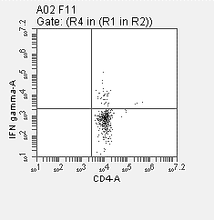
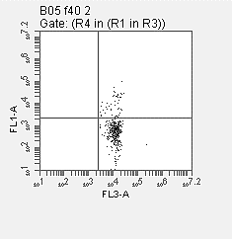
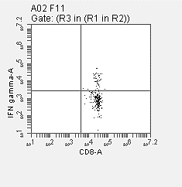
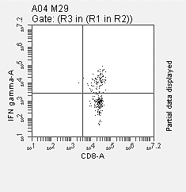
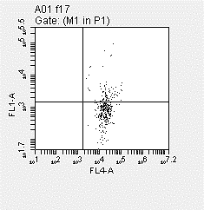
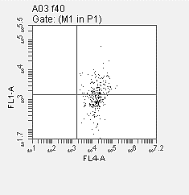
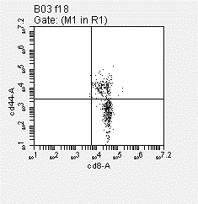
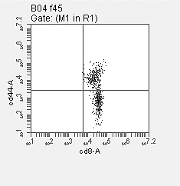
A
WT
RelA^{ΔMye}
23%
AM
82%
16%
AM
86%
CD11b
CD11c
IM
0.5%
CD11b
CD11c
IM
2.4%
14%
Eosinophil
9%
Eosinophil
B
F4/80
Siglec-F
F4/80
Siglec-F
WT
RelA^{ΔMye}
3.7%
Neutrophil
Monocyte
3.9%
Neutrophil
Monocyte
Ly6G
Ly6C
1.4%
Ly6G
Ly6C
1.5%
C
CD11b
CD11b
D
CD11b
CD11b
WT
RelA^{ΔMye}
CD4 gate
20%
18%
WT
17%
RelA^{ΔMye}
19%
CD8
Foxp3
54%
50%
E
CD4
F
CD25
CD4 gate
CD8 gate
WT
6%
RelA^{ΔMye}
WT
RelA^{ΔMye}
10%
19%
40%
IFNγ
IFNγ
G
CD4
H
CD8
WT
CD8 gate
RelA^{ΔMye}
WT
CD8 gate
RelA^{ΔMye}
26%
44%
26%
41%
Granzyme B
CD44
CD8
CD8
Fig. S1. FACS gating strategy for lung immune cells in urethane-treated WT and RelA^{ΔMye} Mice. (A) Gating strategy for AMs (CD11b⁺F4/80⁺CD11c⁺Siglec-F⁺), IMs (CD11b⁺ F4/80⁺CD11c⁻Siglec-F⁻) and eosinophils (CD11b⁺F4/80⁺CD11c⁻Siglec-F⁺). (B) Gating strategy for neutrophils (CD11b⁺Ly6G⁺) and monocytes (CD11b⁺Ly6G⁻Ly6C⁺). (C) Gating strategy for CD4⁺ T cells and CD8⁺ T cells. (D) Gating strategy for Treg cells (CD4⁺CD25⁺Foxp3⁺). (E-H) Gating strategy for IFNγ⁺CD4⁺ cells, IFNγ⁺CD8⁺ cells, GranB⁺CD8⁺ cells and CD44⁺CD8⁺ cells, respectively.

Slide 2
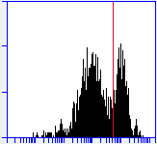
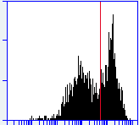
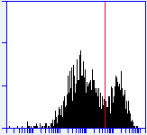
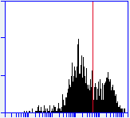
F4/80 gate
WT
33%
RelA^{ΔMye}
RelA^{ΔMye}/CD8^{KO}
CD8^{KO}
47%
30%
35%
Count
Annexin V
Fig. S2. FACS gating strategy for apoptotic lung macrophages from urethane-treated WT, RelA^{ΔMye}, RelA^{ΔMye}/CD8^{KO} and CD8^{KO} mice. Cells are stained by Annexin V and F4/80 antibodies. F4/80⁺ cells are gated to analyze Annexin V staining. Annexin V-positive cells are apoptotic macrophages.

Slide 3
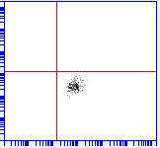
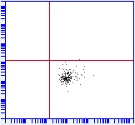
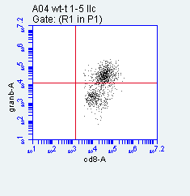

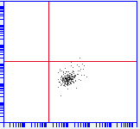
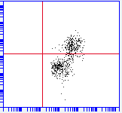
A
CD8 gate
T cell alone
T cell + Mϕ
T cell + Ag-Mϕ
T cell alone
T cell + Mϕ
T cell + Ag-Mϕ
0%
0.5%
59%
0.3%
0.4%
42%
Granzyme B
IFNγ
CD8
B
Mϕ
Ag-Mϕ
WT
23%
RelA^{KO}
25%
WT
24%
RelA^{KO}
28%
Count
Annexin V
WT
Mϕ + T cells
RelA^{KO}
WT
Ag-Mϕ + T cells
Ag-Mϕ + T cells in transwell
25%
23%
29%
RelA^{KO}
38%
WT
27%
RelA^{KO}
24%
Count
Annexin V
Fig. S3. FACS gating strategy for activated CD8⁺ T cells co-cultured with macrophages as well as for apoptotic WT and RelA^{KO} macrophages cultured alone or co-cultured with lung tumor antigen-specific activated T cells. (A) FACS gating strategy for Granzyme B⁺ or IFNγ⁺ CD8⁺ T cells in T cells cultured alone, or co-cultured with WT macrophages (Mϕ) or tumor antigen-pulsed WT macrophages (Ag-Mϕ). (B) FACS gating strategy for Annexin V⁺ F4/80⁺ cells in the indicated macrophages cultured alone or co-cultured with tumor antigen-specific activated T cells.

Slide 4
T cell alone
T cell + WT BMDM
T cell + RelA^{KO} BMDM
40
**
*
80
*
30
60
IFNγ⁺ cells in
CD8⁺ T cells (%)
Gran B⁺ cells in
CD8⁺ T cells (%)
**
20
40
10
20
0
Contact
Transwell
0
Contact
Transwell
Fig. S4. FACS of IFNγ⁺ or granzyme B⁺ cells in CD8⁺ T cells co-cultured with WT or RelA^{KO} BMDMs in normal plates or transwell plates with LCCM containing anti-CD3 and anti-CD28 antibodies. Data are means ± SD (n > 3). *, p < 0.05, **, p < 0.01, Student’s t test.

Slide 5
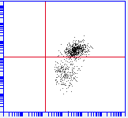
CD8 gate
T cell + Ag-WT Mϕ
T cell + Ag-RelA^{KO} Mϕ
80
*
60%
70%
60
Granzyme B
Gran B⁺ cells in
CD8⁺ T cells (%)
40
20
CD8
0
Figure S5. FACS of Granzyme B⁺ cells in CD8⁺ T cells co-cultured with lung tumor antigen(Ag)-pulsed WT or RelA^{KO} macrophages. Data are means ± SD (n ≥ 3). *p < 0.05, Student’s t test.

Slide 6
urethane
(1 time/week)
tumor examinations
immune cell analysis
0 1 2 3 4 5 6 7 8 9 weeks
αIL-10 (2 times/week)
or αB7x (2-3 times/week)
Fig. S6. Schedule of mouse treatment with IL-10 or B7x antibody.

Slide 7
A
B
T cells
T cells + IL-10
20
*
25
25
15
20
*
20
**
Tumoricidal activity
10
15
15
IFNγ⁺ cells in
CD8⁺ T cells (%)
Gran B⁺ cells in
CD8⁺ T cells (%)
5
10
10
0
-
+
+
5
5
T cells
-
-
IL-10
+
0
0
Fig. S7. (A) In vitro tumoricidal activity of T cells in vitro treated by IL-10. (B) FACS of IFNγ⁺ or granzyme B⁺ cells in CD8⁺ T cells in vitro treated by IL-10. In (A) and (B) data are means ± SD (n > 3). *, p < 0.05, **, p < 0.01, Student’s t test.

Slide 8
Supplementary Table S1. Antibodies Used in the Studies
Antibody | Supplier | Cat. no.
Anti-RelA | Cell signaling | 8242
Anti-HSP 90 | Santa cruz | sc-13119
Anti-F4/80 | AbD Serotec | MCA497G
Anti-CD4-PEcy7 | eBioscience | 25-0042
Anti-CD8-APC | eBioscience | 17-0081
Anti-IFNɣ-FITC | eBioscience | 11-7311
Anti-Granzyme B-FITC | eBioscience | 11-8898
Anti-CD44-PEcy7 | eBioscience | 25-0441
Anti-CD25-PE | eBioscience | 12-0251
Anti-Foxp3-FITC | eBioscience | 11-5773
Anti-Ly6G-FITC | eBioscience | 553127
Anti-CD11b-PE | eBioscience | 11-9668
Anti-CD11c-FITC | eBioscience | 11-0114
Anti-Ly6C-PerCP-Cy5.5 | eBioscience | 45-5932
Anti-Siglec F-PerCP710 | eBioscience | 46-1702
Neutralized FasL antibody | eBioscience | 16-5911
Neutralized IL-10 antibody | eBioscience | 16-7102
Neutralized B7-H4 antibody | eBioscience | 16-5972-81
Anti-CD3e | eBioscience | 16-0031
Anti-CD28 | eBioscience | 16-0281
Anti-Annexin V-FITC | BD | 556547
Anti-Cleaved-caspase 3 | Cell signaling | 9661
Anti-Arginase | Santa cruz | sc-18351
Anti-p50 | Cell signaling | 13586
Anti-p52 | Santa cruz | sc-848
Anti-BCL3 | Santa cruz | sc-185 X
Anti-RNA polymerase II (Rpb1) | Cell signaling | 2629
Donkey anti-rat IgG-FITC | ImmunoReagents | DkxRt-003-FFITC
Donkey anti-goat IgG-TRITC | Jackson ImmunoResearch | 117339
Goat anti-rabbit IgG Biotinylated | Dako | E0432
Rabbit anti-goat IgG Biotinylated | Santa cruz | sc-2774
Goat anti-rabbit IgG-HRP | Santa cruz | sc-2054
Goat anti-mouse IgG-HRP | Santa cruz | sc-2055

Slide 9
Supplementary Table S2. Primers Used for qPCR
Gene name | Forward primer (5’-3’) | Reverse primer (5’-3’)
RelA | GCAGTGCGCCTCTGCTTCCA | CAGTGTTGGGGGCCCGGTTA
18S | AGGAATTGACGGAAGGGCAC | GGACATCTAAGGGCATCACA
IFNγ | TTCAGCAACAGCAAGGCGAA | ATTGAATGCTTGGCGCTGGA
Bcl-2 | AGTACCTGAACCGGCATCTG | CAGCCAGGAGAAATCAAACAG
Survivin | GAACCCGATGACAACCCGAT | ACATACAATTTTGTTCTTGGCTCT
Mcl-1 | GAAACGGGACTGGCTTGTCA | TTCTGATGCCGCCTTCTAGG
Bcl-xL | AGATTCAGCACGAGCAGTCA | GGGCTCAACCAGTCCATTGT
B7H4 | CCATCGCACTCATCATTGGC | GGATGACGATGCCGTTGAGT
IL-10 | AGCTGAAGACCCTCAGGATGCG | TCATTCATGGCCTTGTAGACACCTTG
IL-12a | AACGCAGCACTTCAGAATCACAACC | GCTGAAGGCGTGAAGCAGGATG
IL-12b | CATCTCCTGGTTTGCCATCGTTT | GGGAGTCCAGTCCACCTCTACAACA
SCO2 | TCATCACTGTGGACCCAGAA | TAGGCCCAGCGCTGTAGTAT
Arginase1 | AATCTGCATGGGCAACCTGT | GTCTACGTCTCGCAAGCCAA
VEGFa | GCACTGGACCCTGGCTTTAC | GTCTCAATCGGACGGCAGTA
PD-L1 | CCTGCTGTCACTTGCTACGG | CACTAACGCAAGCAGGTCCA
β-actin | CACCCGCCACCAGTTCGC | ATGCCGGAGCCGTTGTCG
TNFα | GATGAGAAGTTCCCAAATGGC | ACTTGGTGGTTTGCTACGACG
IL-1β | CCTCGTGCTGTCGGACCCAT | GGACAGGTATAGATTCTTTCCTTTGAGGC
IL-6 | AAAGAAATGATGGATGCTACCAAACT | GGTACTCCAGAAGACCAGAGGAAATT
CCL2 | GCTGTTCACAGTTGCCGGCTG | GGGCGTTAACTGCATCTGGCT
CCL3 | GCTCCCAGCCAGGTGTCATTTTC | GGGTTCCTCGCTGCCTCCAA
p50 | CGGTGGTGGAGGCATGTTCGG | TGACCCCTGCGTTGGATTTCGTG
Bcl3 | GCCTACTCACCCCTACTCCA | CGGTAGACAGCGGCTATGTT

Slide 10
Supplementary Table S3. Primers Used for ChIP Assays
Gene name | Forward primer (5’-3’) | Reverse primer (5’-3’)
IL-10 (-95/+37) | TAGAAGAGGGAGGAGGAGCC | TGTGGCTTTGGTAGTGCAAG
B7H4 (-11939/-11752) | TTCCCAACCCCAAGGATTGTT | CAGATGGGTGACTGAGGACAC
B7H4 (+52/+243) | AAAATCTGGCCCCACACACA | CAGCCCACAGGTTCTTAGCA

