Slide 1
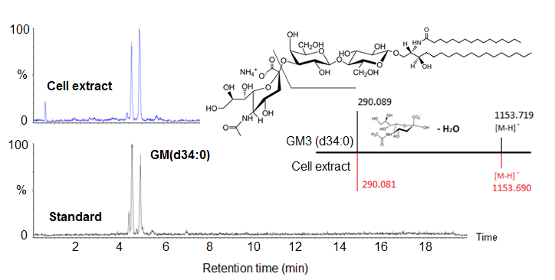
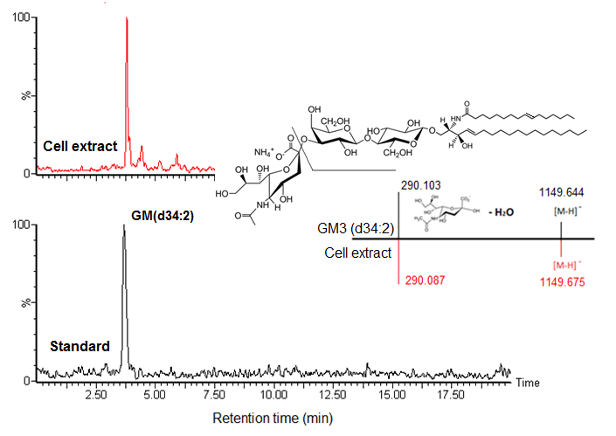
Supplementary Figure 1a Identification of ganglioside GM3 (d34:0) by UPLC-MS^{e}. Putative biomarker GM3(d34:0) by database search was confirmed by authentic standard with retention time, fragmentation ions in EIC. Mass chromatogram was EIC using the molecular ion [MW-H]⁻. Mass spectrum is for illustration with showing only extracted ions of interest and relative intensity.
Supplementary Figure 1b Identification of ganglioside GM3 (d34:2) by UPLC-MS^{e}. Putative biomarker GM3(d34:2) by database search was confirmed by authentic standard with retention time, fragmentation ions in EIC. Mass chromatogram was EIC using the molecular ion [MW-H]⁻. Mass spectrum is for illustration with showing only extracted ions of interest and relative intensity.

Slide 2
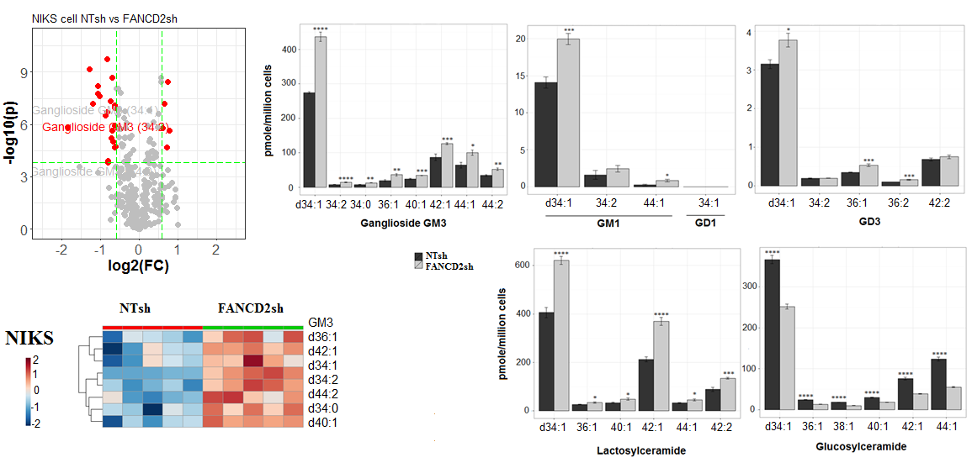
Supplementary Figure 2 Profile of gangliosides, lactosylceramides, glucosylceramides in the NIKS cells: Gangliosides GM3, GM1, and GD3, and lactosylceramides were significantly up-regulated in FANCD2 knockdown NIKS cells. *P < 0.05; **P < 0.01; ***P < 0.001; ****P < 0.0001 (two-tailed t test); Volcano plot indicated ganglioside GM3 species are significantly altered in the FANCD2 knockdown NIKS cells. p-value was calculated with 2-tailed student’s t test, thresholds for significance: Bonferroni adjusted p-value < 0.05, fold change > 1.5.

Slide 3
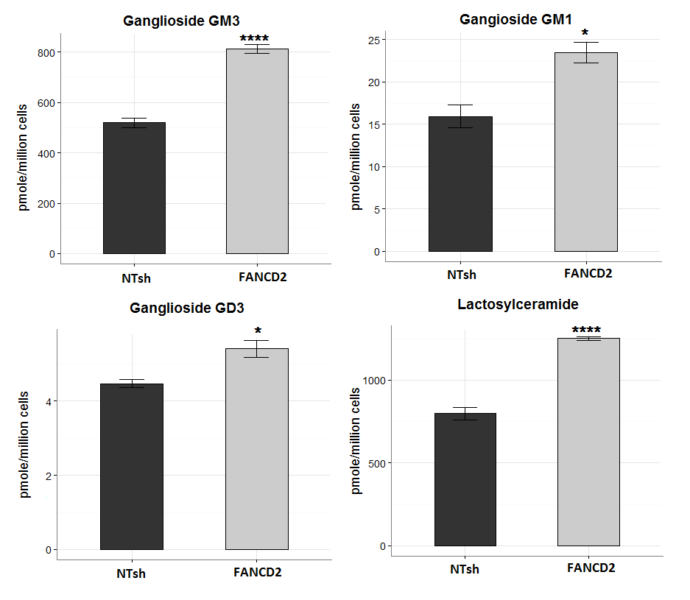
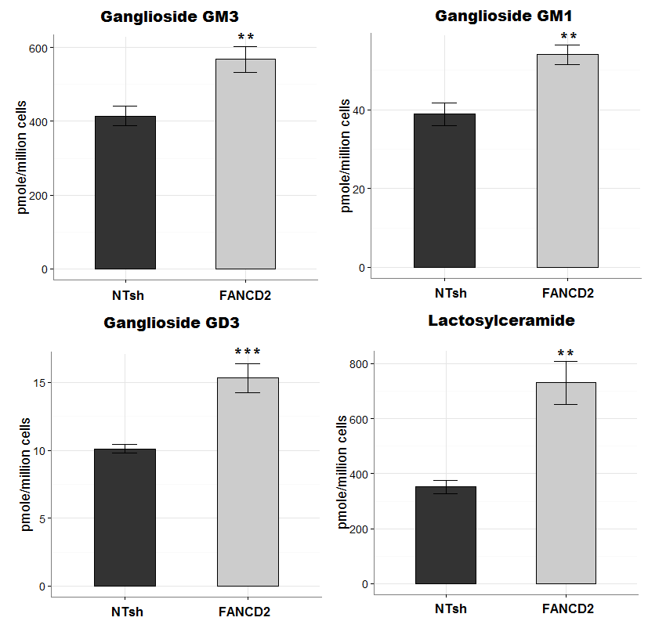
Supplementary Figure 3a Gangliosides GM3, GM1, and GD3, and lactosylceramides were significantly up-regulated in FANCD2 knockdown NIKS cells. *P < 0.05; ****P < 0.0001 (two-tailed t test)
Supplementary Figure 3b Gangliosides GM3, GM1, and GD3, and lactosylceramides were significantly up-regulated in FANCD2 knockdown NOKS cells. **P < 0.01, ***P < 0.001 (two-tailed t test).

Slide 4
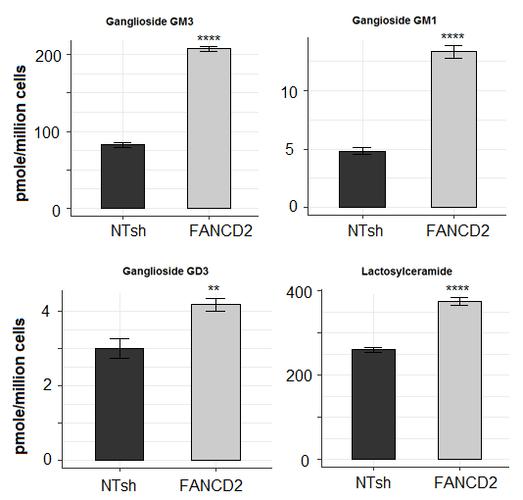
Supplementary Figure 3c Gangliosides GM3, GM1, and GD3, and lactosylceramides were significantly up-regulated in FANCD2 knockdown UMSCC47 cells. **P < 0.01, ****P < 0.0001 (two-tailed t test).

Slide 5
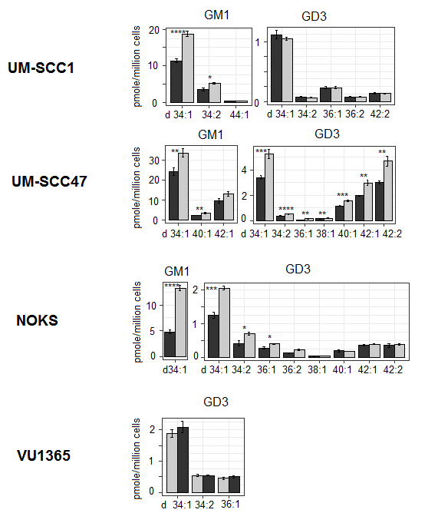
Supplementary Figure 4 Profile of ganglioside GM1 and GD3 in the UM-SCC1, UMSCC-47, NOKS and VU1365 cells: Gangliosides GM1, and GD3 with different acyl chain length, were measured in FANCD2 knockdown UM-SCC1, UM-SCC47, NOKS, and Vu1365 cells. *P < 0.05; **P < 0.01; ***P < 0.001; ****P < 0.0001 (two-tailed t test)

Slide 6
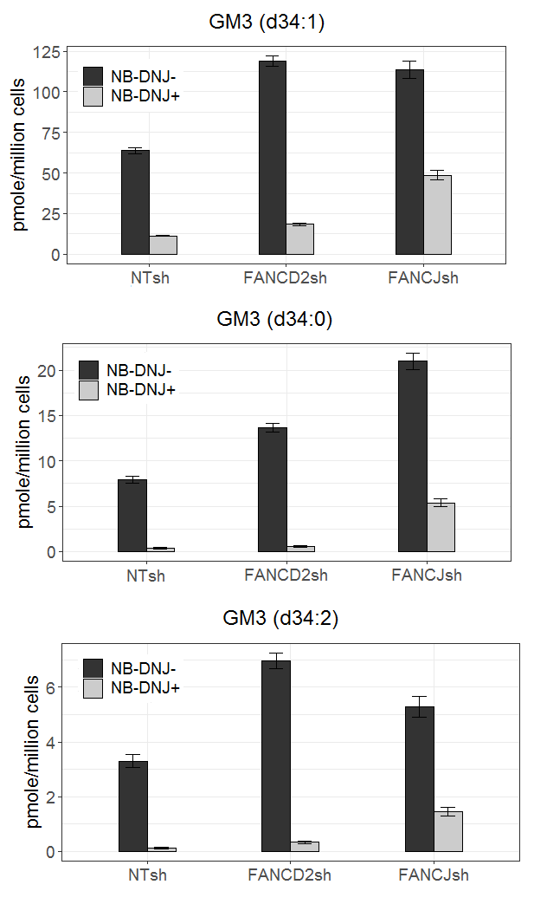
Supplementary Figure 5 Ganglioside GM3 (d34:1), GM3 (d34:0) and GM3 (d34:2) decrease in NTsh, FANCD2sh and FANCJsh UMSCC-1 cells after NB-DNJ exposure

Slide 7
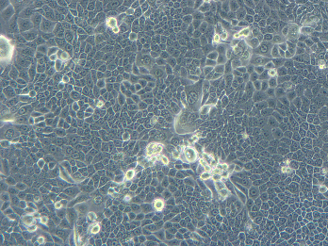
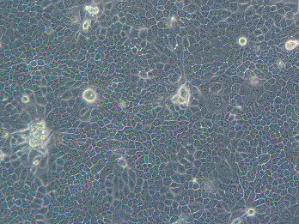
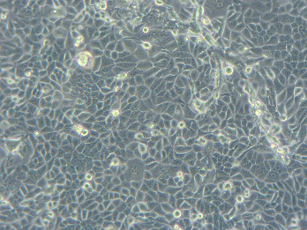
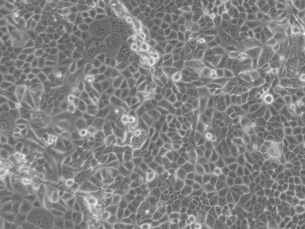
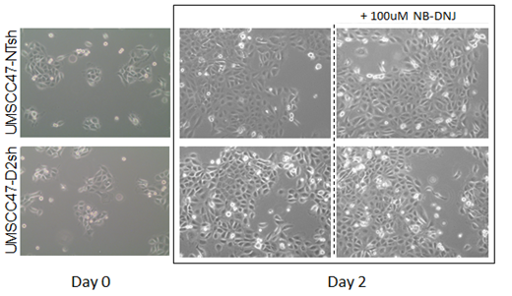
Supplementary Figure 6 NTsh and FANCD2sh NIKS cells (a) and UMSCC-47 cells (b) were plated at equal cell numbers, and NB-DNJ was added following cell attachment, and replenished in fresh media after 24 hrs
a)
+100uM NB-DNJ
NIKS NTsh
NIKS D2sh
Day 0
Day 2
b)

