Slide 1
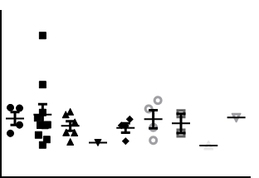
Supplement figure 1.
4
3
2
OxiDJ-1 level (μg/ml)
1
0
-1
5
6
7
8
9
10
11
12
15
On-set duration (year)

