Slide 1
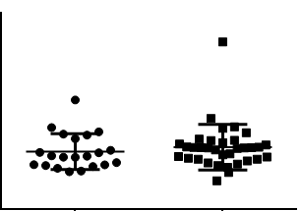
Supplement figure 2.
4
3
2
OxiDJ-1 level (μg/ml)
1
0
-1
male
female

