Slide 1
Figure S1. The alignment of OR51E2 and B2AR (PDB code: 4ldo) used to make the homology model.

Slide 2
 | NAME | mfScore | CAS No | HMDB
1 | Alpha-n-phenylacetyl-l-glutamine | -139.8 | 28047-15-6 | HMDB06344
2 | Estriol | -137.3 | 50-27-1 | HMDB00153
3 | 19-Norandrosterone* | -136.3 | 1225-01-0 | HMDB02697
4 | Epitestosterone | -135.4 | 481-30-1 | HMDB00628
5 | 19-hydroxyandrost-4-ene-3,17-dione 19-OH AD | -131.2 | 510-64-5 | HMDB03955
6 | Testosterone | -127.9 | 58-22-0 | HMDB00234
7 | Adenosine 2,3 cyclic phosphate | -127.6 | 634-01-5 | HMDB11616
8 | Palmitic acid | -126.2 | 57-10-3 | HMDB00220
9 | Stearoylethanolamide | -126.0 | 111-57-9 | HMDB13078
10 | Androstenedione | -125.8 | 63-05-8 | HMDB00053
11 | Gamma-CEHC | -123.0 | 178167-77-6 | HMDB01931
12 | Androstanedione | -122.0 | 846-46-8 | HMDB00899
13 | Tetrahydrocurcumin | -121.0 | 36062-04-1 | HMDB05789
14 | 18-hydroxycortisol* | -120.5 | 86002-90-6 | HMDB00418
15 | Palmitoylethanolamide | -120.0 | 544-31-0 | HMDB02100
16 | Pentadecanoic acid | -119.5 | 1002-84-2 | HMDB00826
17 | D-maltose | -119.4 | 69-79-4 | HMDB00163
18 | Orotidine | -118.7 | 314-50-1 | HMDB00788
19 | Acetaminophen | -118.2 | 16110-10-4 | HMDB10316
20 | Arachidonic acid | -118.0 | 506-32-1 | HMDB01043
21 | 12,13-Epome## | -118.0 |  | HMDB04702
22 | 9(10)-Epode* | -117.9 |  | HMDB10220
23 | 13-cis-Retinoic acid | -117.5 | 4759-48-2 | HMDB06219
24 | N-acetylvanilalanine | -117.5 |  | HMDB11716
25 | 19-Nortestosterone | -116.3 | 434-22-0 | HMDB02725
26 | 6-Hydroxymelatonin | -116.3 | 2208-41-5 | HMDB04081
27 | Etiocholanediol | -116.2 | 1851-23-6 | HMDB00551
28 | Etiocholanolone | -115.9 | 53-42-9 | HMDB00490
29 | Cyclic GMP | -115.5 | 7665-99-8 | HMDB01314
30 | 8-Isoprostane | -114.4 | 155976-51-5 | HMDB04659
31 | Elaidic acid | -113.5 | 112-79-8 | HMDB00573
32 | Dihydrotestosterone | -112.9 | 521-18-6 | HMDB02961
33 | N1-Acetylspermine | -112.6 | 25593-72-0 | HMDB01186
34 | Deoxyguanosine | -112.4 | 961-07-9 | HMDB00085
35 | Pc(18:1(9z)/18:3(6z,9z,12z))### | -112.1 |  | HMDB08106
36 | Linoleoyl ethanolamide | -112.0 | 68171-52-8 | HMDB12252
37 | 2-Hydroxyestradiol-3-methyl | -111.7 | 5976-65-8 | HMDB00380
38 | 5-Methylcytidine | -111.3 | 2140-61-6 | HMDB01032
39 | Retinyl ester | -111.2 |  | HMDB03598
40 | Aldosterone | -111.1 | 52-39-1 | HMDB00037
41 | Fructose 1,6-bisphosphate | -111.0 | 488-69-7 | HMDB01058
42 | 9-cis-Retinoic acid | -110.8 |  | HMDB02369
43 | A-12(13)-Epode | -110.7 |  | HMDB10200
44 | 2-Methoxyestradiol | -110.4 | 362-07-2 | HMDB00405
45 | Phenylalanylphenylalanine | -110.1 | 2577-40-4 | HMDB13302
46 | Histidylproline | -109.9 | 53109-32-3 | HMDB02053
47 | Phenylpropionylglycine | -109.7 | 56613-60-6 | HMDB00860
48 | 8-Isoprostaglandin | -109.6 | 27415-26-5 | HMDB05083
49 | Rosmarinic acid | -109.5 | 537-15-5 | HMDB03572
50 | Prostaglandin A1 | -109.2 | 14152-28-4 | HMDB02656
Table S1. Top 50 metabolites with associated CAS and HMDB numbers, identified by VLS and listed by the mfScore function. From the first 25 compounds, 22 were tested in vitro (in Italics), and detected agonists are indicated in bold Italics. Metabolites with * have not been tested; #gamma-CEHC is 3-(2,7,8-trimethyl-3,4-dihydro-2H-1-benzopyran-2-yl)propanoic acid. 12,13-Epome## is 12,13-cis-Epoxyoctadecenoic acid; 9(10)-Epode* is 9(10)-Epoxy-12Z,15Z-octadecadienoic acid and pc(18:1(9z)/18:3(6z,9z,12z))### is phosphtidylcholine.

Slide 3
 | NAME | Score | CAS | HMDB
1 | Urea | -26.1 | 57-13-6 | HMDB00294
2 | N1-Acetylspermidine | -24.3 | 14278-49-0 | HMDB01276
3 | Glyceraldehyde | -23.3 | 56-82-6 | HMDB01051
4 | Homo-l-arginine | -22.7 | 156-86-5 | HMDB00670
5 | Putreanine# | -22.2 | 25887-39-2 | HMDB06078
6 | N8-Acetylspermidine | -21.4 | 34450-15-2 | HMDB02189
7 | 4-Acetamidobutanoic acid | -20.8 | 3025-96-5 | HMDB03681
8 | 2,3-Diminopropionic acid* | -19.5 | 4033-39-0 | HMDB02006
9 | Acetyl-n-formyl-5-methoxykynurenamine AFMK | -19.4 | 52450-38-1 | HMDB04259
10 | Asymmetric dimethylarginine | -19.4 | 30315-93-6 | HMDB01539
11 | Ureidopropionic acid | -19.1 | 464-88-4 | HMDB00026
12 | Ureidoisobutyric acid | -18.7 | 2905-86-4 | HMDB02031
13 | N-Acetylputrescine | -18.6 | 18233-70-0 | HMDB02064
14 | 8-Hydroxyguanine | -17.4 | 5614-64-2 | HMDB02032
15 | Pelargonidin | -17.3 | 134-04-3 | HMDB03263
16 | Lipoamide | -17.3 | 940-69-2 | HMDB00962
17 | Histamine | -16.9 | 51-45-6 | HMDB00870
18 | Hydroxyacetone | -16.8 | 116-09-6 | HMDB06961
19 | Hydroxypyruvic acid | -16.8 | 1113-60-6 | HMDB01352
20 | Imidazolone** | -16.7 | 75879-18-4 | HMDB04363
21 | 2-pyrrolidinone | -16.4 | 616-45-5 | HMDB02039
22 | Keto-glutaric acid | -16.4 | 328-50-7 | HMDB00208
23 | L-glyceric acid | -16.1 | 28305-26-2 | HMDB06372
24 | Normetanephrine | -16.1 | 97-31-4 | HMDB00819
25 | Glycine | -16.1 | 56-40-6 | HMDB00123
26 | Guanidoacetic acid | -15.9 | 352-97-6 | HMDB00128
27 | N-Acetylcadaverine | -15.8 | 32343-73-0 | HMDB02284
28 | Homocitrulline | -15.7 | 1190-49-4 | HMDB00679
29 | L-2,4-Diaminobutyric acid | -15.6 | 1758-80-1 | HMDB06284
30 | Pyridoxamine | -15.6 | 85-87-0 | HMDB01431
31 | Butanone | -15.5 | 78-93-3 | HMDB00474
32 | Thiocyanate | -15.5 | 302-04-5 | HMDB01453
33 | Hydroxypropionic acid | -15.5 | 503-66-2 | HMDB00700
34 | Acetone | -15.5 | 67-64-1 | HMDB01659
35 | Glycerol | -15.4 | 56-81-5 | HMDB00131
36 | Citrulline | -15.4 | 372-75-8 | HMDB00904
37 | 1-Phenylethylamine | -15.3 | 98-84-0 | HMDB02017
38 | D-alanine | -15.2 | 338-69-2 | HMDB01310
39 | Phenylethylamine | -15.2 | 64-04-0 | HMDB12275
40 | Formiminoglutamic acid | -15.0 | 816-90-0 | HMDB00854
41 | Pyruvic acid | -15.0 | 127-17-3 | HMDB00243
42 | (S)-3,4-Dihydroxybutyric acid | -14.9 | 51267-44-8 | HMDB00337
43 | Pyruvaldehyde | -14.8 | 78-98-8 | HMDB01167
44 | Hydroxykynurenine | -14.8 | 484-78-6 | HMDB00732
45 | Propanal | -14.8 | 123-38-6 | HMDB03366
46 | Glyoxylic acid | -14.7 | 298-12-4 | HMDB00119
47 | Thiosulfate | -14.7 | 14383-50-7 | HMDB00257
48 | Gamma-butyrolactone | -14.7 | 96-48-0 | HMDB00549
49 | Hydrogen carbonate | -14.7 | 71-52-3 | HMDB00595
50 | Tryptophanamide | -14.7 | 20696-57-5 | HMDB13318
Table S2. Top 50 metabolites with associated CAS and HMDB numbers, identified by VLS and listed by the Score function. First 25 compounds were tested in vitro, except # putreanine. Instead of the listed compounds initially listed the following compounds at No. 8 and 20 were tested: * 2,3 diaminopropionic acid, CAS 515-94-6 and ** 4-methyl-2,3-dihydro-1H-imidazol-2one-CAS 1192-34-3 were tested.
Notes:
Unsure of what the part “…exfept #putreanine. Instead of listed compounds No 8 and 20,” is supposed to indicate. Please clarify. Unsure of what was actually tested.

Slide 4
 | No. | Name |  | Sequence | Size | Tm | GC% | Product length
NM_030774.3 | 1 | OR51E2-Fw | 1OR51E2Fw | ATATTTGCAAGCTCGGCCCT | 20 | 60 | 50 | 300 | start 101
 | 2 | OR51E2-Rv | 2OR51E2Rv | GCGTTCCGTCCTTACGATGA | 20 | 60 | 55 |  | end 400
NM_001975.2 | 3 | ENO2-Fw | 3ENO2Fw | TCGCTTTGCCGGACATAACT | 20 | 60 | 50 | 255 | start 28
 | 4 | ENO2-Rv | 4ENO2Rv | GTGCGGAACCCCAATGAGTA | 20 | 60 | 55 |  | end 282
NM_014324.5 | 5 | AMACR-Fw | 5AMACRFw | AAGACGAAGGCAGAGTGGTG | 20 | 60 | 59 | 260 | start 93
 | 6 | AMACR-Rv | 6AMACRRv | ATCTCTTCGCGGCTGAATCC | 20 | 60 | 60 |  | end 352
NM_021098 | 7 | CaV3-Fw | 7CaV3Fw | ATGCCGACTGCCACATAGAG | 20 | 60 | 55 | 262 | start 518
 | 8 | CaV3-Rv | 8CaV3Rv | ACCACATGCGGGATCTTCTC | 20 | 60 | 55 |  | end 779
NM_001011645.2 | 9 | AR-Fw | 9ARFw | CCGGAAGCTGAAGAAACTTGG | 21 | 59 | 52 | 263 | start 2
 | 10 | AR-Rv | 10ARRv | CCACGTGTACAAGCTGTCTCT | 21 | 60 | 52 |  | end 264
NM_001256799.2 | 11 | GAPDH-Fw | 11GAPDHFw | CATCACTGCCACCCAGAAGA | 20 | 60 | 55 | 349 | start 15
 | 12 | GAPDH-Rv | 12GAPDHRv | GTCAAAGGTGGAGGAGTGGG | 20 | 60 | 60 |  | end363
NM_000424.3 | 13 | KRT5-Fw | 13KRT5Fw | GAGATCGCCACTTACCGCAA | 20 | 60 | 55 | 201 | start 1559
 | 14 | KRT5-Rv | 14KRT5Rv | GTAGCTTCCACTGCTACCTCC | 21 | 60 | 57 |  | end 1739
NM_001256282.1 | 15 | KRT8-Fw | 15KRT8Fw | GAATGAATGGGGTGAGCTGG | 20 | 59 | 55 | 298 | start19
 | 16 | KRT8-Rv | 16KRT8Rv | CTCTGGTTGACCGTAACTGC | 20 | 59 | 55 |  | end316
NM_000224.2 | 17 | KRT18-Fw | 17KRT18Fw | TCCTTTCTCTCTCCCCGGAC | 20 | 60 | 60 | 261 | start93
 | 18 | KRT18-Rv | 18KRT18Rv | CGTTCTGGATGCCTCCCATT | 20 | 60 | 55 |  | end353
Table S3. Primers used in PCR assays.

Slide 5
Metabolite | ID | Score | mfScore
Bradykinin | HMDB04246 | 8.43 | -140.15
6-Dehydrotestosterone* | CAS2352-19-4 | 24.84 | -116.27
Kojibiose | HMDB11742 | -6.83 | -110.23
Beta-ionone* | ChemSpider553581 | 3.89 | -108.01
UDP-N-Acetylmuraminate | HMDB11720 | -3.28 | -104.14
Gamma-Tocopherol | HMDB01492 | -0.26 | -103.25
Inositol phosphate | HMDB02985 | 34.62 | -95.85
Sorbitol-6-phosphate | HMDB05831 | 19.82 | -93.96
1-Kestose | HMDB11729 | 42.38 | -85.55
Dimethylbenzimidazole | HMDB03701 | -5.47 | -83.36
Gluconolactone | HMDB00150 | -2.37 | -82.95
N-Formyl-L-methionine | HMDB01015 | 0.39 | -81.64
L-Gulonolactone | HMDB03466 | -1.50 | -76.76
Quinic acid | HMDB03072 | 12.65 | -73.95
Methyldopa | HMDB11754 | 7.06 | -73.32
L-Sorbose | HMDB01266 | -2.59 | -72.11
4-Hydroxybenzaldehyde | HMDB11718 | -5.11 | -69.48
Androstanediol | HMDB00495 | -6.64 | -67.90
Ureidosuccinic acid | HMDB00828 | 3.47 | -67.17
Turanose | HMDB11740 | -2.71 | -65.49
Hydrocinnamic acid | HMDB00764 | 0.04 | -65.4
N-Acetyl-L-alanine | HMDB00766 | -1.07 | -59.75
Nonate | HMDB11717 | -7.57 | -59.28
1,4,6-Androstatrien 17beta-ol-3one* | ChemSpider542686 | -11.67 | -58.66
N-Acetyl-b-glucosaminylamine | HMDB01104 | -3.97 | -53.92
Galactinol dihydrate | HMDB11739 | -0.91 | -53.72
Selenomethionine | HMDB03966 | -8.25 | -50.19
Glycyl-glycine | HMDB11733 | -12.08 | -49.77
L-Histidinol | HMDB03431 | -11.45 | -44.75
N-acetylglutamic acid | HMDB01138 | -12.73 | -41.75
L-Allothreonine | HMDB04041 | -8.68 | -39.14
6-Hydroxynicotinic acid | HMDB02658 | -8.25 | -38.49
D-alanyl-D-alanine | HMDB03459 | -13.53 | -25.28
Melezitose | HMDB11730 | 8.08 | -23.79
Deoxyuridine triphosphate | HMDB01191 | 0.73 | 1.46
1,4,6-Androstatrien-3,17 dione* | ChemSpider94659 | -0.09 | 4.75
Orotidylic acid | HMDB00218 | 40.97 | 48.95
Table S4. VLS results of small library screening. Metabolites are listed based on mfScore values. ID numbers are from: www.HMDBca, www.CAS.org, and www.ChemSpider.org. Ligands in Italics have been experimentally tested in vitro, and and those in bold italics are compounds confirmed as OR51E2 agonists. Compounds with an asterisk have been previously identified as agonists. We also confirmed 1,4,6-androstatriene-3,17-dione as OR51E2 agonist in our luc-assay.

Slide 6
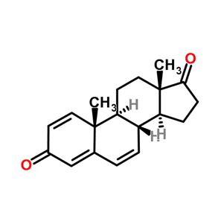
Figure S2. Metabolites that activate OR51E2 from the small - scale VLS screen. Concentration response curves for agonists (red). Responses were normalized to the no metabolite control. N = 3, mean ± SEM.

Slide 7
CH3
Figure S3. Metabolites that activate OR51E2 from the large - scale VLS screen. Concentration - response curves for agonists (red) identified from the mfScore list (Table S1) and from the Score list (Table S2). Responses are normalized to a no-metabolite control. A pCI vector-only control is also presented for each metabolite (black dots). N=3, mean ± SEM. N = 3, mean ± SEM.

Slide 8
*
Figure S4. Metabolites that did not activate OR51E2. Responses were normalized to the no metabolite control. Androstenedione (*) consistently showed increased response at 10 µM concentration. N = 3, mean ± SEM.

Slide 9
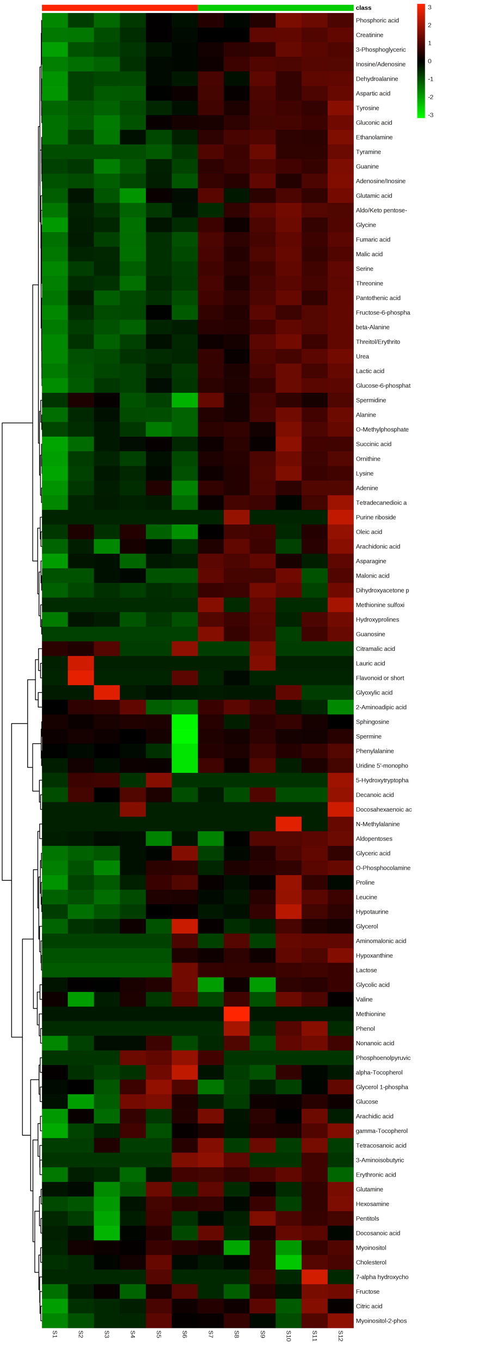
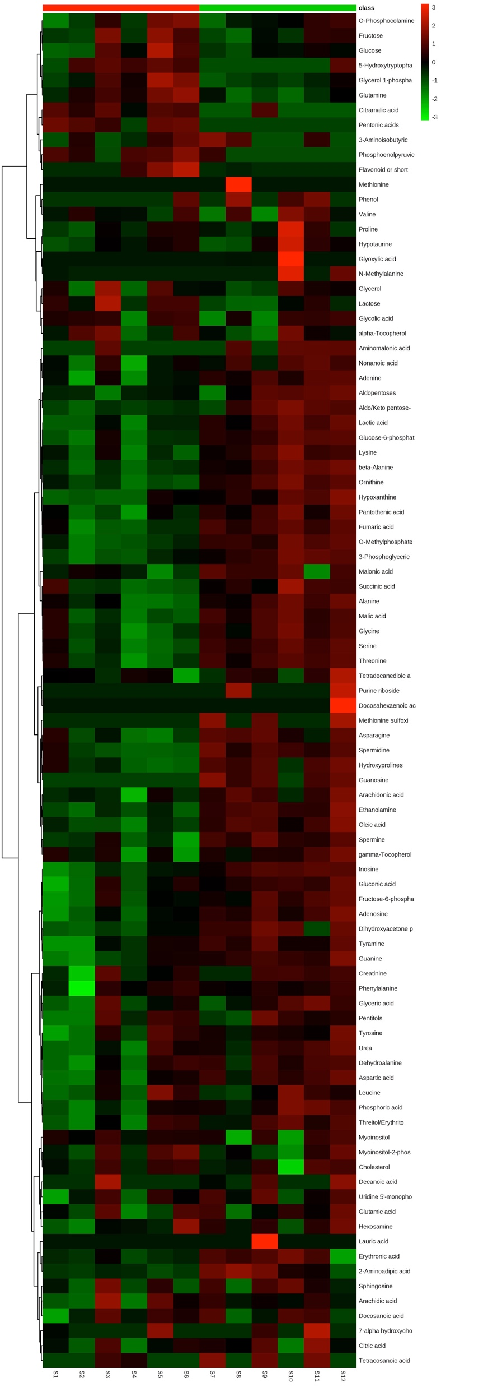
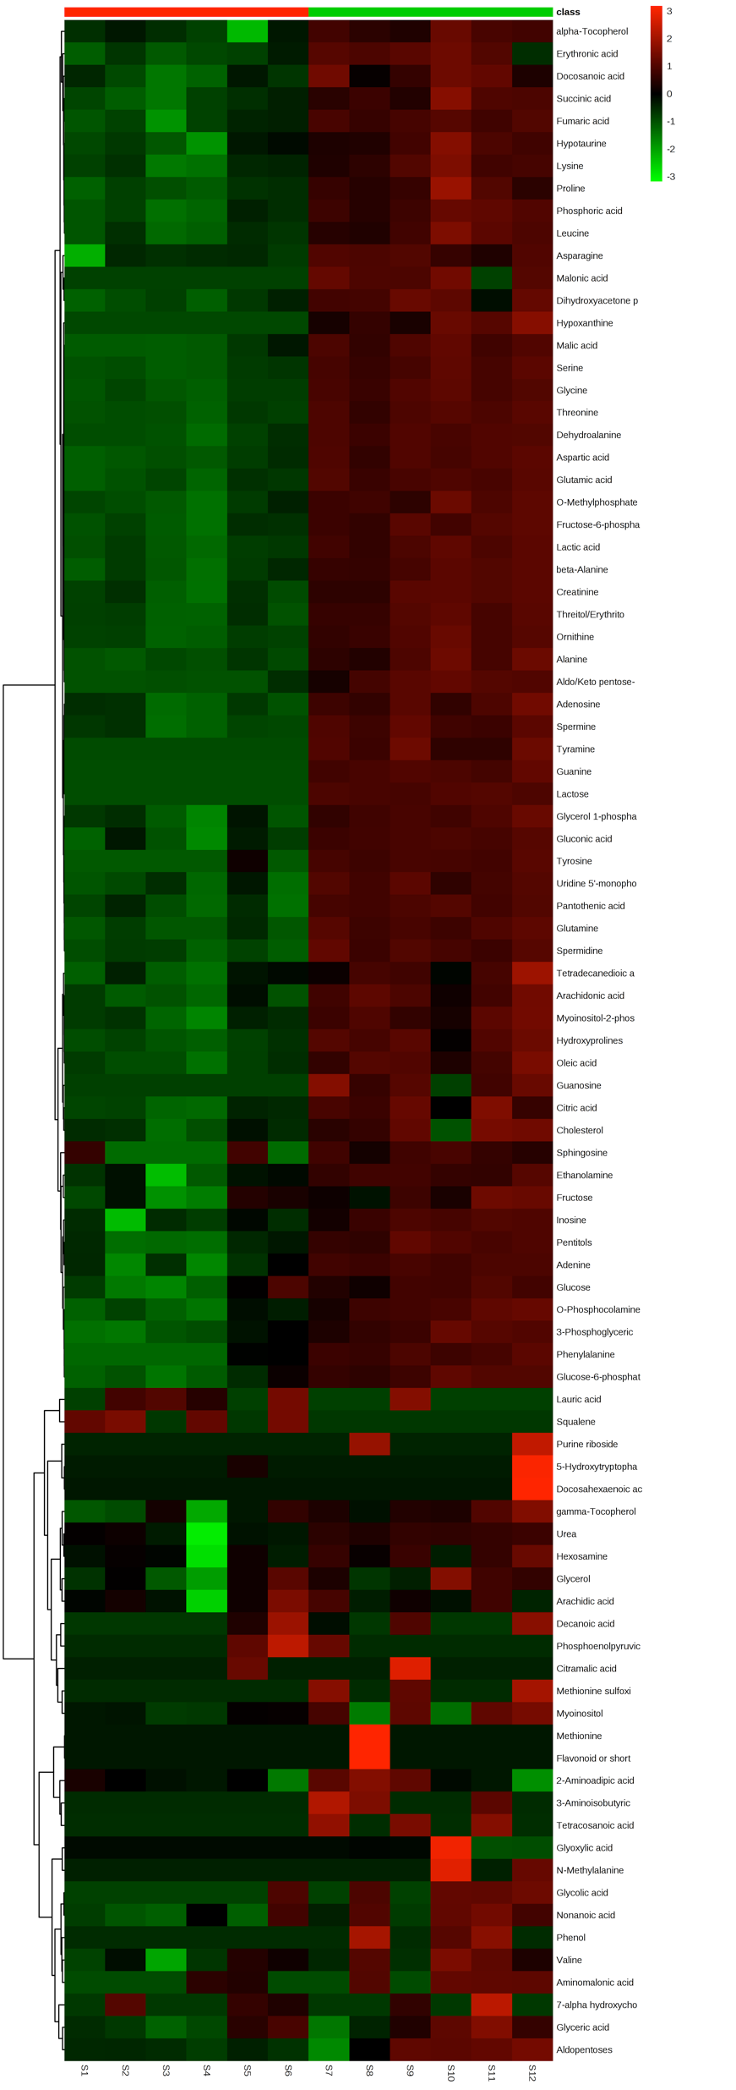
A
B
AFMK CTRL
C
PA CTRL
19-OH AD CTRL
Figure S5. Hierarchical clustering analysis of all annotated intracellular metabolites. Heatmaps are based on the Pearson correlation analysis and indicate annotated metabolites identified by t-test (P <0.05, FDR < 0.1, n = 6). Columns correspond to the samples treated with agonists (S1-6) and control (S7-12) and rows correspond to annotated metabolites. Agonists were applied for 3 days. A. 100 nM 19-OH AD B. 250 µM AFMK and C. 1 mM PA. n = 6 biological replicates for each condition.

Slide 10
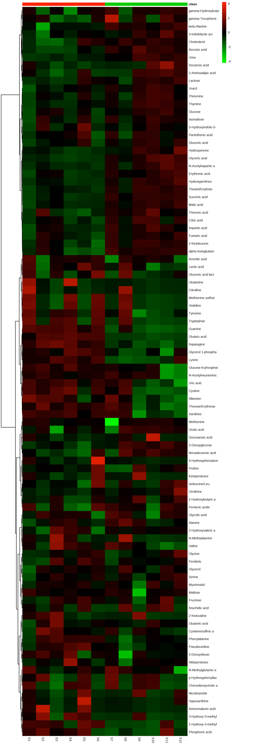
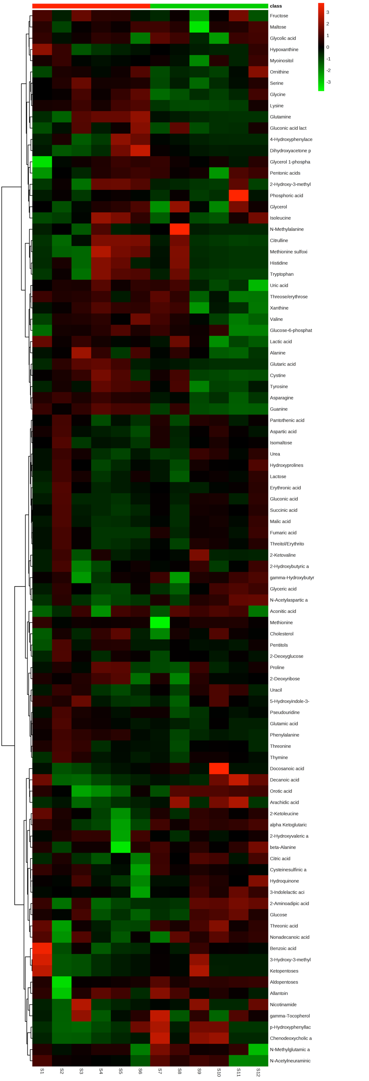
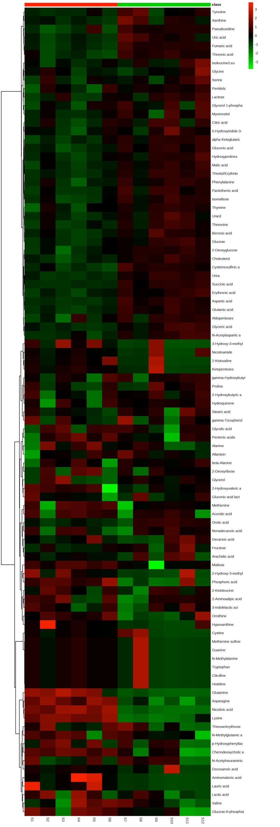
A
B
C
19-OH AD CTRL
AFMK CTRL
PA CTRL
Figure S6. Hierarchical clustering analysis of all annotated extracellular metabolites. Heatmaps are based on the Pearson correlation analysis and indicate annotated metabolites identified by t-test (P <0.05, FDR < 0.1, n = 6). Agonists were applied for 3 days. A. 100 nM 19-OH AD B. 250 µM AFMK and C. 1 mM PA. n = 6 biological replicates for each condition.

Slide 11
A B
19-OH AD | Fold Change | log2(FC)
Flavonoid or short-chain cholesterol ester | 10.77 | 3.43
Phosphoenolpyruvic acid | 4.24 | 2.08
Citramalic acid | 2.96 | 1.56
3-Aminoisobutyric acid | 0.40 | -1.33
Tetracosanoic acid | 0.37 | -1.45
7-alpha hydroxycholesterol | 0.36 | -1.46
Lactose | 0.24 | -2.08
Aminomalonic acid | 0.22 | -2.18
Malonic acid | 0.17 | -2.55
Hypoxanthine | 0.13 | -2.91
Tyramine | 0.03 | -5.04
Phenol | 0.02 | -5.62
Methionine | 0.02 | -5.86
N-Methylalanine | 0.02 | -5.88
Purine riboside | 0.01 | -6.71
Methionine sulfoxide | 0.01 | -7.00
Guanosine | 0.004 | -7.95
Figure S7. All significantly different intracellular metabolites identified by fold change analysis in the cells incubated for 3 days with 100 nM 19-OH AD. A. FC plo.t B. List of the metabolites.
A B
AFMK | Fold Change | log2(FC)
Pentonic acids | 233.17 | 7.87
Flavonoid or short-chain cholesterol ester | 28.65 | 4.84
Phosphoenolpyruvic acid | 5.88 | 2.55
Citramalic acid | 5.25 | 2.39
5-Hydroxytryptophan | 4.57 | 2.19
Aldopentoses | 0.48 | -1.05
Tyramine | 0.47 | -1.08
Tetracosanoic acid | 0.40 | -1.31
Phenol | 0.31 | -1.70
Aminomalonic acid | 0.26 | -1.95
Hypoxanthine | 0.24 | -2.06
Glyoxylic acid | 0.05 | -4.25
N-Methylalanine | 0.05 | -4.46
Methionine | 0.02 | -5.86
Docosahexaenoic acid | 0.01 | -6.17
Lauric acid | 0.01 | -6.30
Purine riboside | 0.01 | -6.71
Methionine sulfoxide | 0.01 | -7.00
Guanosine | 0.004 | -7.95
Figure S8. All significantly different intracellular metabolites identified by fold change (FC) analysis in the cells incubated for 3 days with 250 µM AFMK. A. FC plot. B. List of the metabolites.

Slide 12
A B
PA | Fold Change | log2(FC)
Squalene | 233.00 | 7.86
Lauric acid | 2.83 | 1.50
Phosphoenolpyruvic acid | 2.49 | 1.32
Inosine | 0.49 | -1.03
alpha-Tocopherol | 0.49 | -1.04
Asparagine | 0.45 | -1.17
Gluconic acid | 0.40 | -1.32
Pantothenic acid | 0.39 | -1.37
Hypotaurine | 0.38 | -1.41
Flavonoid or short-chain cholesterol ester | 0.35 | -1.50
Aspartic acid | 0.35 | -1.51
Sphingosine | 0.35 | -1.52
Fumaric acid | 0.34 | -1.54
Aminomalonic acid | 0.34 | -1.55
Adenine | 0.33 | -1.60
Dehydroalanine | 0.32 | -1.63
Glycolic acid | 0.22 | -2.16
Docosanoic acid | 0.21 | -2.22
Pentitols | 0.21 | -2.24
5-Hydroxytryptophan | 0.20 | -2.30
Phenylalanine | 0.20 | -2.32
Tyrosine | 0.11 | -3.16
Glutamine | 0.08 | -3.69
Glyoxylic acid | 0.05 | -4.24
Aldo/Keto pentose-5-phosphate | 0.05 | -4.47
Phenol | 0.02 | -5.62
Methionine | 0.02 | -5.86
N-Methylalanine | 0.02 | -5.88
Docosahexaenoic acid | 0.01 | -6.17
3-Aminoisobutyric acid | 0.01 | -6.37
Purine riboside | 0.01 | -6.71
Methionine sulfoxide | 0.008 | -7.00
Tetracosanoic acid | 0.007 | -7.19
Tyramine | 0.004 | -7.86
Hypoxanthine | 0.004 | -7.87
Guanosine | 0.004 | -7.95
Malonic acid | 0.003 | -8.23
Guanine | 0.002 | -8.77
Lactose | 0.002 | -9.26
Figure S9. All significantly different intracellular metabolites identified by fold change analysis incubated for 3 days with 1 mM PA. A. FC plot. B. List of the metabolites.

Slide 13
19-OH AD | t.stat | p.value | -log10(p) | FDR
Tyramine | -11.79 | 3.44E-07 | 6.46 | 3.10E-05
Fumaric acid | -9.19 | 3.43E-06 | 5.46 | 1.10E-04
Pantothenic acid | -8.87 | 4.73E-06 | 5.33 | 1.10E-04
Serine | -8.51 | 6.84E-06 | 5.16 | 1.10E-04
Adenosine/Inosine | -8.41 | 7.59E-06 | 5.12 | 1.10E-04
Lactic acid | -8.33 | 8.23E-06 | 5.08 | 1.10E-04
Guanine | -8.20 | 9.47E-06 | 5.02 | 1.10E-04
Threonine | -8.18 | 9.73E-06 | 5.01 | 1.10E-04
Malic acid | -7.90 | 1.32E-05 | 4.88 | 1.32E-04
beta-Alanine | -7.70 | 1.64E-05 | 4.78 | 1.48E-04
Tyrosine | -6.82 | 4.65E-05 | 4.33 | 3.43E-04
Urea | -6.77 | 4.95E-05 | 4.31 | 3.43E-04
Alanine | -6.76 | 4.95E-05 | 4.31 | 3.43E-04
Fructose-6-phosphate | -6.62 | 5.91E-05 | 4.23 | 3.80E-04
Glucose-6-phosphate | -6.40 | 7.87E-05 | 4.10 | 4.72E-04
Ethanolamine | -6.34 | 8.43E-05 | 4.07 | 4.74E-04
O-Methylphosphate | -6.25 | 9.52E-05 | 4.02 | 5.04E-04
Ornithine | -5.64 | 2.15E-04 | 3.67 | 1.07E-03
Inosine/Adenosine | -5.60 | 2.27E-04 | 3.64 | 1.08E-03
Threitol/Erythritol | -5.50 | 2.64E-04 | 3.58 | 1.19E-03
Glycine | -5.18 | 4.14E-04 | 3.38 | 1.77E-03
3-Phosphoglyceric acid | -5.06 | 4.90E-04 | 3.31 | 2.01E-03
Dehydroalanine | -5.00 | 5.39E-04 | 3.27 | 2.11E-03
Hydroxyprolines | -4.93 | 5.96E-04 | 3.22 | 2.23E-03
Hypoxanthine | -4.76 | 7.74E-04 | 3.11 | 2.79E-03
Aspartic acid | -4.61 | 9.62E-04 | 3.02 | 3.25E-03
Lysine | -4.60 | 9.75E-04 | 3.01 | 3.25E-03
Guanosine | -4.55 | 1.06E-03 | 2.98 | 3.40E-03
Aldo/Keto pentose-5-phosphate | -4.51 | 1.13E-03 | 2.95 | 3.51E-03
Gluconic acid | -4.48 | 1.17E-03 | 2.93 | 3.51E-03
Dihydroxyacetone phosphate | -4.31 | 1.54E-03 | 2.81 | 4.46E-03
Adenine | -4.29 | 1.59E-03 | 2.80 | 4.47E-03
Phosphoric acid | -4.23 | 1.75E-03 | 2.76 | 4.68E-03
Creatinine | -4.22 | 1.77E-03 | 2.75 | 4.68E-03
Tetradecanedioic acid | -4.00 | 2.51E-03 | 2.60 | 6.45E-03
Asparagine | -3.71 | 4.04E-03 | 2.39 | 1.01E-02
Glutamic acid | -3.66 | 4.42E-03 | 2.35 | 1.07E-02
Malonic acid | -3.60 | 4.89E-03 | 2.31 | 1.16E-02
Spermidine | -3.46 | 6.08E-03 | 2.22 | 1.40E-02
Succinic acid | -3.40 | 6.75E-03 | 2.17 | 1.52E-02
Lactose | -3.26 | 8.59E-03 | 2.07 | 1.88E-02
Hypotaurine | -2.87 | 1.66E-02 | 1.78 | 3.56E-02
Arachidonic acid | -2.78 | 1.93E-02 | 1.71 | 4.05E-02
Leucine | -2.75 | 2.04E-02 | 1.69 | 4.16E-02
Phenylalanine | -2.74 | 2.08E-02 | 1.68 | 4.16E-02
Pentitols | -2.45 | 3.45E-02 | 1.46 | 6.76E-02
Oleic acid | -2.41 | 3.66E-02 | 1.44 | 6.92E-02
gamma-Tocopherol | -2.41 | 3.69E-02 | 1.43 | 6.92E-02
O-Phosphocolamine | -2.34 | 4.12E-02 | 1.38 | 7.57E-02
Docosanoic acid | -2.31 | 4.34E-02 | 1.36 | 7.81E-02
Methionine sulfoxide | -2.18 | 5.41E-02 | 1.27 | 9.55E-02
Phenol | -2.16 | 5.63E-02 | 1.25 | 9.75E-02
Table S5. All significantly different intracellular metabolites identified by t-test analysis incubated with 100 nM 19-OH AD for 3 days.

Slide 14
AFMK | t.stat | p.value | log10(p) | FDR
Ornithine | -7.20 | 2.93E-05 | 4.53 | 1.35E-03
Ethanolamine | -6.97 | 3.86E-05 | 4.41 | 1.35E-03
O-Methylphosphate | -6.85 | 4.45E-05 | 4.35 | 1.35E-03
Oleic acid | -6.03 | 1.27E-04 | 3.90 | 2.12E-03
beta-Alanine | -5.86 | 1.60E-04 | 3.80 | 2.12E-03
Fumaric acid | -5.85 | 1.61E-04 | 3.79 | 2.12E-03
3-Phosphoglyceric acid | -5.84 | 1.63E-04 | 3.79 | 2.12E-03
Inosine | -5.63 | 2.19E-04 | 3.66 | 2.12E-03
Serine | -5.59 | 2.30E-04 | 3.64 | 2.12E-03
Spermidine | -5.58 | 2.33E-04 | 3.63 | 2.12E-03
Glucose-6-phosphate | -5.08 | 4.77E-04 | 3.32 | 3.69E-03
Lactic acid | -5.07 | 4.87E-04 | 3.31 | 3.69E-03
Malic acid | -4.80 | 7.20E-04 | 3.14 | 4.81E-03
Pentonic acids | 4.78 | 7.44E-04 | 3.13 | 4.81E-03
Threonine | -4.74 | 7.92E-04 | 3.10 | 4.81E-03
Guanosine | -4.55 | 1.06E-03 | 2.98 | 6.01E-03
Spermine | -4.45 | 1.23E-03 | 2.91 | 6.61E-03
Lysine | -4.23 | 1.74E-03 | 2.76 | 8.80E-03
Alanine | -4.10 | 2.13E-03 | 2.67 | 1.02E-02
Adenosine | -4.05 | 2.33E-03 | 2.63 | 1.03E-02
Aldo/Keto pentose-5-phosphate | -4.04 | 2.37E-03 | 2.63 | 1.03E-02
Hypoxanthine | -4.01 | 2.49E-03 | 2.60 | 1.03E-02
Glycine | -3.90 | 2.95E-03 | 2.53 | 1.17E-02
Pantothenic acid | -3.81 | 3.44E-03 | 2.46 | 1.28E-02
Citramalic acid | 3.79 | 3.52E-03 | 2.45 | 1.28E-02
Hydroxyprolines | -3.68 | 4.27E-03 | 2.37 | 1.49E-02
Guanine | -3.64 | 4.51E-03 | 2.35 | 1.50E-02
Asparagine | -3.63 | 4.60E-03 | 2.34 | 1.50E-02
Dihydroxyacetone phosphate | -3.58 | 5.01E-03 | 2.30 | 1.57E-02
Glutamine | 3.43 | 6.42E-03 | 2.19 | 1.95E-02
Adenine | -3.31 | 7.89E-03 | 2.10 | 2.32E-02
Succinic acid | -3.08 | 1.16E-02 | 1.94 | 3.29E-02
2-Aminoadipic acid | -3.02 | 1.29E-02 | 1.89 | 3.45E-02
Tyramine | -3.00 | 1.32E-02 | 1.88 | 3.45E-02
Phosphoenolpyruvic acid | 3.00 | 1.33E-02 | 1.88 | 3.45E-02
Fructose-6-phosphate | -2.98 | 1.38E-02 | 1.86 | 3.50E-02
Arachidonic acid | -2.93 | 1.51E-02 | 1.82 | 3.72E-02
Phosphoric acid | -2.91 | 1.56E-02 | 1.81 | 3.73E-02
Aspartic acid | -2.88 | 1.63E-02 | 1.79 | 3.79E-02
5-Hydroxytryptophan | 2.62 | 2.57E-02 | 1.59 | 5.85E-02
Gluconic acid | -2.57 | 2.78E-02 | 1.56 | 6.17E-02
Glycerol 1-phosphate | 2.50 | 3.15E-02 | 1.50 | 6.82E-02
Lactose | 2.34 | 4.13E-02 | 1.38 | 8.75E-02
Urea | -2.32 | 4.27E-02 | 1.37 | 8.84E-02
Table S6. All significantly different intracellular metabolites identified by t-test analysis incubated with 250 µM AFMK for 3 days.

Slide 15
PA | t.stat | p.value | -log10(p) | FDR
Lactose | -74.86 | 4.42E-15 | 14.355 | 4.02E-13
Guanine | -30.79 | 3.06E-11 | 10.514 | 1.39E-09
Glycine | -19.25 | 3.12E-09 | 8.5064 | 8.69E-08
Threonine | -18.85 | 3.82E-09 | 8.4181 | 8.69E-08
Serine | -16.84 | 1.15E-08 | 7.9401 | 1.94E-07
Dehydroalanine | -16.65 | 1.28E-08 | 7.8933 | 1.94E-07
Spermidine | -16.17 | 1.69E-08 | 7.7716 | 2.20E-07
Aspartic acid | -15.45 | 2.63E-08 | 7.5796 | 2.64E-07
Glutamine | -15.33 | 2.84E-08 | 7.5466 | 2.64E-07
Glutamic acid | -15.30 | 2.90E-08 | 7.5377 | 2.64E-07
Lactic acid | -14.44 | 5.04E-08 | 7.2976 | 4.17E-07
Ornithine | -13.94 | 7.07E-08 | 7.1504 | 5.36E-07
Threitol/Erythritol | -13.27 | 1.13E-07 | 6.9487 | 7.88E-07
Tyramine | -12.99 | 1.38E-07 | 6.8593 | 8.99E-07
Spermine | -12.65 | 1.77E-07 | 6.7517 | 1.07E-06
Aldo/Keto pentose-5-phosphate | -11.92 | 3.12E-07 | 6.5055 | 1.78E-06
Fructose-6-phosphate | -11.45 | 4.53E-07 | 6.3436 | 2.32E-06
beta-Alanine | -11.43 | 4.60E-07 | 6.3377 | 2.32E-06
Malic acid | -11.31 | 5.09E-07 | 6.2931 | 2.44E-06
Alanine | -11.07 | 6.21E-07 | 6.2071 | 2.78E-06
Pantothenic acid | -11.03 | 6.42E-07 | 6.1923 | 2.78E-06
Creatinine | -10.47 | 1.04E-06 | 5.98E+00 | 4.32E-06
O-Methylphosphate | -10.02 | 1.56E-06 | 5.81E+00 | 6.16E-06
Adenosine | -9.95 | 1.66E-06 | 5.78E+00 | 6.28E-06
Uridine 5'-monophosphate | -9.81 | 1.89E-06 | 5.72E+00 | 6.87E-06
Phosphoric acid | -9.25 | 3.23E-06 | 5.49E+00 | 1.11E-05
Hydroxyprolines | -9.23 | 3.28E-06 | 5.48E+00 | 1.11E-05
Oleic acid | -9.04 | 3.99E-06 | 5.40E+00 | 1.30E-05
Leucine | -8.10 | 1.06E-05 | 4.97E+00 | 3.29E-05
Fumaric acid | -8.07 | 1.09E-05 | 4.96E+00 | 3.29E-05
Glycerol 1-phosphate | -7.98 | 1.20E-05 | 4.92E+00 | 3.52E-05
Tyrosine | -7.93 | 1.28E-05 | 4.89E+00 | 3.61E-05
Pentitols | -7.88 | 1.34E-05 | 4.87E+00 | 3.61E-05
Gluconic acid | -7.88 | 1.35E-05 | 4.87E+00 | 3.61E-05
Hypoxanthine | -7.74 | 1.58E-05 | 4.80E+00 | 4.07E-05
Arachidonic acid | -7.72 | 1.61E-05 | 4.79E+00 | 4.07E-05
Proline | -7.26 | 2.73E-05 | 4.56E+00 | 6.70E-05
Succinic acid | -7.12 | 3.21E-05 | 4.49E+00 | 7.69E-05
Lysine | -6.83 | 4.57E-05 | 4.34E+00 | 1.05E-04
Dihydroxyacetone phosphate | -6.82 | 4.63E-05 | 4.33E+00 | 1.05E-04
O-Phosphocolamine | -6.80 | 4.76E-05 | 4.32E+00 | 1.06E-04
Myoinositol-2-phosphate | -6.73 | 5.15E-05 | 4.29E+00 | 1.09E-04
Glucose-6-phosphate | -6.73 | 5.17E-05 | 4.29E+00 | 1.09E-04
Citric acid | -6.42 | 7.65E-05 | 4.12E+00 | 1.58E-04
Phenylalanine | -6.21 | 1.00E-04 | 4.00E+00 | 2.02E-04
Adenine | -6.03 | 1.27E-04 | 3.90E+00 | 2.52E-04
3-Phosphoglyceric acid | -5.98 | 1.35E-04 | 3.87E+00 | 2.61E-04
Asparagine | -5.78 | 1.78E-04 | 3.75E+00 | 3.38E-04
Docosanoic acid | -5.75 | 1.86E-04 | 3.73E+00 | 3.46E-04
Erythronic acid | -5.38 | 3.08E-04 | 3.51E+00 | 5.61E-04
Hypotaurine | -5.37 | 3.14E-04 | 3.50E+00 | 5.61E-04
Malonic acid | -4.87 | 6.51E-04 | 3.19E+00 | 1.14E-03
alpha-Tocopherol | -4.75 | 7.83E-04 | 3.11E+00 | 1.34E-03
Inosine | -4.72 | 8.16E-04 | 3.09E+00 | 1.38E-03
Guanosine | -4.55 | 1.06E-03 | 2.98E+00 | 1.75E-03
Ethanolamine | -4.35 | 1.45E-03 | 2.84E+00 | 2.36E-03
Tetradecanedioic acid | -4.14 | 2.00E-03 | 2.70E+00 | 3.20E-03
Cholesterol | -3.36 | 7.23E-03 | 2.14E+00 | 1.13E-02
Glucose | -3.19 | 9.73E-03 | 2.01E+00 | 1.50E-02
Squalene | 3.14 | 1.05E-02 | 1.98E+00 | 1.59E-02
Sphingosine | -2.89 | 1.62E-02 | 1.79E+00 | 2.41E-02
Fructose | -2.58 | 2.72E-02 | 1.57E+00 | 4.00E-02
Urea | -2.48 | 3.24E-02 | 1.49E+00 | 4.69E-02
gamma-Tocopherol | -2.46 | 3.36E-02 | 1.47E+00 | 4.78E-02
Nonanoic acid | -2.26 | 4.74E-02 | 1.32E+00 | 6.63E-02
Tetracosanoic acid | -2.23 | 4.99E-02 | 1.30E+00 | 6.88E-02
Aldopentoses | -2.19 | 5.33E-02 | 1.27E+00 | 7.24E-02
Methionine sulfoxide | -2.18 | 5.41E-02 | 1.27E+00 | 7.24E-02
Phenol | -2.16 | 5.63E-02 | 1.25E+00 | 7.43E-02
3-Aminoisobutyric acid | -2.15 | 5.72E-02 | 1.24E+00 | 7.43E-02
Hexosamine | -2.01 | 7.26E-02 | 1.14E+00 | 9.17E-02
Glycolic acid | -2.01 | 7.27E-02 | 1.14E+00 | 9.17E-02
Valine | -2.00 | 7.36E-02 | 1.13E+00 | 9.17E-02
Table S7. All significantly different intracellular metabolites identified by t-test analysis in the cells incubated for 3 days with 1 mM PA.

Slide 16
Figure S10. All significantly different extracellular metabolites identified by fold change analysis of CM incubated for 3 days with 100 nM 19-OH AD. A. FC plot. B. List of the metabolites.
A B
19-OH AD | Fold Change | log2(FC)
Aminomalonic acid | 45.71 | 5.51
Glutaric acid | 44.46 | 5.47
Glutamine | 25.42 | 4.67
4-Hydroxyphenylacetic acid | 14.54 | 3.86
Guanine | 7.56 | 2.92
2-Hydroxy-3-methylvaleric acid | 4.35 | 2.12
Tryptophan | 4.08 | 2.03
Cystine | 3.47 | 1.8
Methionine sulfoxide | 3.11 | 1.64
3-Hydroxy-3-methylglutaric acid | 3.06 | 1.61
Histidine | 2.86 | 1.52
Hypoxanthine | 2.24 | 1.16
Threose/Erythrose | 2.19 | 1.13
gamma-Tocopherol | 0.32 | -1.65
Nonadecanoic acid | 0.3 | -1.75
2-Aminoadipic acid | 0.23 | -2.1
Docosanoic acid | 0.08 | -3.74
Decanoic acid | 0.03 | -5.31
A B
AFMK | Fold Change | log2(FC)
Glutamine | 11.97 | 3.58
Glutaric acid | 8.36 | 3.06
4-Hydroxyphenylacetic acid | 6.82 | 2.77
Guanine | 6.23 | 2.64
Cystine | 3.97 | 1.99
Tryptophan | 3.91 | 1.97
Hypoxanthine | 3.78 | 1.92
2-Hydroxy-3-methylvaleric acid | 3.53 | 1.82
Histidine | 3.09 | 1.63
Dihydroxyacetone phosphate | 2.88 | 1.53
Methionine sulfoxide | 2.86 | 1.52
Citrulline | 2.72 | 1.44
Threose/erythrose | 2.39 | 1.26
2-Aminoadipic acid | 0.44 | -1.19
p-Hydroxyphenyllactic acid | 0.42 | -1.27
Decanoic acid | 0.41 | -1.28
Docosanoic acid | 0.39 | -1.37
Arachidic acid | 0.30 | -1.75
Chenodeoxycholic acid | 0.08 | -3.64
Figure S11. All significantly different extracellular metabolites identified by fold change analysis of CM incubated for 3 days with 250 µM AFMK. A. FC plot B. List of the metabolites.

Slide 17
A B
PA | Fold Change | log2(FC)
Nicotinic acid | 108.03 | 6.76
Glutamine | 51.31 | 5.68
Lauric acid | 28.50 | 4.83
Aminomalonic acid | 26.89 | 4.75
beta-Alanine | 0.47 | -1.09
Hydroquinone | 0.44 | -1.19
Nonadecanoic acid | 0.42 | -1.25
2-Ketovaline | 0.40 | -1.31
N-Acetylneuraminic acid | 0.39 | -1.37
gamma-Tocopherol | 0.37 | -1.42
Glycerol | 0.35 | -1.52
Decanoic acid | 0.29 | -1.76
N-Methylalanine | 0.17 | -2.52
Citrulline | 0.16 | -2.66
Pseudouridine | 0.13 | -2.95
Docosanoic acid | 0.11 | -3.19
Guanine | 0.10 | -3.33
Cysteinesulfinic acid | 0.10 | -3.35
Methionine sulfoxide | 0.08 | -3.66
Xanthine | 0.08 | -3.70
Tryptophan | 0.06 | -4.04
Nicotinamide | 0.06 | -4.12
Histidine | 0.05 | -4.24
Cystine | 0.04 | -4.49
Ketopentoses | 0.04 | -4.59
Orotic acid | 0.02 | -5.61
Arachidic acid | 0.02 | -6.03
Uric acid | 0.01 | -6.22
Fumaric acid | 0.01 | -6.62
Figure S12. All significantly different extracellular metabolites identified by fold change analysis of CM incubated for 3 days with 1 mM PA. A. FC plot. B. List of the metabolites.

Slide 18
19-OH AD | t.stat | p.value | -log10(p) | FDR
Guanine | 6.50 | 6.89E-05 | 4.16 | 0.01
Asparagine | 5.55 | 2.46E-04 | 3.61 | 0.01
Glutaric acid | 4.92 | 6.09E-04 | 3.22 | 0.02
Glyceric acid | -4.33 | 1.49E-03 | 2.83 | 0.04
Benzoic acid | -3.95 | 2.73E-03 | 2.56 | 0.05
alpha Ketoglutaric acid | -3.64 | 4.52E-03 | 2.35 | 0.07
2-Deoxyglucose | -3.36 | 7.25E-03 | 2.14 | 0.09
Succinic acid | -3.26 | 8.51E-03 | 2.07 | 0.09
Urea | -3.23 | 9.04E-03 | 2.04 | 0.09
Table S8. All significantly different extracellular metabolites identified by t-test analysis incubated with 100 nM 19-OH AD for 3 days.
AFMK | t.stat | p.value | -log10(p) | FDR
Guanine | 6.84 | 4.50E-05 | 4.35 | 0.00
Lysine | 5.07 | 4.83E-04 | 3.32 | 0.02
Asparagine | 4.19 | 1.87E-03 | 2.73 | 0.06
Table S9. All significantly different extracellular metabolites identified by t-test analysis incubated with 250 µM AFMK for 3 days.

Slide 19
PA | t.stat | P-value | -log10(p) | FDR
Fumaric acid | -58.85 | 4.87E-14 | 13.31 | 4.63E-12
Nicotinic acid | 35.46 | 7.54E-12 | 11.12 | 3.58E-10
Threonic acid | -14.08 | 6.42E-08 | 7.19 | 2.03E-06
Aspartic acid | -12.55 | 1.92E-07 | 6.72 | 4.16E-06
Succinic acid | -12.37 | 2.19E-07 | 6.66 | 4.16E-06
Urea | -11.28 | 5.24E-07 | 6.28 | 8.29E-06
Glutamic acid | -10.25 | 1.27E-06 | 5.90 | 1.61E-05
Cysteinesulfinic acid | -10.17 | 1.36E-06 | 5.87 | 1.61E-05
Cholesterol | -9.52 | 2.48E-06 | 5.60 | 2.62E-05
Uric acid | -9.39 | 2.83E-06 | 5.55 | 2.69E-05
Gluconic acid | -8.08 | 1.08E-05 | 4.97 | 9.30E-05
Erythronic acid | -7.99 | 1.18E-05 | 4.93 | 9.38E-05
Threitol/Erythritol | -7.25 | 2.76E-05 | 4.56 | 1.94E-04
2-Deoxyglucose | -7.15 | 3.12E-05 | 4.51 | 1.94E-04
Pseudouridine | -7.15 | 3.12E-05 | 4.51 | 1.94E-04
N-Acetylaspartic acid | -7.11 | 3.27E-05 | 4.49 | 1.94E-04
alpha Ketoglutaric acid | -6.86 | 4.38E-05 | 4.36 | 2.45E-04
Glyceric acid | -6.67 | 5.58E-05 | 4.25 | 2.95E-04
Malic acid | -6.21 | 1.01E-04 | 4.00 | 4.95E-04
Glucose | -6.16 | 1.07E-04 | 3.97 | 4.95E-04
Isomaltose | -6.14 | 1.09E-04 | 3.96 | 4.95E-04
Lysine | 5.96 | 1.40E-04 | 3.85 | 6.05E-04
Phenylalanine | -5.85 | 1.61E-04 | 3.79 | 6.65E-04
Benzoic acid | -5.64 | 2.15E-04 | 3.67 | 8.33E-04
Pantothenic acid | -5.63 | 2.19E-04 | 3.66 | 8.33E-04
Threonine | -5.27 | 3.62E-04 | 3.44 | 1.32E-03
Hydroxyprolines | -5.17 | 4.17E-04 | 3.38 | 1.45E-03
Xanthine | -5.16 | 4.28E-04 | 3.37 | 1.45E-03
Orotic acid | -4.91 | 6.17E-04 | 3.21 | 2.02E-03
Glutamine | 4.86 | 6.65E-04 | 3.18 | 2.10E-03
Uracil | -4.66 | 8.95E-04 | 3.05 | 2.74E-03
Aldopentoses | -4.62 | 9.51E-04 | 3.02 | 2.82E-03
Thymine | -4.43 | 1.28E-03 | 2.89 | 3.62E-03
Asparagine | 4.42 | 1.30E-03 | 2.89 | 3.62E-03
Tyrosine | -4.40 | 1.34E-03 | 2.87 | 3.65E-03
Lactose | -4.08 | 2.23E-03 | 2.65 | 5.88E-03
Isoleucine/Leu | -3.89 | 3.01E-03 | 2.52 | 7.74E-03
Pentitols | -3.82 | 3.37E-03 | 2.47 | 8.42E-03
Hydroquinone | -3.69 | 4.21E-03 | 2.38 | 1.02E-02
2-Hydroxybutyric acid | -3.54 | 5.32E-03 | 2.27 | 1.26E-02
5-Hydroxyindole-3-acetic acid | -3.53 | 5.48E-03 | 2.26 | 1.27E-02
Citric acid | -3.50 | 5.76E-03 | 2.24 | 1.30E-02
Myoinositol | -3.40 | 6.74E-03 | 2.17 | 1.49E-02
beta-Alanine | -3.32 | 7.76E-03 | 2.11 | 1.68E-02
Glycerol 1-phosphate | -3.16 | 1.02E-02 | 1.99 | 2.16E-02
Stearic acid | -2.95 | 1.46E-02 | 1.84 | 3.02E-02
Glycerol | -2.85 | 1.73E-02 | 1.76 | 3.50E-02
Serine | -2.81 | 1.84E-02 | 1.74 | 3.64E-02
Fructose | -2.76 | 2.02E-02 | 1.70 | 3.91E-02
Allantoin | -2.69 | 2.26E-02 | 1.65 | 4.30E-02
Proline | -2.67 | 2.36E-02 | 1.63 | 4.40E-02
Glycine | -2.55 | 2.89E-02 | 1.54 | 5.27E-02
gamma-Hydroxybutyric acid | -2.38 | 3.88E-02 | 1.41 | 6.96E-02
Nonadecanoic acid | -2.33 | 4.23E-02 | 1.37 | 7.44E-02
Gluconic acid lactone | -2.27 | 4.66E-02 | 1.33 | 8.04E-02
Arachidic acid | -2.23 | 4.99E-02 | 1.30 | 8.46E-02
Table S10. All significantly different extracellular metabolites identified by t-test analysis incubated with 1 mM PA for 3 days.

Slide 20
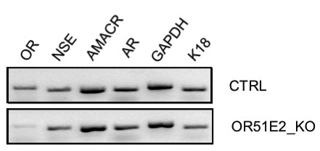
A
AMACR
GAPDH
OR
NSE
AR
K18
19-OH AD
AFMK
CTRL
B
AMACR
GAPDH
OR
NSE
AR
K18
CTRL_19 OH AD
KO_19-OH AD
C
Figure S13. Representative gel images. A. Transcript levels of markers after stimulation with agonists 19-OH AD and AFMK for 3 days. B. Markers in the OR51E2-knockout (KO) and control cells (CTRL). C. Representative gel image of transcript levels of markers after 3 days stimulation with 1 µM 19-OH AD in OR51E2-KO LNCaP cells.

