Slide 1
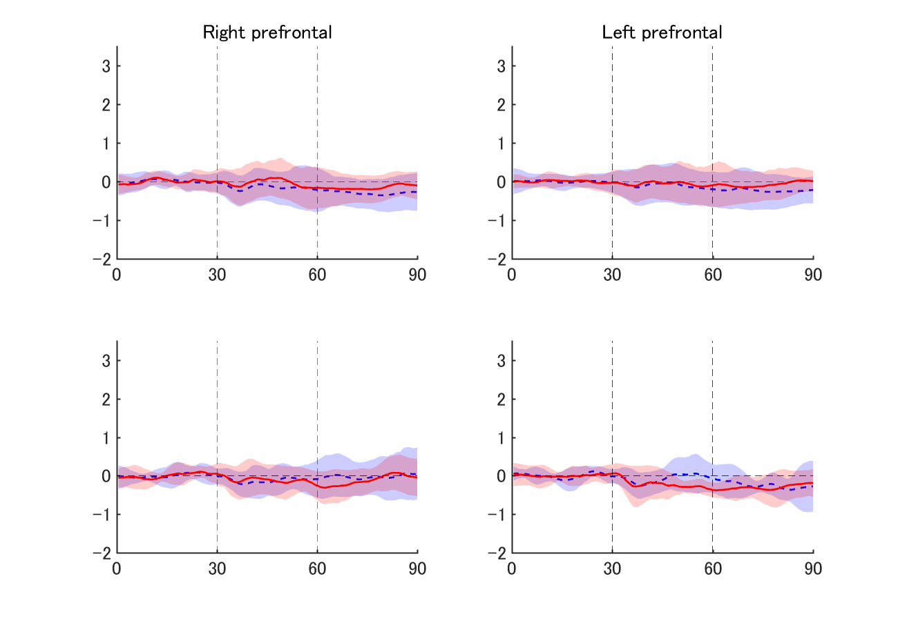
Supplementary Fig. 1
mmMm
MZ
twins
sec
DZ
twins

