Slide 1
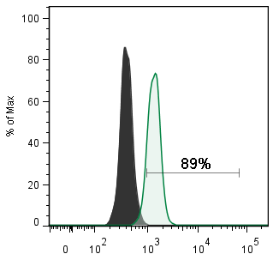
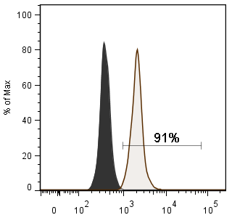
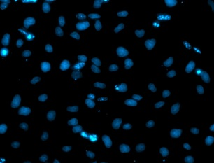
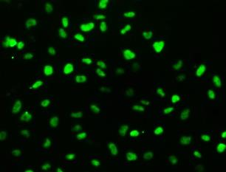
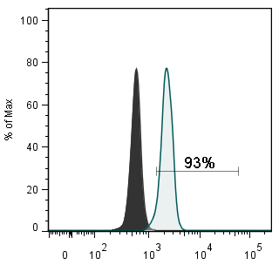
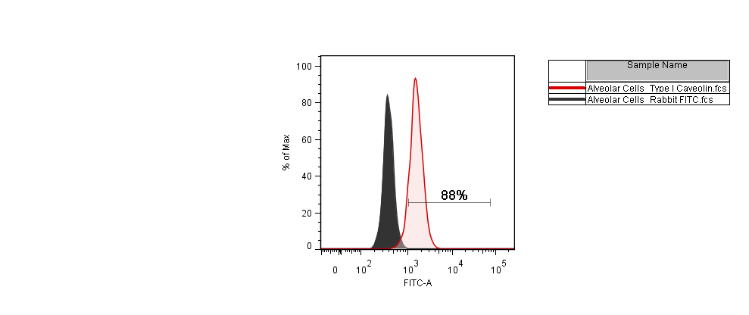
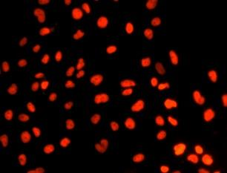
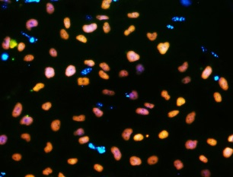
Definitive Endoderm markers
A
C-Kit
B
SOX17
E
F
DAPI
SOX17
C
FOXA2
D
CXCR4
G
H
31µm
FOXA2
SOX17/FOXA2/DAPI
Figure S1. Characterization of cells at day 5 of differentiation to produce definitive endoderm (DE). Flow cytometric analysis showed the cell population derived from iPSCs at day 5 expressed a high percentage of markers associated with this germ layer. (A-D) shows the flow cytometry for C-Kit, SOX17, FOXA2, CXCR4. Roughly 89% of the cells were positive for c-kit, 91% positive for SOX17, 93% positive for FOXA2, and 88% of the cells expressed the endoderm surface marker CXCR4. DE cells derived from iPSCs stained positively for SOX17 and FOXA2, and the majority of the cells were double-positive for both SOX17 and FOXA2. (E-H) shows immunofluorescence analysis of DE markers; (E) shows DAPI staining for nuclei; (F) shows SOX17 positive cells; (G) shows FOXA2 positive cells; (H) merge at day 5. Scale bar, 31 μm

Slide 2
A
Conditions | Agonist/Antagonist 5-7 | Agonist/Antagonist 7-10 | Agonist/Antagonist 10-15
A | SB/Noggin | BMP4,bFGF, WNT3a, KGF | IWR-I, high RA, BMP7, KGF
B | DSM,SB/ IWP2, SB | WNT3a, BMP4, FGF10, KGF, RA | IWR-I, high RA, BMP7, KGF
C | SB/Noggin | BMP4,bFGF, WNT3a, KGF | WNT3a, BMP4, FGF10, KGF, RA
D | DSM,SB/ IWP2, SB | WNT3a, BMP4, FGF10, KGF, RA | WNT3a, BMP4, FGF10, KGF, RA
B
D
C
E
Figure S2. Characterization of cells at day 15 of differentiation to produce lung progenitor cells. To generate the anterior foregut endoderm, the definitive endoderm cells at day 5 were exposed sequentially to different combinations of BMP4/TGFβ and Wnt agonist and antagonists as listed in the table A and then the expression of NKX2.1 were examined in different condition by qRT-PCR and immunostaining. (A) List of growth factors and inhibitors for 4 different growth factor combinations that are added to differentiation media from day 5 to day15. (B) Analysis of NKX2.1/ FOXA2 positive cells in differentiated cells that are cultured in media A, B, C and D listed in table A. To count the NKX2.1/ FOXA2 positive cells, immunocytochemical staining against human NKX2.1 and FOXA2 was preformed and the percentage of positive nuclear staining for both NKX2.1 and FOXA2 was calculated based on the total cell numbers in three high power fields. (C) Expression of NKX2.1 on day 15 cultured in 4 induction media quantified by qRT-PCR over the expression of NKX2.1 in iPSC. All of these results are consistent with other groups’ findings that a combination of FGF, BMP4, and WNT signaling after the sequential blocking of BMP4/TGFB and Wnt signaling in DE, predominantly promotes initial lineage specification of lung-specific NKX2.1⁺ progenitor cells from anterior endoderm. Then to enhance the differentiation of NKX2.1⁺ lung progenitors at day 15 into airway progenitor cells (NKX2.1⁺SOX2⁺), the growth factor combination in induction medium was switched to BMP7, KGF, high concentration of retinoic acid, and IWR-1(WNT antagonist). (D) Analysis of SOX2 positive cells in differentiated cells that are cultured in A, B, C and D media, listed in table 1. The immunocytochemical staining against human SOX2 was preformed. The percentage of positive nuclear staining for both SOX2 and NKX2.1 was calculated based on the total cell numbers in three high power fields. We found inhibition of WNT pathway using IWR-1 along with using high RA and BMP7 augmented the NKX2.1⁺/SOX2⁺ airway progenitor cells up to 30% as compared to 1-2% before treatment at day 20. (E) mRNA expression of SOX2, cells generated from DE cells at day 15 cultured in 4 induction media that are listed in table A. (Data expressed as quantification of mRNA normalized to GAPDH and average fold change in gene expression over iPS cells. Bar indicate ± SEM and n = 3 independent experiments for qRT-PCR and staining).

Slide 3
SB/DSM
DSM/IWP2
bFGF, KGF,
WNT3a, BMP4
0
6
8
15
Activin A
Early lung progenitor (FOXA2/NKX2.1⁺)
iPS
DE
AFE
Lung Progenitor
FGF10, KGF,
WNT3a, EGF,RA
KGF, BMP7, EGF, high RA
B27, Insulin , DEX , IBX
D25
DCI medium
FGF10, KGF,
EGF,RA, B27, Insulin , DEX , IBX
D32
BEGM from Lonza
Alveolar progenitors
NKX2.1⁺ SPC ⁺
&
Proximal Airway progenitors
NKX2.1 ⁺ P63 ⁺
Figure S3. Schematic protocol for directed differentiation of iPSCs to both alveolar and airway epithelial cells in vitro. Cytokines were added at different steps indicated on the panel. Definitive endoderm efficiently induced from iPSC by high concentrations of activin A (100 ng/ml) from day 0 to day 5. Then the DE cells were exposed sequentially to dorsomorphin/SB431542 [(2µg/ml)/(10μM)] from days 5 to 6 followed by IWP2 /SB431542 [(5μM)/(10μM)] from day 6 to 7. To specify lung cell fate, at day 8, medium was switched to lung endoderm differentiation medium containing bFGF (10ng/ml), BMP4 (10ng/ml), CHIR (3 μM), and KGF (10 ng/ml) for 7 days.
Early lung endoderm cells (NKX2.1⁺) are multipotent and their fate are dependent upon signals provided by either the local microenvironment or by signals that control proximal versus distal cell fates. BMP and WNT pathways are two of the major signaling cascades that regulate proximal-to distal patterning of the airway tree. BMP4 is expressed distally while BMP7 is expressed around the airway. Distal bFGF and FGF10 are replaced by proximal KGF (FGF7), while WNT signaling is inhibited in the proximal stalk progenitors and present in the distal tip. Also high retinoic acid (RA) signaling prevent distal lung development and favors airway development.
To differentiate the early lung progenitor cells into the type II progenitor cells, we cultured these progenitor cells in differentiation media containing KGF(10ng/ml), FGF10 (10ng/ml), RA (0.5μM), CHIR (3μM), EGF(10ng/ml) for another 15 days after which CHIR was removed from the differentiation cocktail for the rest of differentiation. At day 40 of differentiation, the cells, now termed ATII progenitor cells, were maintained in DCI media containing IMDM/F12, B27(1X), Insulin (5 mg/ml), KGF(10ng/ml), EGF(0ng/ml), retinoic acid (50nM), dexamethasone (50 nM), butyrylcAMP (0.1 mM) and isobutylmethylxanthine (0.1 mM).
To enhance airway epithelial fate and suppress distal cell fate in NKX2.1⁺ lung progenitors at day 15, the growth factor combination was switched to airway induction medium containing, IMDM/F12 as a basal media supplemented with RA (1μM), BMP7 (10ng/ml), KGF (10ng/ml), EGF (10ng/ml), B27(1X), Insulin (5 mg/ml), dexamethasone (50 nM), butyrylcAMP (0.1 mM) and isobutylmethylxanthine (0.1 mM) for another 17 days. At day 32, cells were split with trypsin and reseeded on collagen I/III coated plates in BEGM™ medium from Lonza until use.

Slide 4
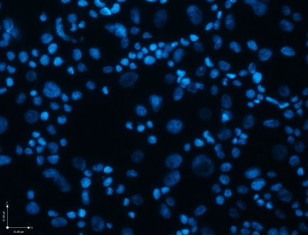
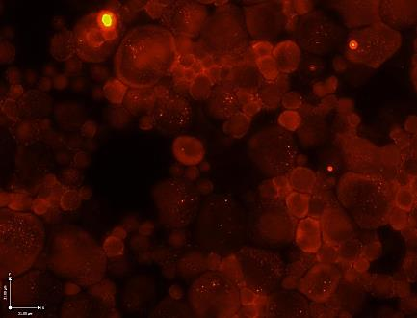
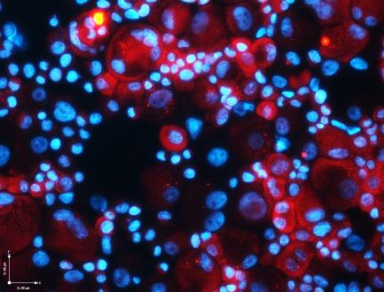
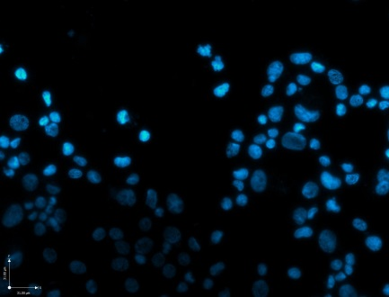
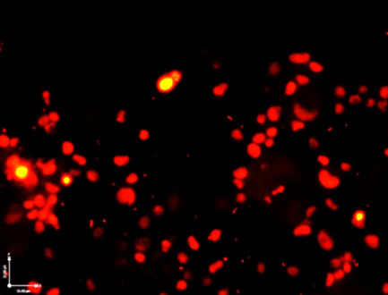
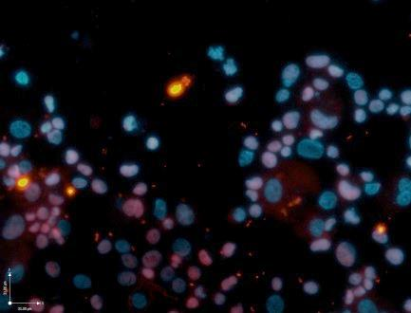
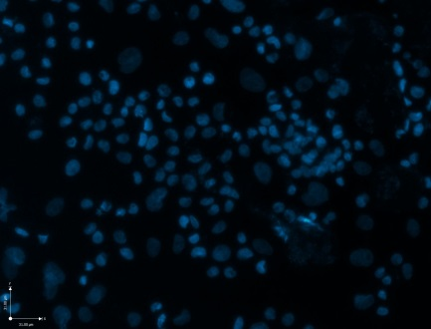
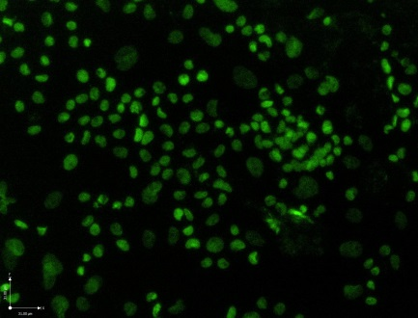
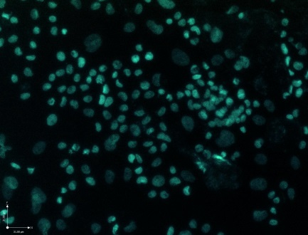
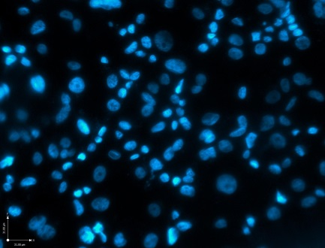
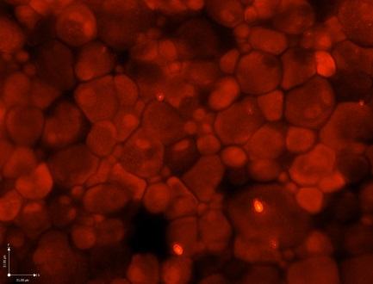
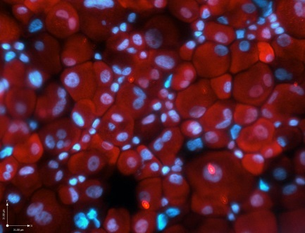
A
B
C
31µm
DAPI
CK5
CK5/DAPI
D
E
F
DAPI
P63
P63/DAPI
G
H
I
DAPI
NKX2.1
NKX2.1/DAPI
J
K
L
DAPI
CCSP
CCSP/DAPI
Figure S4. Characterization of human airway cells isolated from human trachea (cytocentrifuged prepared). (A-L) Immunofluorescence analysis of human airway cells markers. (A,D,G,J) DAPI staining for nuclei (B) CK5 staining; (E) P63 staining; (H) NKX2.1 staining; (K) CCSP staining; (C,F,I,L) Merge. Scale bar, 31 μm.

Slide 5
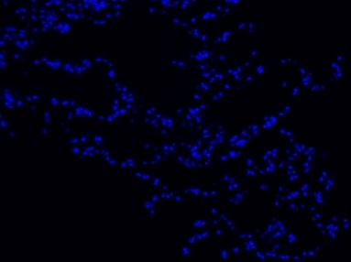
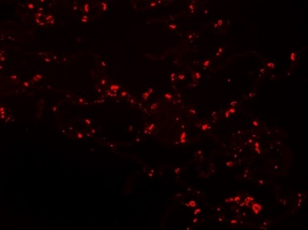
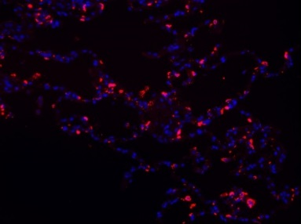
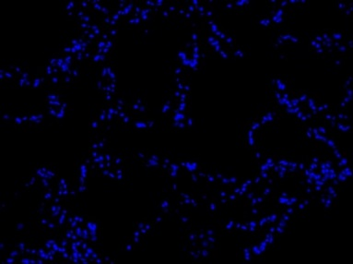
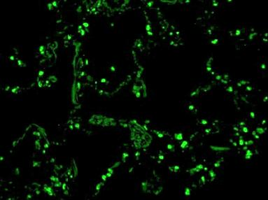
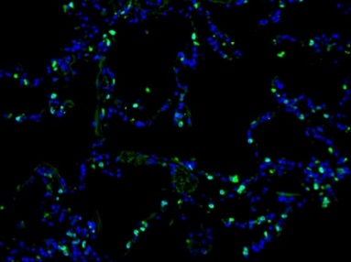
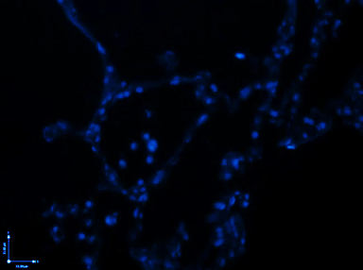
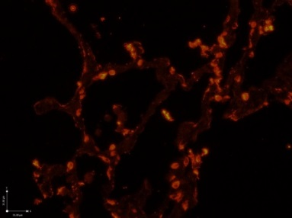
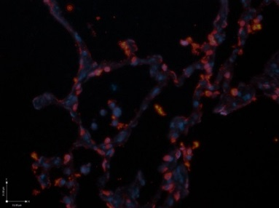
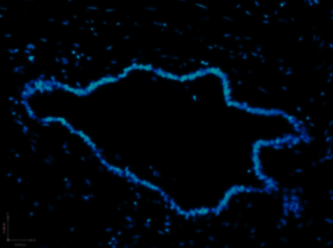
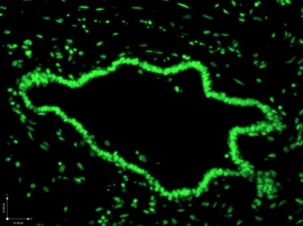
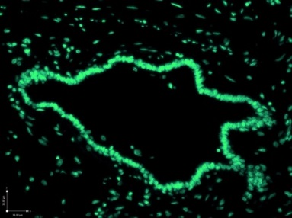
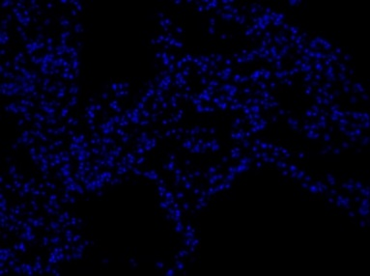
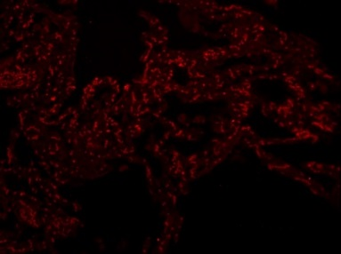
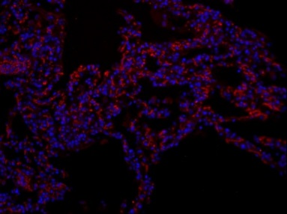
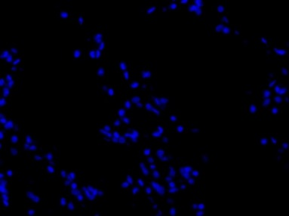
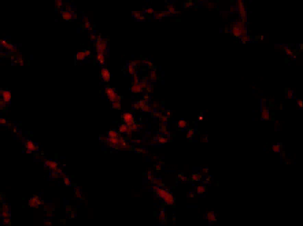
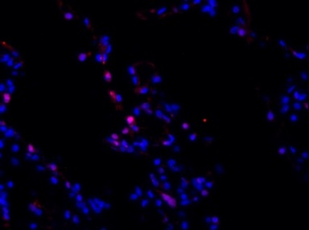
A
B
C
31µm
DAPI
NKX2.1
NKX2.1/DAPI
D
E
F
DAPI
SPB
SPB/DAPI
G
H
I
DAPI
SPC
SPC/DAPI
J
K
L
DAPI
FOXJ1
FOXJ1/DAPI
M
N
O
DAPI
CCSP
CCSP/DAPI
P
Q
R
DAPI
P63
P63/DAPI
Figure S5. Immunostaining of human lung.. (A,D,G,J,M,P) DAPI staining for nuclei (B) shows NKX2.1 staining; (E) shows SPB staining; (H) shows SPC staining; (K) shows FOXJ1 staining; (N) shows CCSP staining; (Q) shows P63 staining; (C,F,I,L,O,R) Merge. Scale bar, 31 μm.

Slide 6
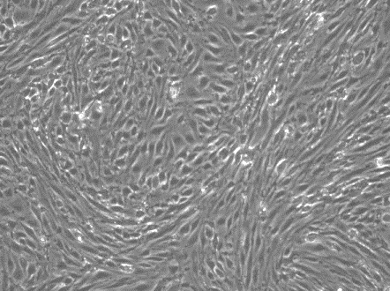
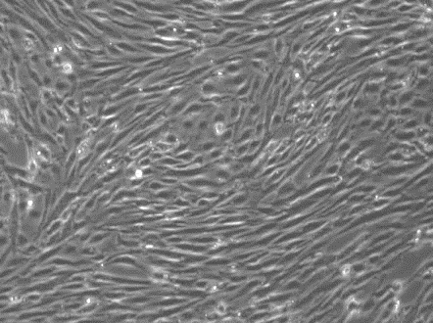
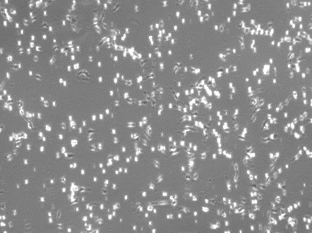
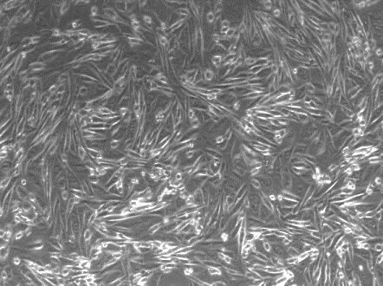
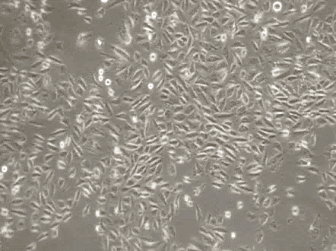
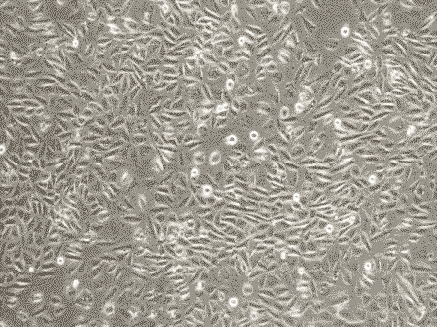
Endothelial media Co-culture media Epithelial cells media
A
A
B
C
Rat Lung Microvascular
Endothelial Cells
6.8µm
D
E
F
iPSC- derived Lung
epithelial cells
G
Media type | Composition
Endothelial media | MCDB media
Epithelial media | Alveolar epithelial media: IMDM/F12, supplemented with B27(1X), Insulin (5 mg/ml), KGF(10ng/ml), EGF(0ng/ml), retinoic acid (50nM), dexamethasone (50 nM), butyrylcAMP (0.1 mM) and isobutylmethylxanthine (0.1 mM) Airway epithelial media: Complete BEGM media from Lonza
Co-culture media | MCDB: 50% Alveolar epithelial media : 25% IMDM/F12, supplemented with B27(1X), Insulin (5 mg/ml), KGF(10ng/ml) EGF(0ng/ml), retinoic acid (50nM), dexamethasone (50 nM), butyrylcAMP (0.1 mM) and isobutylmethylxanthine (0.1 mM) Airway epithelial cells (BEGM): 25%
H
I
Figure S6. Optimization of endothelial- epithelial co-culture media . (A-C) Phase-contrast images of rat lung microvascular endothelial cells cultured in (A) endothelial media MCDB (B) co-culture media and (C) in epithelial media. (D-F) Phase-contrast images of iPSC- lung progenitor cells cultured in (D) endothelial media, MCDB (E) co-culture media and (F) in epithelial media. Scale bar, 6.8 μm.
(G)The summary of co-culture media components. H) Expression of endothelial marker ,CD31, in different media. (I) Expression of epithelial marker, NKX2.1 in all three different media. (Data expressed as quantification of mRNA normalized to GAPDH. Bar indicate ± SEM and n = 3 independent experiments for qRT-PCR).

