Slide 2
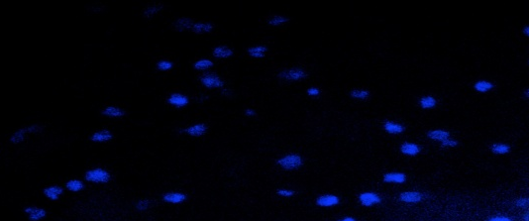
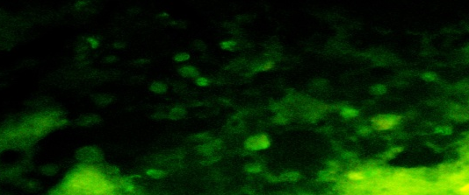




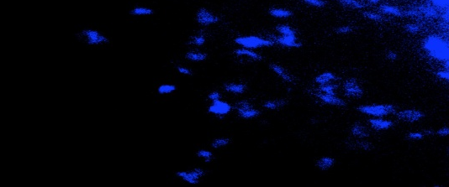

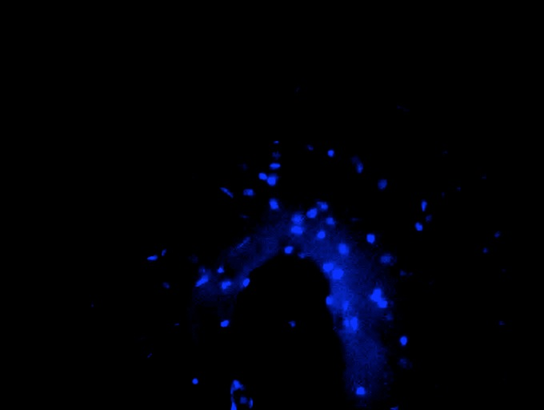

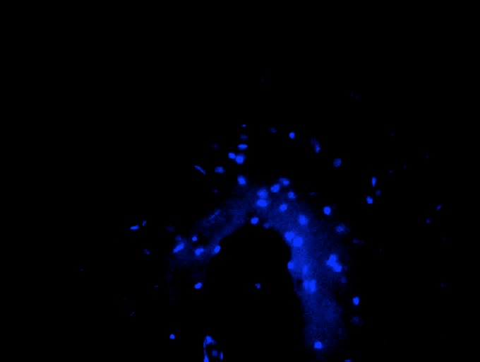
Supplementary Figure
DAPI
TUNEL
DAPI + TUNEL
merged
Positive Control
200μm
A
B
C
Negative Control
D
E
F
Saline
G
H
I
GW4869
J
K
L

